Slide 1

The Death of Evidence(?)
Implications for Immunization
Jonathan M. Samet, MD, MS
Dean and Professor
Colorado School of Public Health
Immunize Nevada
Nevada Immunization Learning Exchange Webinar
April 23, 2019

Slide 2
The Trump Administration and Science

Slide 3
Source: http://www.ucsusa.org/sites/default/files/attach/2017/07/sidelining-science-es-ucs-7-20-2017.pdf?utm_source=Fareed%27s+Global+Briefing&utm_campaign=2f25f0703a-EMAIL_CAMPAIGN_2017_07_24&utm_medium=email&utm_term=0_6f2e93382a-2f25f0703a-84433973

Slide 4

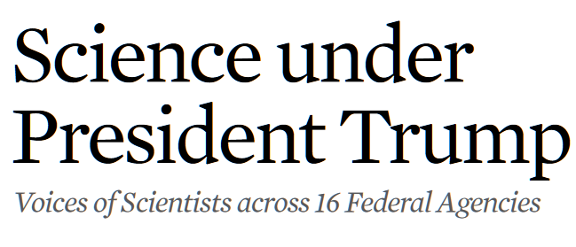
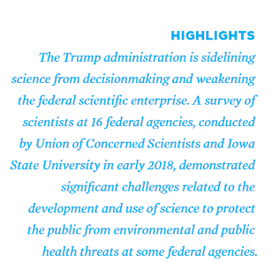
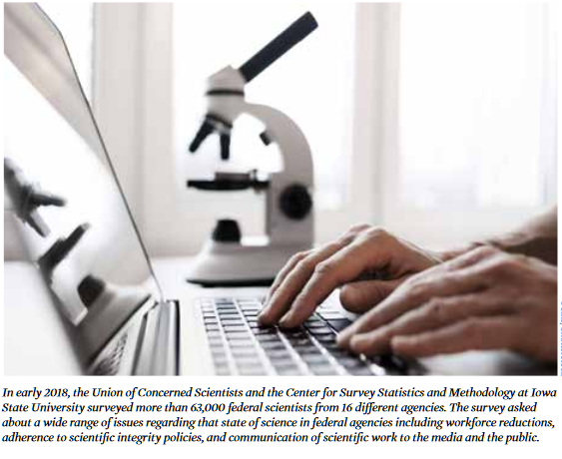

Slide 5
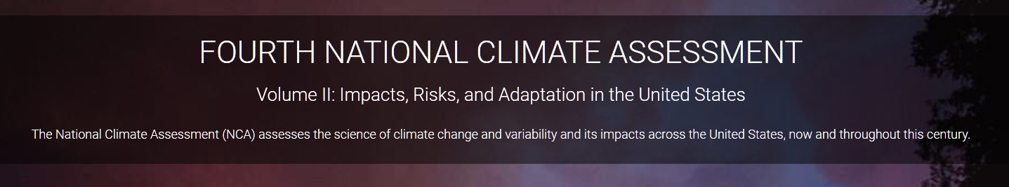
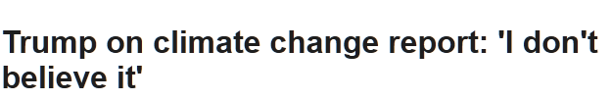
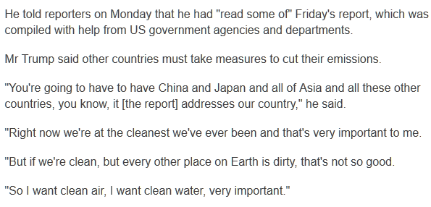
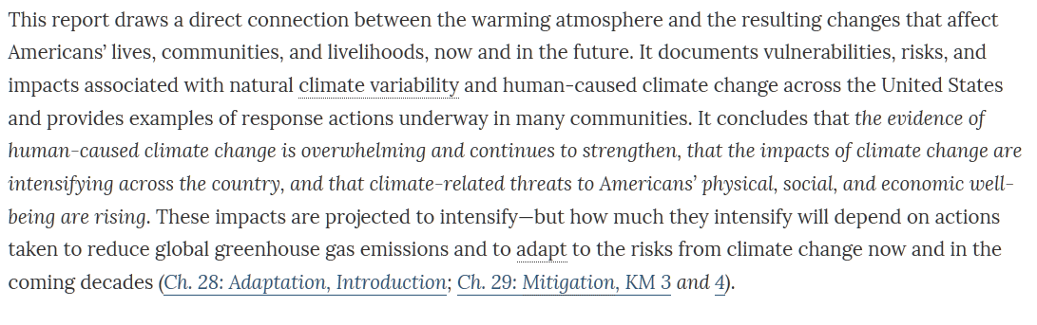

Slide 6
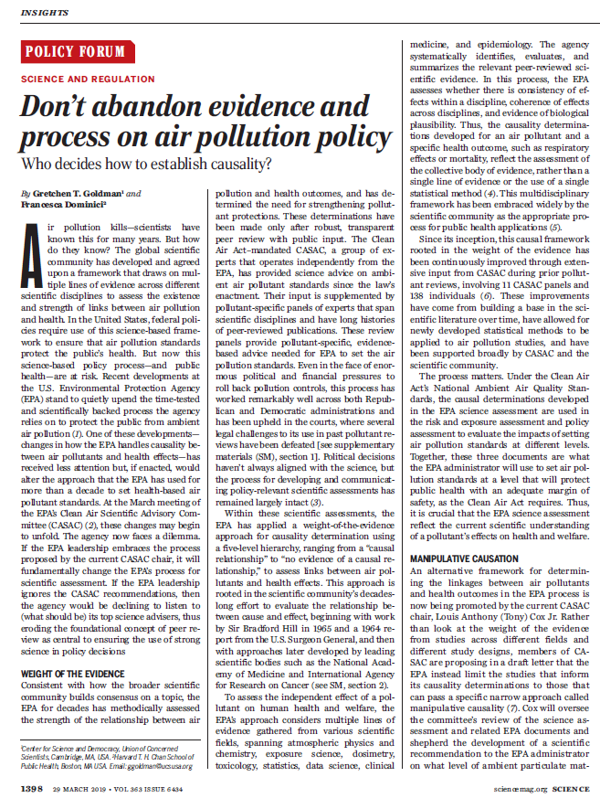
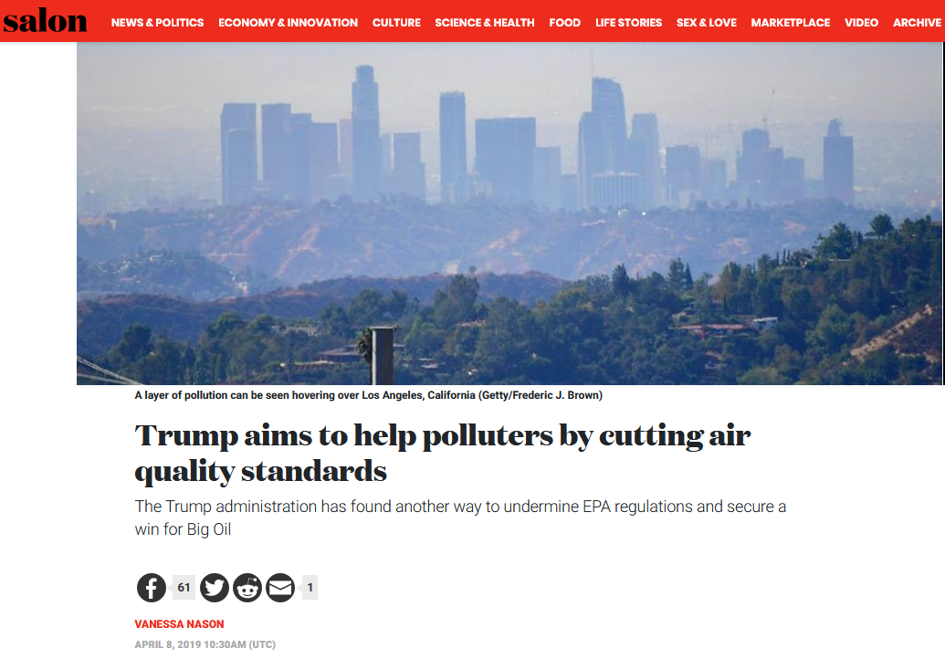
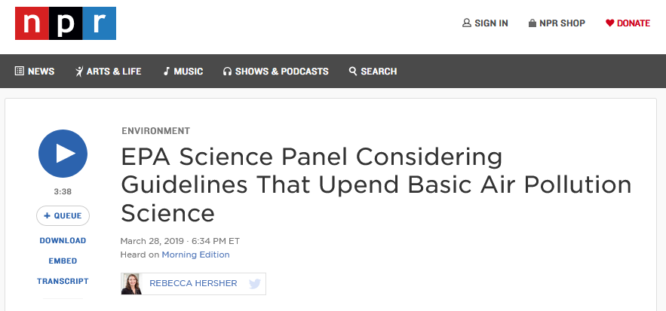
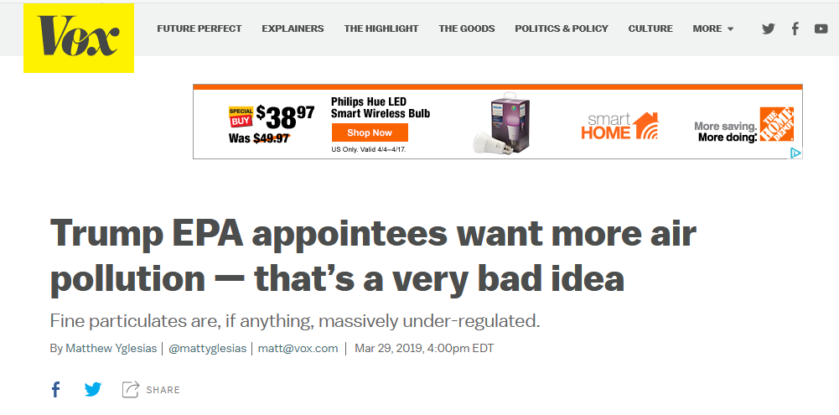

Slide 7
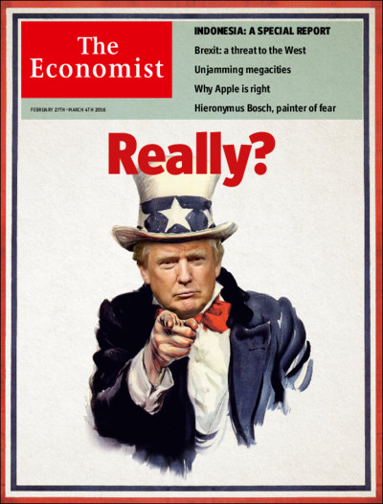
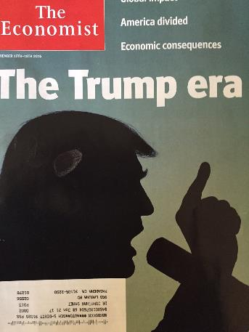
This is more than Trump!

Slide 8
Why?
The Consequences of the Death of Evidence

Slide 9

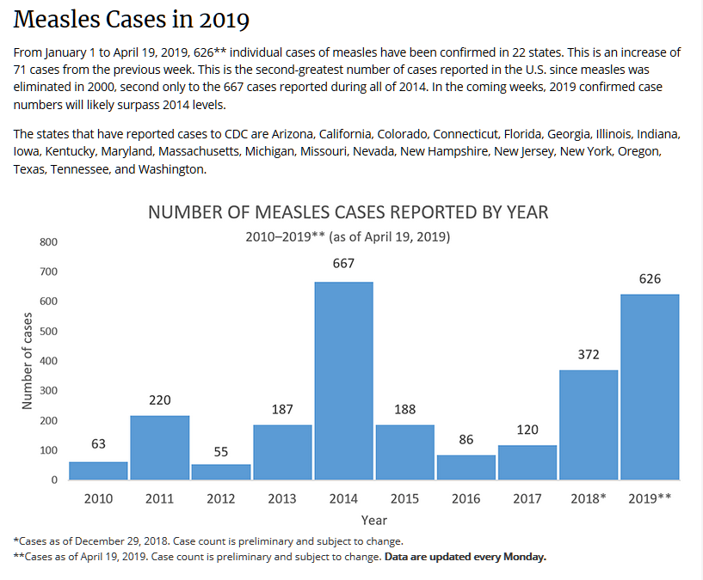
https://www.cdc.gov/measles/cases-outbreaks.html

Slide 10
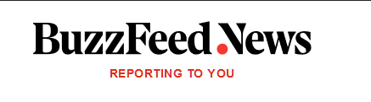
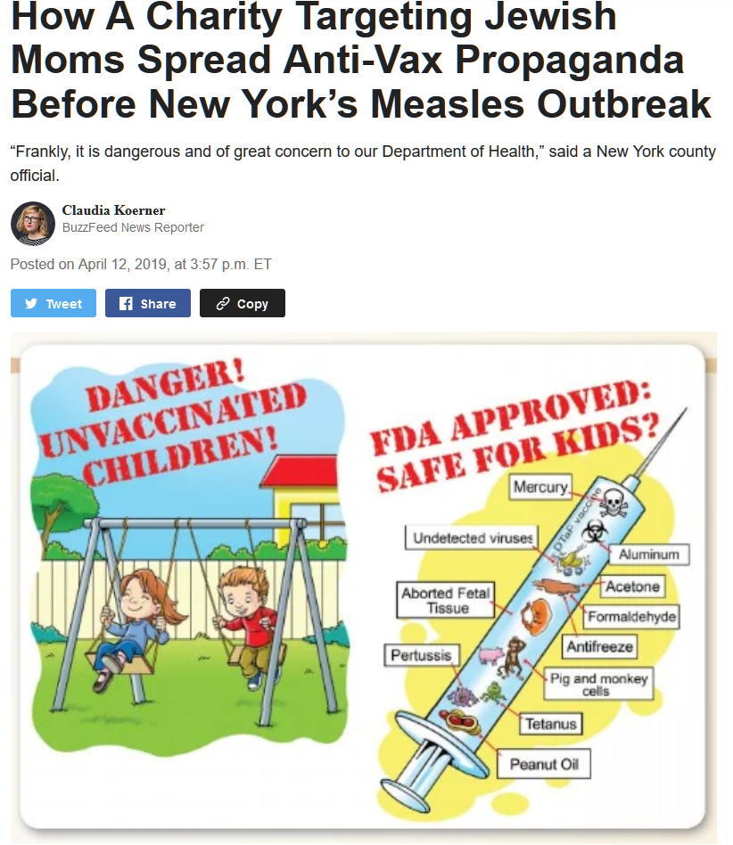
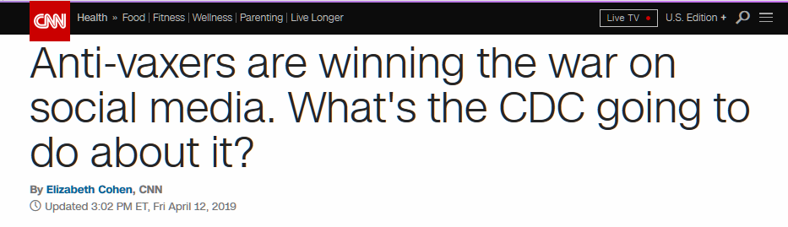

Slide 11
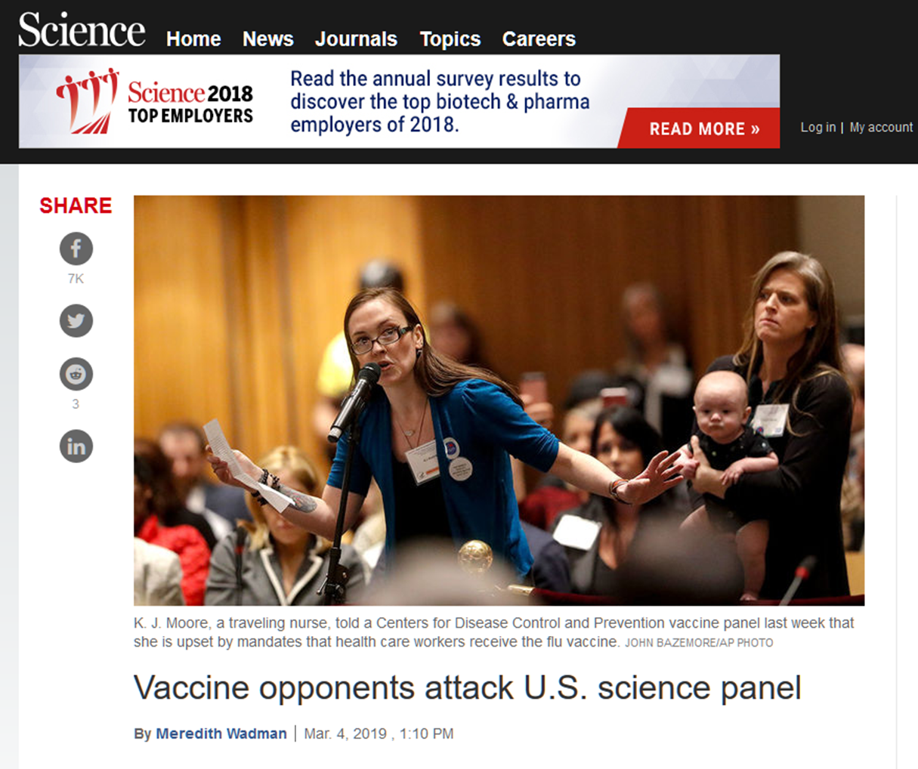
The increasingly vituperative public attacks can be tough on ACIP scientists, however. “How does it feel knowing that your vote killed my son?” one woman asked the panel in October 2018.
But Romero doubts the protests will make it tougher to recruit experts to serve on the committee. “It would take a lot to make us not come,” he says, calling the position “the pinnacle of public health impact. … Most of us consider this an extremely high honor to be here.”

Slide 12
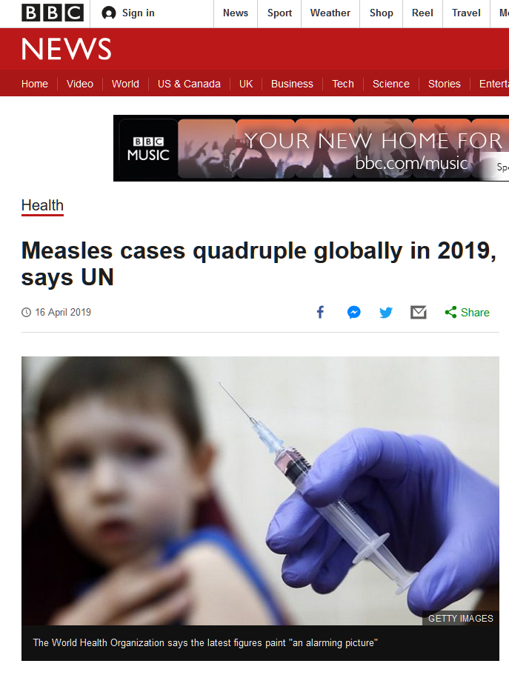

Slide 14
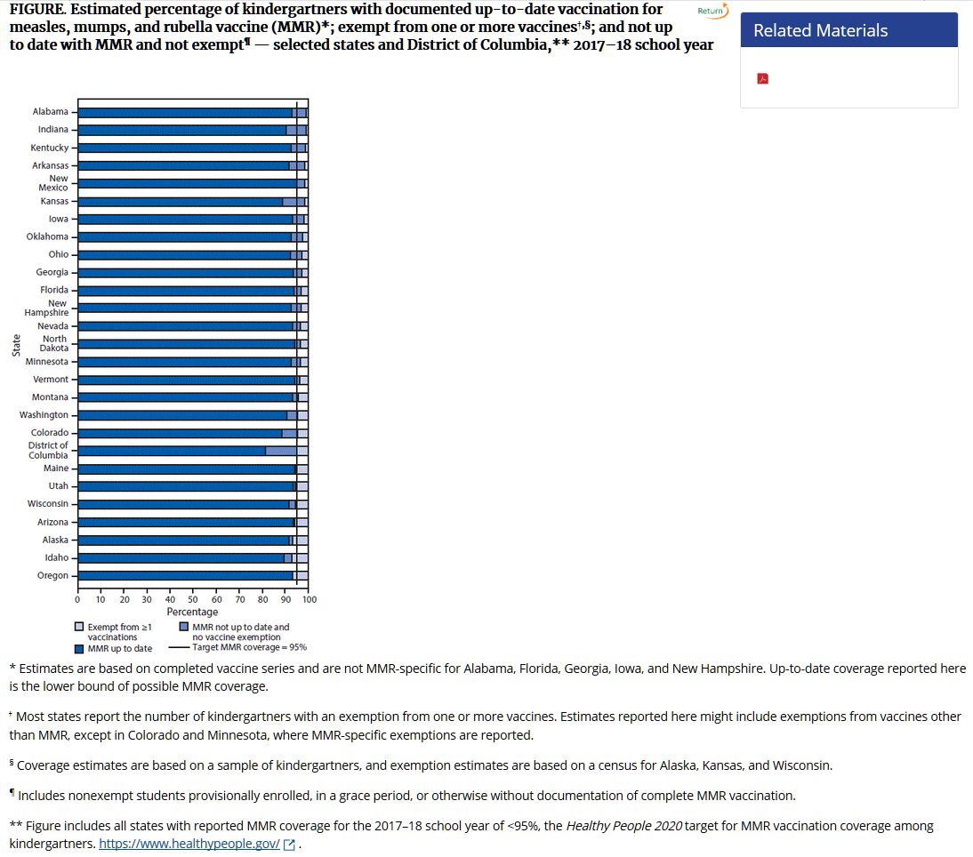
Mellerson JL, Maxwell CB, Knighton CL, Kriss JL, Seither R, Black CL. Vaccination Coverage for Selected Vaccines and Exemption Rates Among Children in Kindergarten — United States, 2017–18 School Year. MMWR Morb Mortal Wkly Rep 2018;67:1115–1122. DOI: http://dx.doi.org/10.15585/mmwr.mm6740a3.

Slide 15
MAKING EVIDENCE-BASED DECISIONS (OR NOT)

Slide 16
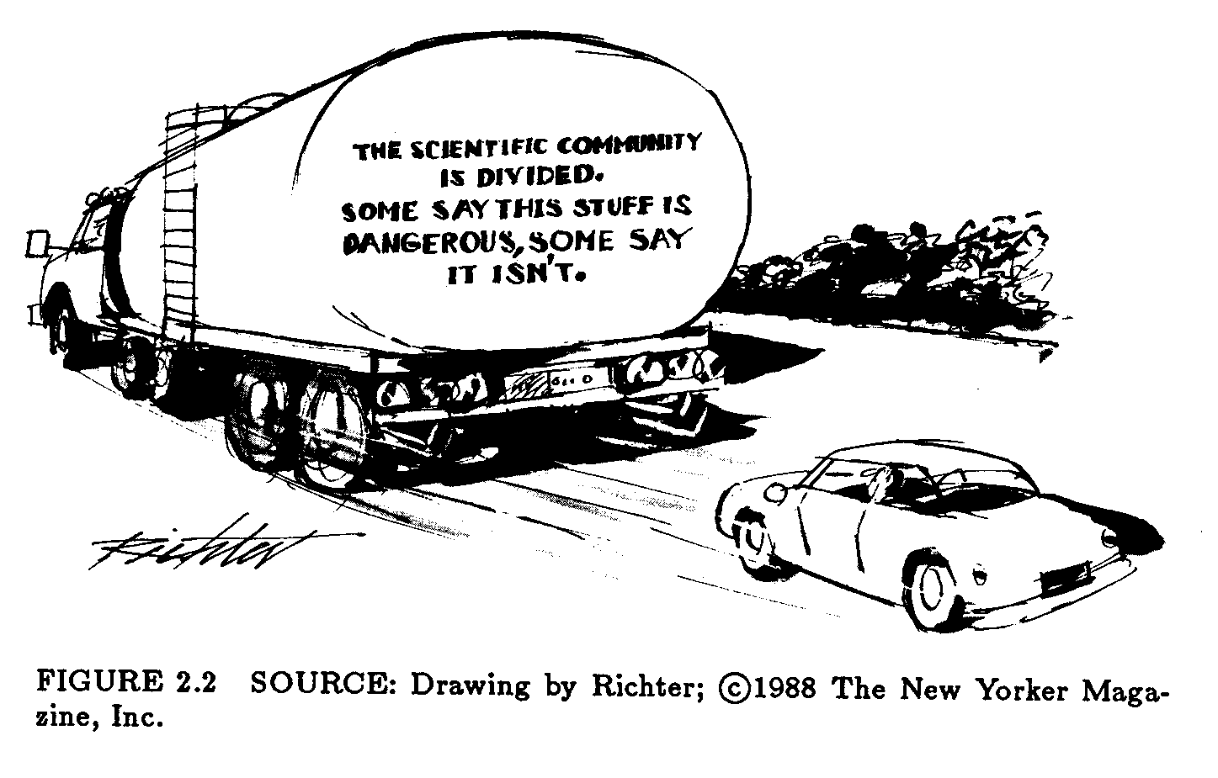

Slide 17
The Yin Yang of Evidence
Evidence: what we know
Ignorance: what we do not know
Uncertainty: the consequence of ignorance
Doubt: lack of belief/confidence in something

Slide 18
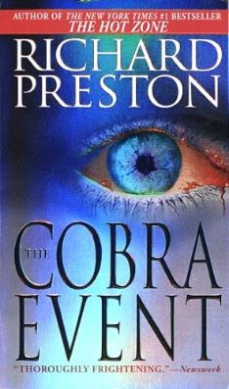
John Snow and Cholera
“Dr. John Snow was one of the first great disease detectives, a founder of the science of modern epidemiology. …He was a physician in London in 1853 when there was an outbreak of cholera. …He discovered that the sick people had been using the same water pump… Something from the water in that pump was causing the disease. …he removed the handle from the water pump. It stopped the outbreak. …This is the classic story of epidemiology.”

Slide 19
The John Snow Model
Identify Cholera Outbreak
Identify the Problem
Investigate Broad Street
Gather Data
Infer that Water Transmits Cholera
Analyze and Interpret the Evidence
Recommend Removal of Pump Handle
Translate from Evidence to Action
Continue Tracking
Surveillance

Slide 20
Evidence to Action—It’s Easy!
Evidence
Action

Slide 21
Evidence to Policy—It’s Easy!
Evidence
Policy
NOT

Slide 22
The Evidence Scale
Act
Not Act
Evidence
Uncertainty

Slide 23
The Evidence Scale
Act
Not Act
Evidence
Politics
Costs
Activists
Advocates
Uncertainty

Slide 24
The Evidence Scale
Act
Not Act
Evidence
Politics
Costs
Activists
Advocates
Uncertainty

Slide 25
The Evidence Scale
Act
Not Act
Evidence
Politics
Costs
Activists
Advocates
Uncertainty

Slide 26
THE STORY BEGINS:
THE CREATION OF DOUBT

Slide 27
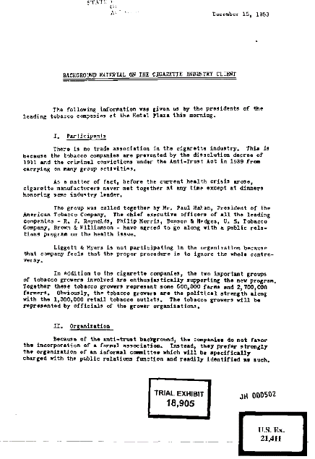
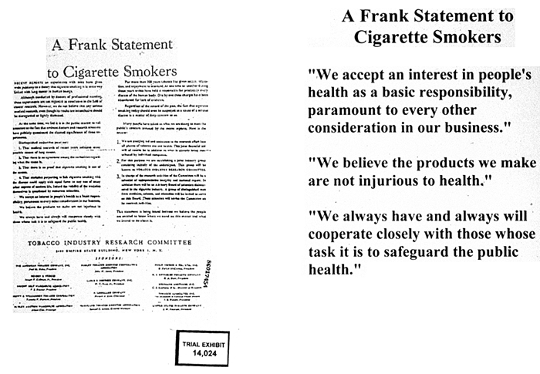
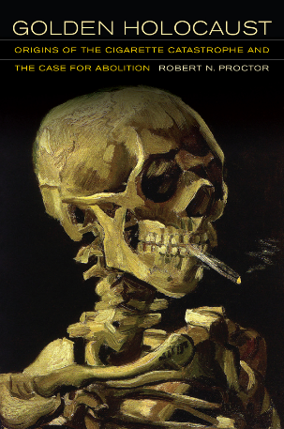
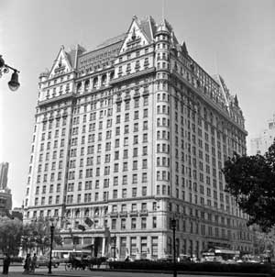
Industry Tactics
The tobacco industry has “marketed and sold their lethal product with zeal, with deception, with a single-minded focus on their financial success and without regard for the human tragedy or social costs that success exacted.”
Judge Gladys Kessler

Slide 28
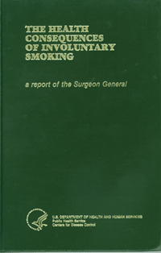
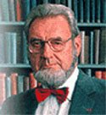
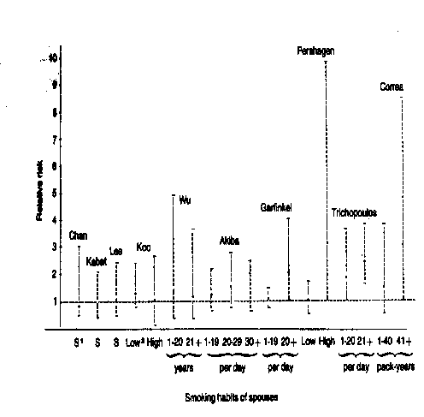
The 1986 Surgeon General’s Report
“Involuntary smoking is a cause of disease, including lung cancer, in healthy nonsmokers.”
C. Everett Koop, MD, DSc
Surgeon General, 1982-89

Slide 29
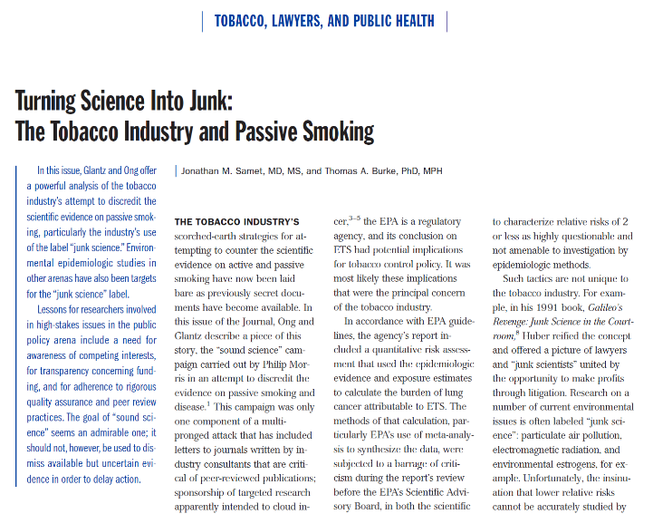
Turning Science into Junk
How?
Confounding and bias
Attack epidemiology
Attack methods
“Counter science”
Hire critics
Create scientific societies and journals
Harass researchers

Slide 30
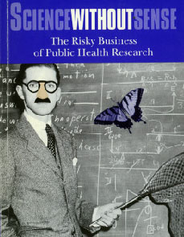
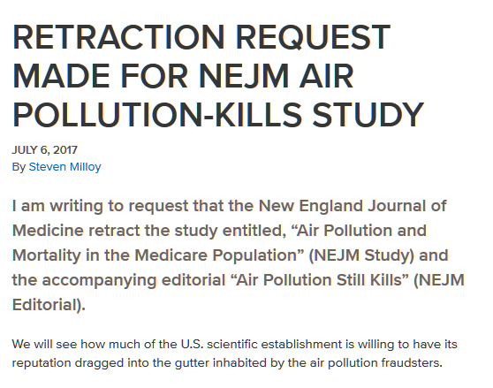
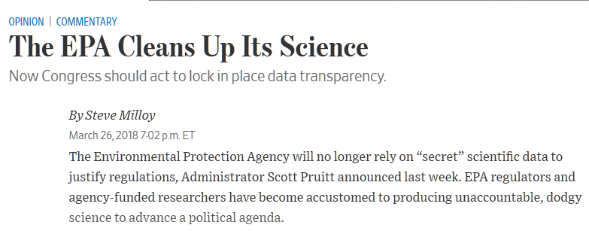
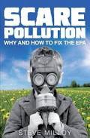
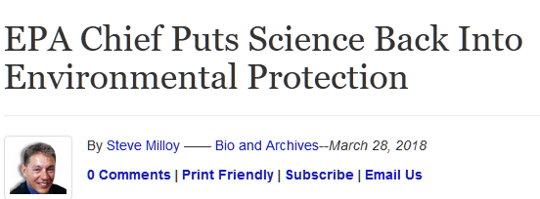
Undermining Epidemiology

Slide 31
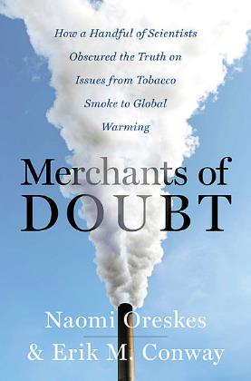
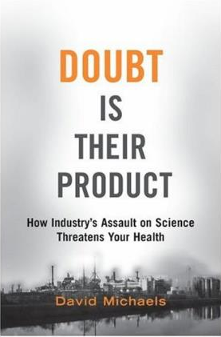
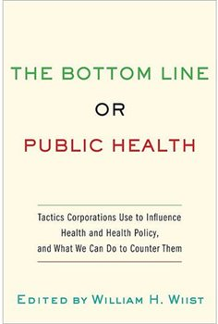
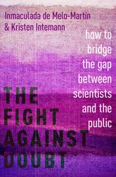
Selected books on “Doubt”
The Old…
The New…

Slide 32
BELIEF REPLACES EVIDENCE

Slide 33
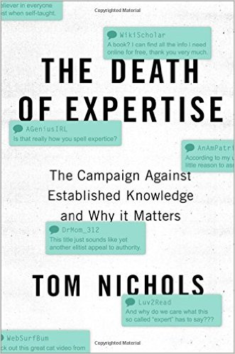
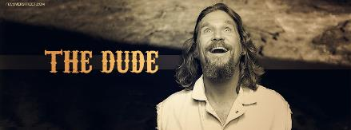
“Yeah, well, you know, that’s just, like, your opinion, man,”
The Big Lebowski

Slide 34
On some issues, belief sometimes replaces evidence for some people:
Childhood vaccination and autism
Climate change
Evolution
Genetically modified organisms
EMR from cell phones

Slide 35

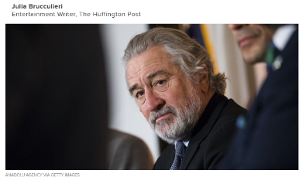
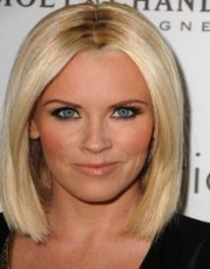
Vaccination and Autism
Jenny McCarthy
Anti-vaccine activist and e-cigarette promoter
Robert Kennedy Jr.
Anti-vaccine activist

Slide 36
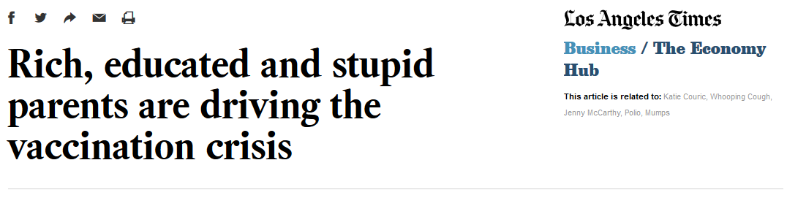
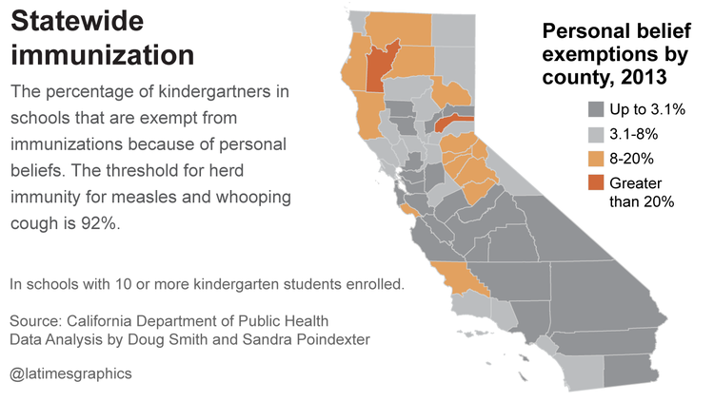
LATimes, Sept 2 & 3, 2014

Slide 37
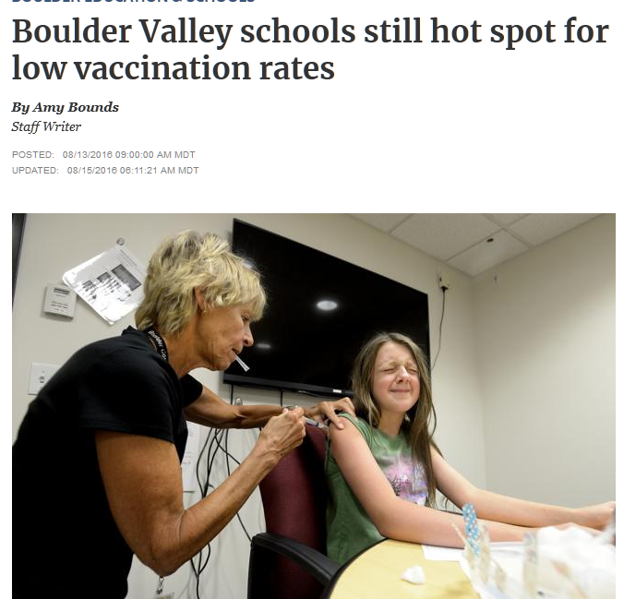
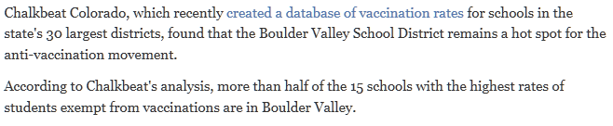


Slide 38
Death of Expertise (Nichols)
“...fundamentally a rejection of science and dispassionate rationality.”
“Any assertion of expertise from an actual expert meanwhile, produces an explosion of anger from certain quarters…”
“…having equal rights in a political system also means that each person’s opinion about anything must be an equal to anyone else’s.

Slide 39
What is going on?
The politicization of some science (e.g., climate change
A decline of science literacy and numeracy
The internet and social media
Devaluation of experts and expertise
High-level “dissing of science”

Slide 40
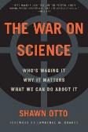
“Science is never partisan, but science is always political,” said Otto. “Science takes nothing on faith; it says, ‘show me the evidence and I’ll judge for myself.’ But the discoveries that science makes either confirm or challenge somebody's cherished beliefs or vested economic or ideological interest. Science creates knowledge—knowledge is power, and that power is political.”
National Academies of Science. (2017). Examining the mistrust of science: Proceedings of a workshop—in brief. National Academies Press. Page 1.

Slide 41
Climate Change, Politics, and Science Literacy
National Academies of Science. (2017). Examining the mistrust of science: Proceedings of a workshop—in brief. National Academies Press. Page 4.

Slide 42
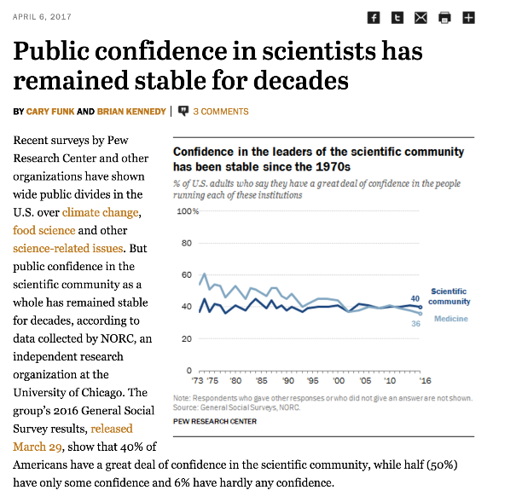
Source: http://www.pewresearch.org/fact-tank/2017/04/06/public-confidence-in-scientists-has-remained-stable-for-decades/

Slide 43
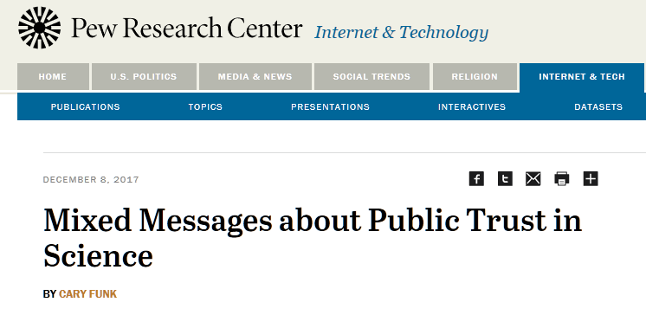

Slide 44




Slide 45



Slide 46
Cultural Cognition is Key (Kahn)
“..refers to the influence of group values—ones relating to equality and authority, individualism and community—on risk perception and related beliefs.
In other words, who we are and the groups we identify with are drivers of the credibility of scientific evidence.

Slide 47
National Academies of Science. (2017). Examining the mistrust of science: Proceedings of a workshop—in brief. National Academies Press. Page 5.

Slide 48
Hence
Dr. Paul Broun
US Congressman, House Science Committee member
“God’s word is true. I’ve come to understand that. All that stuff I was taught about evolution and embryology and the big bang theory, all that is lies straight from the pit of Hell,” said Broun, who is an MD. “It’s lies to try to keep me and all the folks who were taught that from understanding that they need a savior.”
Only coal miners in West Virginia believe that: “I made them this promise,” Trump said, “we will put our miners back to work.”
Some believe that having guns in schools saves lives.
Some believe that evolution did not occur but that humans resulted from ”intelligent design.”

Slide 49
EXPERTS IN THE
POST-EXPERT WORLD

Slide 50

Being an expert?

Slide 51


Available at http://science.house.gov

Slide 52



T”These weaknesses parallel the valid complaints made by the National Academy of Sciences (NAS) in its recent report, Review of the Environmental Protection Agency’s Draft IRIS Assessment of Formaldehyde

Slide 53
Trump/Pruitt/Wheeler EPA, For Example

Slide 54






Slide 55
A few happenings at EPA
Clean Power Plant Rule
Paris Climate Agreement
Science Advisory Board
Waters of the United States
Appointees
“Transparent science”
IRIS/TSCA
CASAC panels

Slide 56





Slide 57







He’s even made Rolling Stone

Slide 58
WHAT TO DO IN THE POST-EVIDENCE ERA?

Slide 59
“Wherever the people are well-informed, they can be trusted with their own government,” wrote Thomas Jefferson.
National Academies of Science. (2017). Examining the mistrust of science: Proceedings of a workshop—in brief. National Academies Press. Page 1.

Slide 60
Otto’s Battle Plan (1)
Do Something
A National Center for Science and Self-Governance
Push for Science Debates
Using Science Advisors More Effectively
Preaching in the Age of Science
Teachers should Teach Science Civics
Granting Bodies Should Require and Fund More Outreach

Slide 61
Otto’s Battle Plan (2)
Scientists Should Adopt a Scientific Code of Ethics
Business Leaders Should Form a Chamber of Progressive Commerce
Diplomats and Elected Leaders Should Use Transformative Foreign Policy
Candidates Should Sign Science Pledges
Editors/Journalism/Pro-Evidence/Anti-Fraud
Scientists Need to Fight Back

Slide 62

A Time to Rally!
Scientific evidence does not change when the administration changes.

Slide 63
Should we be paranoid?
“Strange how paranoia can link up with reality now and then.” ― Philip K. Dick
“Paranoia strikes deep
Into your life it will creep”—Buffalo Springfield
Is the “death of evidence” manufactured?
If so, by whom? Why?
Are there identifiable players? A deep conspiracy?

Slide 64
READINGS

Slide 65


Source: http://sites.nationalacademies.org/PGA/guirr/PGA_177700

Slide 66


Slide 67
YOUR THOUGHTS?

