Slide 1
MMR/MMRV Measles Outbreak Vaccination Recommendations – Beyond the Provider Letter
Andrew Kroger M.D., M.P.H.
Nevada State Immunization Program
August 20, 2019

Slide 2
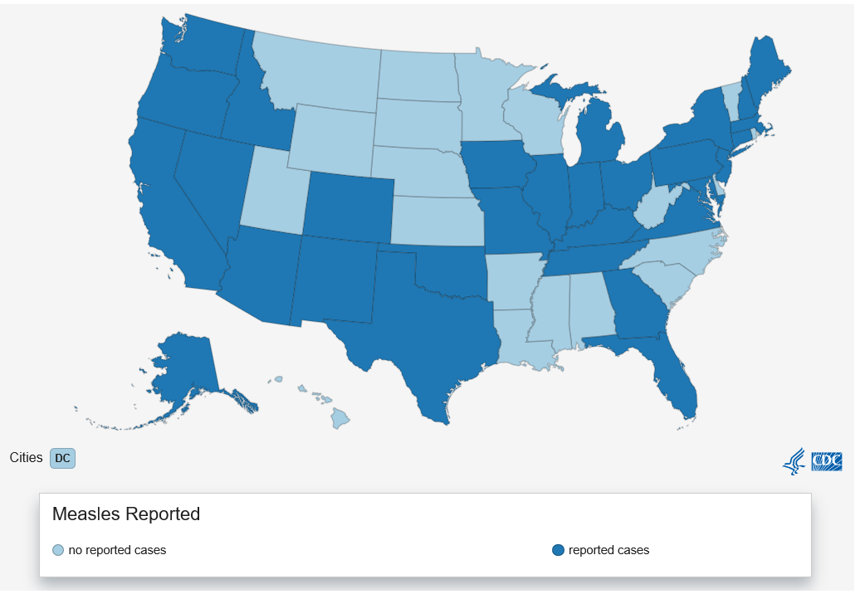
States with Reported Measles Cases (as of 8/9/2019)
The states that have reported cases to CDC are Alaska, Arizona, California, Colorado, Connecticut, Florida, Georgia, Idaho, Illinois, Indiana, Iowa, Kentucky, Maine, Maryland, Massachusetts, Michigan, Missouri, New Mexico, Nevada, New Hampshire, New Jersey, New York, Ohio, Oklahoma, Oregon, Pennsylvania, Texas, Tennessee, Virginia, and Washington.
www.cdc.gov/measles/cases-outbreaks.html
Notes:
From January 1 to August 9, 2019, 1,182 individual cases of measles have been confirmed in 30 states. This is the greatest number of cases reported in the U.S. since 1992 and since measles was declared eliminated in 2000.
•As of August 9, 2019, 124 of the people who got measles this year were hospitalized, and 64 reported having complications, including pneumonia and encephalitis.
•The majority of cases are among people who were not vaccinated against measles.
•More than 75% of the cases this year are linked to outbreaks in New York and New York City. Measles is more likely to spread and cause outbreaks in U.S. communities where groups of people are unvaccinated.

Slide 3
Measles cases and outbreaks: https://www.cdc.gov/measles/cases-outbreaks.html
Notes:
Here is another look at measles data for recent years. You can really see the high number of cases in 2019 as compared to other recent years and the year has not yet concluded, so would expect that number to change.
(Note: double check data. It says it is updated every Monday, but last date of update is more than a week ago.)

Slide 4
Measles in U.S. 2019
1,182 cases (as of August 9)
Majority of cases in those unvaccinated
5 outbreaks (in four states)
New York (plus a separate outbreak in New York City
Washington
California
Texas
Notes:
California outbreak is in Los Angeles
Texas outbreak is in El Paso

Slide 5
MMR Recommendations for Children and Adolescents (Birth through 18 years)
First dose at 12–15 months of age
Minimum age is 12 months
Doses given before 12 months of age are not counted as valid
Infants as young as 6 months should receive MMR before international travel*
Revaccinate at 12 months of age or older
Second dose at 4–6 years of age
May be administered before age 4 years, provided at least 4 weeks (minimum interval) have elapsed since the first dose (Example: international travel)
Intended to produce measles and/or mumps immunity in persons who failed to respond to the first dose and may boost antibody titers in some persons who responded to the first dose
People who received 2 doses of MMR vaccine as children according to the U.S. vaccination schedule are considered protected for life
Catch-up through 18 years of age (19th birthday)
MMRV licensed through age 12 years
*ACIP off-label recommendation www.cdc.gov/mmwr/pdf/rr/rr6204.pdf
Notes:
The first dose of MMR is routinely recommended for children between 12 and 15 months of age.
The minimum age for a routine dose is 12 months.
For international travel for a child (going to a measles endemic area) who is at least 6 months of age, ACIP allows that a dose of MMR be administered, or in outbreak situations. (Note that this is an off-label use of the vaccine.)
The vaccine is not routinely recommended before 12 months of age because if maternal antibodies are present, they could interfere with the vaccine. But if the child is at high-risk because of international travel, there is a chance that the child may respond to the vaccine and the vaccine will not harm the child.
However, a dose administered more than 4 days before the first birthday does not count as one of the 2 valid doses, so it should be repeated once the child is 12 months of age as long as 4 weeks have elapsed.
The 2nd dose is routinely recommended at 4 to 6 years of age, but it is considered valid as long as it is given 4 weeks after the first dose. If international travel is planned with a child older than 12 months of age, the 2nd MMR dose should be given as long as 4 weeks have elapsed since the first dose.
The 4-day grace period does apply between 2 doses of MMR, but the grace period should not be used to schedule appointments. It is primarily used for record review when deciding if doses are valid.
Of course, if there is a school law that requires a dose on or after the 4th birthday, then another dose should be administered.
The 2nd dose is not really a booster dose, although it may boost the antibody titer in those who responded to the first dose. The main reason for the 2nd dose is to produce immunity in persons who didn’t respond to the first dose.
People who received 2 doses of MMR vaccine as children are considered to be protected for life and do not need routine booster doses.

Slide 6
International / Domestic Travel and Infants
A high-risk factor for measles
For international travel children are recommended for a dose of MMR at 6 through 11 months of age, but this dose does NOT count toward the two-dose routine schedule
For domestic travel, if the destination travel public health department is recommending 6-11 month old infant vaccination routinely (even for non-travelers) then travel to these regions can match the recommendation (can vaccinate at 6-11 months)

Slide 7
Measles Camp Guidance
Be prepared before camp opens
Document the vaccination status of camp and staffers
Promptly isolate campers and staff with suspected measles
https://www.cdc.gov/measles/toolkit/healthcare-providers.html
Report suspect measles cases immediately to local health department
https://www.cdc.gov/measles/resources/camp-guidance.html

Slide 8
MMR Vaccination Recommendations for Adults
Adults at low risk for measles
Most received dose/s or had measles disease as children
Presumptive evidence of immunity (any one of these)
Age-appropriate vaccination or
Documented laboratory immunity (based on vaccination or disease) or
Birth before 1957*
If presumptive evidence of immunity met do NOT need any doses
* Health care facilities can consider vaccinating health care providers regardless of birth year

Slide 9
Adults – One Dose or Two?
Most adults recommended for only one dose coverage
Some adults recommended for two doses
Students at post-secondary schools
Health care personnel
International travelers

Slide 10
International / Domestic Travel and Adults
A high risk factor for measles
Adults are recommended for two doses for international travel
For domestic travel, if the destination travel public health department is recommending additional doses for adults (even for non-travelers), an adult can receive a second dose for travel to this domestic destination
For adults, three doses of measles vaccine is not recommended, even in an outbreak (but three dose recommendation for MMR might be recommended in some mumps outbreaks)

Slide 11
The Provider Letter
Encouraged providers to check if their adults need one dose or two doses, and THEN ascertain immunity
One rationale for thinking about it this way: health care providers born before 1957, are considered for two doses of MMR if they lack evidence of immunity
We want to make sure health care providers have measles immunity - but we don’t want to focus on adults generally

Slide 12
Interim Infection Prevention and Control Guidelines for Measles in Health Care Settings
Ensure health care providers are immune to measles (vaccination)
Minimize potential exposures to measles
Adhere to standard and airborne precautions
Manage measles exposures
Manage measles outbreaks
Train and educate providers
Reporting within hospitals and to local health authorities
https://www.cdc.gov/infectioncontrol/guidelines/measles/index.html

Slide 13
Management of Health Care Providers Exposed to Measles
A. Management of exposed healthcare personnel
For HCP with presumptive evidence of immunity to measles who have had an exposure to measles:
Postexposure prophylaxis is not necessary.
Work restrictions are not necessary.
Implement daily monitoring for signs and symptoms of measles infection for 21 days after the last exposure; have awareness that previously vaccinated individuals may have a modified disease presentation.
For HCP without presumptive evidence of immunity to measles who have had an exposure to measles:
Administer postexposure prophylaxis in accordance with CDC and ACIP recommendations.
Exclude from work from the 5th day after the first exposure until the 21st day after the last exposure, regardless of receipt of postexposure prophylaxis.
HCP who received the first dose of MMR vaccine prior to exposure may remain at work and should receive the second dose of MMR vaccine, at least 28 days after the first dose.
Implement daily monitoring for signs and symptoms of measles infection for 21 days after the last exposure.
During a measles outbreak, administer measles vaccine to healthcare personnel in accordance with CDC and ACIP recommendations.
B. Management of healthcare personnel infected with measles
For HCP with known or suspected measles, exclude from work for 4 days after the rash appears (with rash onset considered as Day 0).
For immunosuppressed HCP who acquire measles, exclude from work for the duration of illness.
https://www.cdc.gov/infectioncontrol/guidelines/measles/index.html
Notes:
“Last exposure” means “last exposure before vaccination”.

Slide 14
Adults – Do Past Doses Count?
YES
Exceptions – Doses administered from 1963 to 1967, and the vaccine recipient does not recall whether the vaccine was live-attenuated or inactivated vaccine (or is certain the vaccine was inactivated).
Exception – Doses administered in infancy
Soft exception – Doses administered before 1979 do NOT count as a dose of mumps vaccine

Slide 15
Adults – Do They Need to be Caught-up Based on Adolescent 2 – dose Recommendations?
NO
Two dose catch up of adolescents was published in 2003 (first time it appeared on the Child ACIP schedule)
Adults who are recommended for only one dose of MMR vaccine (low risk) and received a valid dose (i.e. not killed-unknown measles vaccines), do NOT need a second dose of MMR vaccine simply on the basis of the catch-up recommendation.

Slide 16
Are Serologic Tests (Titers) Recommended?
No
80% sensitive
Probably less sensitive to detect vaccine-induced immunity
If someone has age-appropriate documented vaccination, ACIP recommends IGNORING post-vaccination titers (even after the final dose)*
* Exception – women of childbearing age who have a negative titer for rubella after two doses of rubella-containing vaccine need an additional dose. Do NOT conduct a serology after this third dose

Slide 17
What if Titers are Obtained?
Historic test results
Inadvertent titers
Titers are specific for measles and rubella– a positive titer is evidence of immunity
Lacking mumps specificity – titers are not covered by insurance
It is more cost-effective and simpler to vaccinate
Additional doses are NOT harmful – one extra mumps dose beyond age-appropriate vaccination is recommended in mumps outbreaks
If doses aren’t document, they were NOT given

Slide 18
MMR Vaccine Adverse Reactions
Fever 5%–15% (measles)
Rash, pruritis, purpura 5% (measles)
Thrombocytopenia 1/30,000–40,000 doses (measles)
Lymphadenopathy Rare (rash, pruritis, purpura)
Allergic reactions Rare
Parotitis Rare (mumps)
Hearing loss Rare (mumps)
Notes:
Since all three components of MMR are live viruses, adverse reactions following vaccination are predictable and represent viral replication that leads to mild illness in susceptible vaccine recipients. Adverse reactions generally occur 7 to 10 days after vaccination.
The most common reaction following vaccination is a low-grade fever in about 5 to 15 percent of recipients, which is usually attributed to the measles component and MMR might cause febrile seizures. The risk is approximately one case for every 3,000 to 4,000 doses of MMR vaccine administered. The rate is almost twice that for MMRV.
A rash occurs in about 5 percent of recipients, and lasts a day or two. It is usually attributed to the measles component, but may also be caused by the rubella vaccine virus. The rash is much milder than the rash that occurs with disease.
Thrombocytopenia, or low platelet count, occurs in 1 in 30 to 40 thousand doses and is usually transient and benign.
Lymphadenopathy, or swollen tender lymph nodes, and allergic reactions are rare.
Parotitis and hearing loss are rare reactions usually attributed to the mumps component.

Slide 19
Adult Schedule
Routine administration
Medical Indications

Slide 20
MMR and MMRV Contraindications
History of anaphylactic reaction to neomycin
History of severe allergic reaction to any component of the vaccine
Immunosuppression – Disease, drugs
Pregnancy
Ask if pregnant or likely to become so in next 4 weeks*
Exclude those who say "yes“
For others, explain theoretical risks and then vaccinate
First-degree family history of a congenital hereditary immunodeficiency
Determine if vaccinee also has the same condition; if not, vaccinate
*ACIP off-label recommendation; Vaccine package insert states 3 months
Notes:
MMR is contraindicated if someone has a history of a severe anaphylactic type reaction to neomycin or any component in the vaccine. This does not include eggs, but it does include gelatin. This also applies to MMRV.
Neither MMR or MMRV should be administered to women who are known to be pregnant or attempting to become pregnant.
ACIP recommends that a patient of child-bearing age be asked if they are pregnant or likely to become pregnant within the next 4 weeks. If the answer is yes, the woman should not be vaccinated. Because there is a theoretical risk to the fetus when the mother receives a live virus vaccine, women should be counseled to avoid becoming pregnant for 4 weeks after receipt of MMR vaccine. The vaccine package insert recommends deferral of pregnancy for 3 months after vaccination, but ACIP’s off-label recommendation is 4 weeks. If the vaccine is inadvertently administered to a pregnant woman or a pregnancy occurs within 28 days of vaccination, she should be counseled about the theoretical risk to the fetus. There have been no reports of vaccine-related harm to a fetus because of inadvertent vaccination during pregnancy so MMR vaccination during pregnancy should not be considered an indication for termination of pregnancy.
If someone has a moderate or severe acute illness, they should not be vaccinated until their condition improves. This applies to all vaccines.
If someone has recently received an antibody-containing blood product, it could interfere with the immune response to the vaccine. The length of time to allow for these antibodies to clear the person’s system before vaccination depends on the concentration and quantity of the product. There is a table of recommended intervals between antibody-containing products and measles-containing vaccines on page A-24 of Appendix A in the Pink Book and this table is also published in the ACIP General Best Practice Guidelines for Immunization.
A personal or family history of seizures for any reason is a precaution for MMRV and I will discuss this more a little later.

Slide 21
Immunosuppression (MMR, MMRV)
Primary immunodeficiency disease
Blood cancer
Metastatic cancer
Solid organ transplant – 2 months after transplant
HIV (if immunocompromised HIV)
Perinatal HIV – If vaccinated BEFORE or during CD4 trough (aka “on CART for less than 6 months”), revaccinate
Revaccination 6 months of immunocompetent parameters
Others – vaccination if 6 months of immunocompetent parameters
Anticancer drugs – time to vaccination
Steroids – specific parameters – 1 month
Antimetabolites, alkylating agents, radiation therapy, immunomodulators, anti-transplant rejection – 3 months
Lymphocyte depleting agents, checkpoint inhibition – 6 months

Slide 22
HIV but not immunosuppressed
Needs to receive MMR vaccine!
MMRV contraindicated
6 months of immunocompetent parameters
CD4 percentages ≥15% for persons aged 5 years and younger
CD4 percentages ≥15% and CD4 count ≥200 lymphocytes/mm ³ for persons older than 5 years.
When only CD4 counts or CD4 percentages are available for those aged >5 years, the assessment of severe immunosuppression can be on the basis of the CD4 values (count or percentage) that are available.
When CD4 percentages are not available for those 5 years old or younger, the assessment of severe immunosuppression can be on the basis of age-specific CD4 counts at the time CD4 counts were measured (i.e., above age-specific CD4 count criteria: CD4 count >750 lymphocytes/mm3 while aged ≤12 months and CD4 count 500 lymphocytes/mm3 while aged 1 through 5 years).

Slide 23
Household Contacts of Immunosuppressed Persons
Immunosuppressed persons at risk of disease
Vaccinate their household contacts
MMR vaccine viruses not transmissible from vaccine-associated rash

Slide 24
MMR and MMRV Precautions
Moderate or severe acute illness
Recent blood product
Personal or family (i.e., sibling or parent) history of seizures of any etiology
Should be vaccinated with separate MMR and varicella vaccines, not MMRV)
*ACIP off-label recommendation; Vaccine package insert states 3 months
Notes:
MMR is contraindicated if someone has a history of a severe anaphylactic type reaction to neomycin or any component in the vaccine. This does not include eggs, but it does include gelatin. This also applies to MMRV.
Neither MMR or MMRV should be administered to women who are known to be pregnant or attempting to become pregnant.
ACIP recommends that a patient of child-bearing age be asked if they are pregnant or likely to become pregnant within the next 4 weeks. If the answer is yes, the woman should not be vaccinated. Because there is a theoretical risk to the fetus when the mother receives a live virus vaccine, women should be counseled to avoid becoming pregnant for 4 weeks after receipt of MMR vaccine. The vaccine package insert recommends deferral of pregnancy for 3 months after vaccination, but ACIP’s off-label recommendation is 4 weeks. If the vaccine is inadvertently administered to a pregnant woman or a pregnancy occurs within 28 days of vaccination, she should be counseled about the theoretical risk to the fetus. There have been no reports of vaccine-related harm to a fetus because of inadvertent vaccination during pregnancy so MMR vaccination during pregnancy should not be considered an indication for termination of pregnancy.
If someone has a moderate or severe acute illness, they should not be vaccinated until their condition improves. This applies to all vaccines.
If someone has recently received an antibody-containing blood product, it could interfere with the immune response to the vaccine. The length of time to allow for these antibodies to clear the person’s system before vaccination depends on the concentration and quantity of the product. There is a table of recommended intervals between antibody-containing products and measles-containing vaccines on page A-24 of Appendix A in the Pink Book and this table is also published in the ACIP General Best Practice Guidelines for Immunization.
A personal or family history of seizures for any reason is a precaution for MMRV and I will discuss this more a little later.

Slide 25
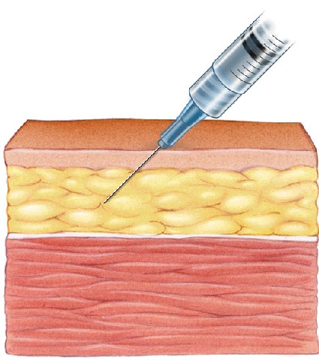
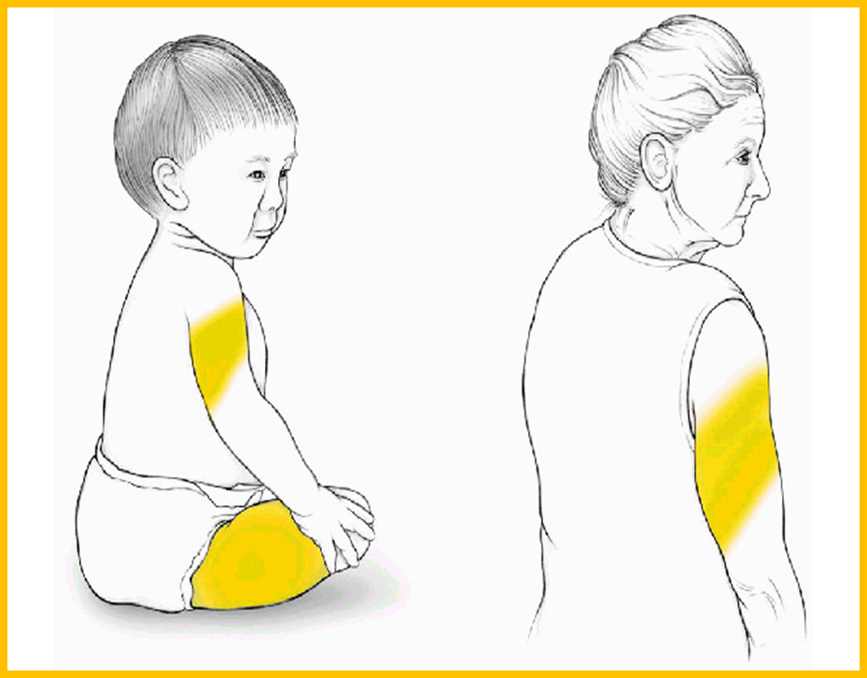
MMR and MMRV Administration
Preparation
MMR-containing vaccines must be reconstituted BEFORE administering
Use ONLY the diluent supplied by the manufacturer
Route: Subcutaneous injection
Needle gauge: 23–25 gauge
Needle length: 5/8 inch
Site: Upper outer triceps of the arm or the thigh
45° Angle
Notes:
The only diluent that should be used to reconstitute MMR or MMRV is the sterile water diluent that is supplied by the manufacturer.
Both MMR and MMRV should be administered by the subcutaneous route into fatty tissue.
For subcutaneous injections a 23 to 25 gauge needle is used and a 5/8-inch needle is sufficient to reach subcutaneous tissue.
Although a subcutaneous injection can be administered into the fatty tissue of the upper anterolateral thigh of anyone, it is typically used for infants or toddlers. The fatty part of the triceps area of the upper arm is generally used for older children, adolescents, and adults.

Slide 26
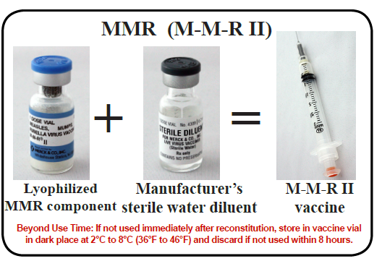
MMR Storage and Handling
Store in the refrigerator between 2°C and 8°C (36°F and 46°F)
May also be stored in the freezer
Protect vaccine from light by keeping in the original packaging with the lid closed
Store diluent at room temperature or refrigerate
Discard if not used within 8 hours after reconstitution
Do not fill syringe with reconstituted vaccine until ready to administer
Notes:
MMR vaccine can be stored with other refrigerated vaccines or in the freezer.
The diluent can be refrigerated or stored at room temperature, but it should never be frozen.
MMR is a live vaccine so it should be protected from light by keeping it in the original packaging until ready to administer.
Once it is reconstituted the vaccine should be used as soon as possible. Store reconstituted vaccine in the vaccine vial in a dark place in the refrigerator and discard if not used within 8 hours.
You should not draw reconstituted vaccine into a syringe until you are ready to administer it.

Slide 27
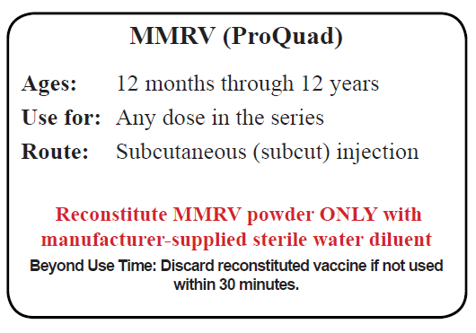
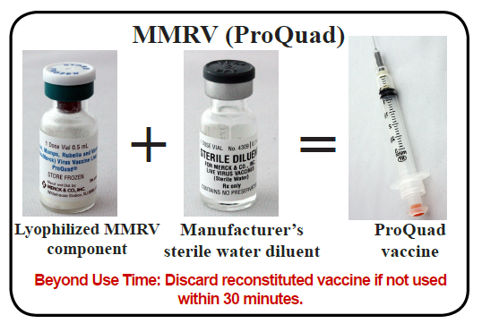
MMRV Storage and Handling
Store in the freezer between -50°C and -15°C (-58°F and +5°F)
Do NOT use dry ice
Protect vaccine from light
Vaccine may be stored at refrigerator temperature (2°C and 8°C or between 36°F and 46°F) for up to 72 continuous hours after removal from freezer
Store diluent at room temperature or refrigerate
If not used immediately, the reconstituted vaccine may be stored at room temperature, protected from light, for up to 30 minutes
Do not freeze reconstituted vaccine
Discard if not used within 30 minutes after reconstitution
Do not fill syringe with reconstituted vaccine until ready to administer
Notes:
Because MMRV contains varicella vaccine virus it should be stored with other varicella-containing vaccines at the recommended freezer temperature.
It should never be stored, even temporarily, using dry ice.
If removed from the freezer, it can be stored for up to 72 continuous hours at refrigerator temperature, but if not used by then it must be discarded. It should not be returned to the freezer.
It should also be stored in the original packaging and protected from light.
Use MMRV within 30 minutes of reconstitution or discard it.
And never freeze reconstituted vaccine.
The diluent for MMRV is the same as for MMR and it should be stored at room temperature or refrigerated. Do not freeze the diluent.

Slide 28
Resources
Additional information about measles can be found at the following links:
• Measles Outbreak Toolkit: https://www.cdc.gov/measles/toolkit/healthcare-providers.html
Measles vaccination: https://www.cdc.gov/measles/vaccination.html
• Measles evidence of immunity: https://www.cdc.gov/measles/hcp/index.html#immunity
• Cases and outbreaks: https://www.cdc.gov/measles/cases-outbreaks.html
• Measles and travel: https://www.cdc.gov/measles/travelers.html
• Measles Camp Guidance https://www.cdc.gov/measles/resources/camp-guidance.html
Measles complications: https://www.cdc.gov/measles/about/complications.html
• Measles signs and symptoms: https://www.cdc.gov/measles/about/signs-symptoms.html
• Surveillance and reporting: https://www.cdc.gov/measles/stats-surv.html
• Infection control (airborne precautions) : https://www.cdc.gov/infectioncontrol/basics/transmission-based-precautions.html#anchor_1552333331
• Measles FAQs: https://www.cdc.gov/measles/about/faqs.html
• Additional measles references and resources: https://www.cdc.gov/measles/resources/ref-res.html
For questions about measles cases or disease control recommendations in your area, please contact your health department.

Slide 29
Resources
MMR ACIP Guidelines
https://www.cdc.gov/mmwr/pdf/rr/rr6204.pdf
ACIP Recommended Schedules
https://www.cdc.gov/vaccines/schedules/hcp/index.html
General Best Practice Guidelines for Immunization (Altered Immunocompetence)
https://www.cdc.gov/vaccines/hcp/acip-recs/general-recs/immunocompetence.pdf

