Slide 1
Maternal Immunization: Research to Practice and Making a Strong Recommendation
NILE Immunize Nevada Webinar
March 14, 2019
Ashley Brooks, MPH
National Center for Immunization and Respiratory Diseases

Slide 2
Disclosure
Presenter has no conflict of interest.
Discussions on unlicensed products and off-label uses are in the context of ACIP considerations.
The use of trade names is for identification purposes only and does not imply endorsement.
Disclaimer – The opinions expressed in this presentation are solely those of the presenters and do not necessarily represent official positions of CDC.

Slide 3
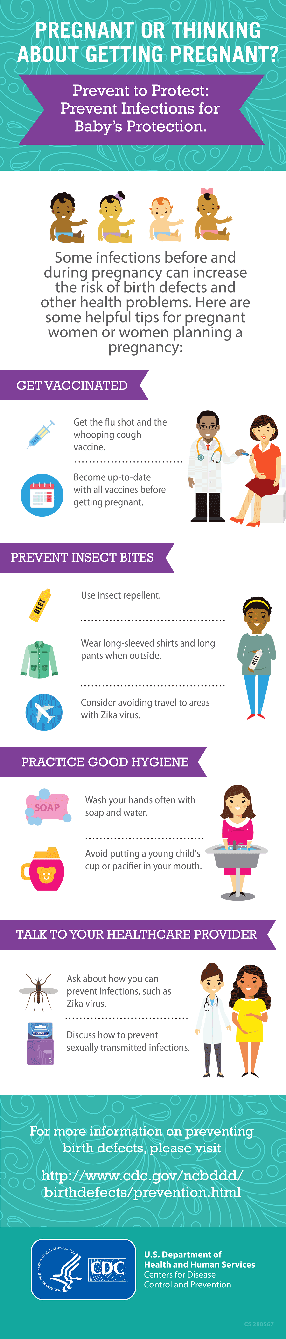
Presentation Objectives
Discuss findings and guiding principles from research with pregnant women and prenatal care providers
Understand the barriers and facilitators to vaccinating pregnant women
Discuss tips for communicating with pregnant women about vaccination
Discuss vaccination resources and materials for pregnant women and prenatal care providers
Notes:
READ SLIDE

Slide 4

Importance of Maternal Immunization
Background

Slide 5
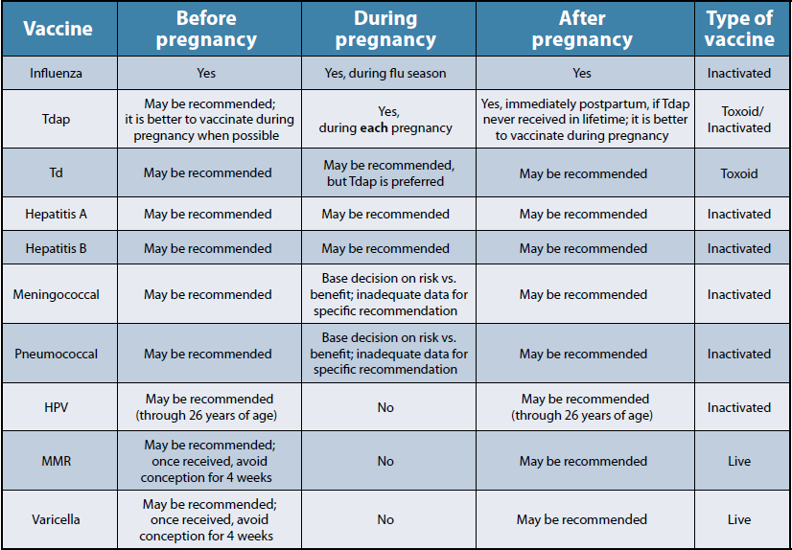
Maternal Vaccination
Notes:
This chart lists key vaccination recommendations for before, during, and after pregnancy. It is a quick reference table summarizing important contraindications and recommendations related to maternal vaccination.
As you can see here, I have highlight the two routine vaccines that are recommended during pregnancy.
Live vaccines administered to a pregnant women pose a theoretical risk to the fetus, so live attenuated virus and live bacterial vaccines are contraindication during pregnancy.

Slide 6
Influenza and Pregnancy
Influenza illness during pregnancy
  Changes in immune, heart and lung functions while pregnant
  Higher risk for severe illness and complications
  Increase in delivery complications (fetal distress, preterm labor, cesarean delivery)
Vaccinating pregnant women
  Protective levels of anti-flu antibody for mom, passive transfer of antibody for baby
  Reduced risk for influenza infection and hospitalizations among infants <6 mos age
Importance of vaccination
  Protective levels of anti-flu antibody for mom, passive transfer of antibody for baby
  Reduced risk for influenza infection and hospitalizations among infants <6 mos age
  Newborns are too young to receive flu vaccines
Grohskopf LA et al. Prevention and control of seasonal influenza with vaccines: Recommendations of the Advisory Committee on Immunization Practices — United States, 2013–2014. MMWR 2013;62(RR07);1–43
Eick AA et al. Maternal influenza vaccination and effect on influenza virus infection in young infants. Arch Pediatr Adolesc Med 2011;165:104–11
Notes:
Flu is more likely to cause severe illness in pregnant women than in women who are not pregnant. This is contributed by the changes in the immune system, heart and lungs during pregnancy making pregnant women more prone to severe illness from flu.
Flu may also be harmful for a pregnant woman’s developing baby.
The flu shot given during pregnancy has been shown to protect both the mother and her baby for several months after birth from flu. Pregnant women have protective levels of anti-influenza antibodies after vaccination. Passive transfer of anti-influenza antibodies that provide some protection from vaccinated women to their babies has been reported.
Vaccination of women while pregnant reduces risk for flu infection and hospitalization among infants younger than 6 mo of age. We know this is important since infants younger than 6 mo are too young to be vaccinated.
CDC, ACOG, ACNM, AAFP, and ACIP recommend influenza vaccination for women who are or will be pregnant.

Slide 7
History of Recommendations for influenza vaccine during pregnancy
Advisory Committee on Immunization Practices (ACIP) recommendations for pregnant women
  1960: Pregnant women noted to be at risk of severe illness and were recommended to receive influenza vaccine
  since 1990s: Vaccination during 2nd and 3rd trimesters recommended
  2004: Influenza vaccine recommended for all pregnant women during any trimester of pregnancy
  2017: Any licensed, recommended and age-appropriate trivalent, quadrivalent, or recombinant inactivated influenza vaccine can be administered during pregnancy
Grohskopf L. Presented at the June 2017 ACIP meeting: https://www.cdc.gov/vaccines/acip/meetings/downloads/slides-2017-06/flu-06-grohskopf.pdf
Notes:
1957 deaths – prompted 1960 recommendation, subsequent years not mentioned, later noted (90s) 2nd and 3rd trimester were high risk periods.

Slide 8
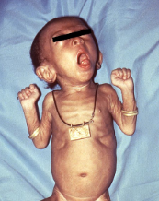

Burden of Pertussis
Pertussis is a contagious respiratory diseases characterized by a severe cough that can last for weeks or months
Notifiable disease based on clinical, lab, epi criteria
21,000 cases in 2015, 22% among adults (underdiagnosed and underreported)
Transmission from adults to children
  Disease most severe for infants and can suffer life-threatening complications
  Among hospitalized, apnea (61%), pneumonia (23%), death (1%)
CDC. National Notifiable Disease Surveillance System www.cdc.gov/pertussis/surv-reporting.html
CDC. MMWR 2017;66(11):1-28
Notes:
Pertussis is a nationally-notifiable disease. Clinicians should notify the appropriate health department of all patients with suspected pertussis.
Since 2010, CDC sees between 10,000 and 50,000 cases of whopping cough each year in the US. There are cases reported in every state.
In 2015 there were 21,000 cases with 22% of those among adults age 20+ years. Provisionally, for 2016 there were more than 15,000 reported cases with a similar % of adults.
Whooping cough disease is most severe for infants. Pertussis in infants causes them to stop breathing and turn blue. About half of babies who get whooping cough end up in the hospital. Hospitalization is most common in infants younger than 6 months of age. Of those infants, with pertussis who need treatment in a hospital, approx.:
61% will have apnea
23 % get pneumonia
1.1% will have seizures
And 1% will die.
Other complications can include anorexia, dehydration, difficulty sleeping, hernias, and urinary incontinence.

Slide 9
Pertussis cases reported in the U.S.
Pertussis cases have steadily increased in recent decades.
More than 20,000 cases per year in recent years
For U.S. infants under 1 year old:
  2,276 cases in 2017
  9 deaths in 2017
Number of Pertussis Cases by Year
Year | Cases
2012 | 48,277
2013 | 28,639
2014 | 32,971
2015 | 20,762
2016 | 17,972
2017 | 18,975
2018 | 12,264*
*As of December 8, 2018
22
Sources: https://www.cdc.gov/pertussis/surv-reporting/cases-by-year.html
https://www.cdc.gov/pertussis/surv-reporting.html
https://wonder.cdc.gov/nndss/static/2016/annual/2016-table2k.html
https://wonder.cdc.gov/nndss/nndss_weekly_tables_menu.asp.
Notes:
Pertussis is endemic in the United States, with peaks in reported disease every few years and frequent outbreaks
Although many pertussis cases are not diagnosed and therefore not reported, this slide gives us an idea of the number of cases we see each year. Pertussis cases have steadily increased in recent decades, with more than 20,000 reported cases in recent years. In 2017, there were 18,975 cases, including over 2,200 cases and 9 deaths in infants under 1 year old. We do not yet have final numbers for 2018.
While these numbers may seem high, we no longer see 200,000 cases each year like we did before we had pertussis vaccines.

Slide 10
Burden of Flu
Flu is a contagious respiratory illness caused by influenza viruses that infect the nose, throat, and sometimes the lungs
CDC estimates that flu has resulted in between 9.3 million-49.0 million illnesses, between 140,000-960,000 hospitalizations and between 12,000-79,000 deaths annually since 2010
Deaths in children with lab-confirmed influenza are reportable in the US
  183 deaths were reported for the 17-18 season
  People at high risk of developing flu-related complications
  Children younger than 5, but especially children younger than 2 years old
  Adults 65 years of age and older
  Pregnant women (and women up to 2 weeks postpartum)
  Residents of nursing homes and other long-term care facilities
CDC. Influenza www.cdc.gov/flu
CDC. Influenza-Burden www.cdc.gov/flu/about/burden/index.htm
Notes:
Pertussis is a nationally-notifiable disease. Clinicians should notify the appropriate health department of all patients with suspected pertussis.
Since 2010, CDC sees between 10,000 and 50,000 cases of whopping cough each year in the US. There are cases reported in every state.
In 2015 there were 21,000 cases with 22% of those among adults age 20+ years. Provisionally, for 2016 there were more than 15,000 reported cases with a similar % of adults.
Whooping cough disease is most severe for infants. Pertussis in infants causes them to stop breathing and turn blue. About half of babies who get whooping cough end up in the hospital. Hospitalization is most common in infants younger than 6 months of age. Of those infants, with pertussis who need treatment in a hospital, approx.:
61% will have apnea
23 % get pneumonia
1.1% will have seizures
And 1% will die.
Other complications can include anorexia, dehydration, difficulty sleeping, hernias, and urinary incontinence.

Slide 11
Tdap Vaccination Recommendation
Pertussis illness
  Most deaths are among infants who are too young to be protected by the childhood pertussis vaccine series (DTaP) that starts when infants are 2 months old.
  Infants are at the greatest risk of contracting pertussis and having severe, potentially life-threatening complications from the infection in first months of life.
Importance of vaccination
  Maternal Tdap vaccination helps protect newborns by passing antibodies (proteins produced by the body to fight off diseases) to baby before birth.
  Fewer babies will be hospitalized for and die from pertussis when Tdap is given during pregnancy rather than during the postpartum period.
  Cocooning alone may not be effective and is hard to implement.
Source: Tdap (Pertussis) Vaccine and Pregnancy. https://www.cdc.gov/vaccines/pregnancy/hcp-toolkit/tdap-vaccine-pregnancy.html
Notes:
Pertussis, or whooping cough, is a serious vaccine preventable-disease that has made a comeback in recent years. Newborns can catch it from their parents, siblings, or others that they come in close contact with.
READ SLIDES.
NOTE: The term “cocooning” refers to vaccinating anyone who comes in close contact with an infant.

Slide 12
Tdap Vaccination Recommendations
Adults
  1 dose Tdap if previously not received, except for pregnant women
Pregnant women
  Direct protection for mom, indirect protection for baby
  Infants of vaccinated moms were born with significantly higher anti-pertussis antibodies if Tdap given in pregnancy weeks 27–36
  Concentration of anti-pertussis antibodies in infant cord blood higher when mothers vaccinated earlier in this window
  Longer exposure to vaccine allows higher vaccine-induced antibody levels produced by mother and transferred to infant
  Vaccination is recommended for every pregnancy
  Cocooning alone may not be effective and it is difficult to implement
CDC. MMWR 2012;61:ND:719–32
CDC. MMWR 2013;62(07):131–135
Notes:
In 2012, the Advisory Committee on immunization Practices (ACIP) voted to recommend that HCPs administer a dose of Tdap during each pregnancy.
Tdap vaccination providers direct protection for mom and indirect protection for baby by passive anti-body transfer.
Getting Tdap during gestational weeks 27 to 36 weeks is 85% more effective at preventing pertussis in infants younger than 2 months old. Postpartum Tdap administration only provides protection to the mother—it does not provide immunity to the infant. It takes about 2 weeks after Tdap receipt for the mother to have protection against pertussis, thereby is vaccinated postpartum, she is at risk for contracting and spreading the disease to her vulnerable newborn during this time.
To maximize passive antibody transfer to the infant, HCPs should administer Tdap during the early part of gestational weeks 27 through 36.
The level of pertussis antibodies decreases over time, so you should administer Tdap during every pregnancy in order to transfer the greatest number of protective antibodies to each infant. ACOG and ACNM support this recommendation.
Cocooning alone may not be effective and it difficult to implement. Since ACIP recommended since 2005, full implementation of cocooning has proven to be a challenge, limiting its impact as an independent prevention strategy. Cocooning in combination with maternal Tdap vaccination and administering childhood DTaP series on schedule, provides the best protection to the infant.

Slide 13
History of Recommendations for Tdap vaccine during pregnancy
ACIP recommendations in pregnant women¹
  2006: Tdap booster to post-partum mothers and family members (cocooning)
  2011: Tdap for unvaccinated pregnant women after 20 weeks gestation
  2012: Tdap for every pregnant woman at every pregnancy regardless of prior immunization status (optimally between 27-36 weeks gestation)
Centers for Disease Control and Prevention. MMWR (2012)
Notes:
The 2012 recommendation replaces the original recommendation that pregnant women get the vaccine only if they had not previously received it.

Slide 14
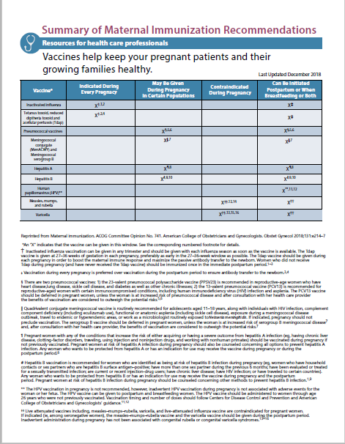
https://www.cdc.gov/vaccines/pregnancy/hcp-toolkit/resources.html
Notes:
Here is a summary of CDC’s maternal immunization recommendations. This fact sheet was developed in collaboration with ACOG.
It clearly shows which vaccines:
-Are indicated during every pregnancy (flu and Tdap)
-May be given during pregnancy in certain populations
-Are contraindicated during pregnancy
-Can be initiated postpartum or when breastfeeding or both
We are in the process of getting this new fact sheet up on the website, but you will be able to find it at this URL very soon.

Slide 15

What does communication research tell us?
CDC Maternal Research
Notes:
CDC’s research helps us develop communication strategies and materials based on information that both general consumers and health care providers are seeking. The goal is to get a better understanding of knowledge, attitudes, and behaviors regarding maternal vaccines, and also to provide a better understanding of provider needs and recommendations.

Slide 16
Understanding vaccine knowledge, attitudes and beliefs
CDC conducts formative and evaluation research with pregnant women, parents and healthcare professionals in order to inform its immunization education and outreach.
Methodology: focus groups, in-depth interviews, online surveys, polls
This research helps CDC to better understand audiences’ knowledge of diseases and vaccines and helps CDC to track attitudes, beliefs and self-reported practices over time. It also helps CDC to develop and test communication materials for healthcare providers and patients.
30
Notes:
First, we must understand the knowledge, attitudes, and beliefs when it comes to vaccination.
CDC conducts both formative and evaluation research with pregnant women, parents, and healthcare professionals to inform its immunization education and outreach.
To do this, CDC uses several methodologies including focus groups, in-depth interview, online surveys, and polls.
This research helps CDC better understand the audience’s knowledge of diseases and vaccines and also helps CDC to track attitudes, beliefs and self-reported practices over time.

Slide 17
Summary of Findings from 2014 Mixed Methods Research
Methodology:
Surveys
Focus groups
In depth interviews
Pregnant Women
Low disease and vaccine awareness
Protection for their babies is very important
Want to be assured of safety
High information-seeking
Want information from ob-gyn or midwife
Ob-gyns
Are recommending vaccines to pregnant patients
Understand importance of maternal vaccination
Low perceived susceptibility
Systems barriers to stocking vaccines
Notes:
In 2014, CDC conducted mixed methods research comprised of surveys, focus groups, and in depth interviews.
[Explain each]
The survey of pregnant women was an
Online survey of U.S. women 18–45 years of age.
There were 487 respondents that were eligible and completed the survey.
Data were collected in June/July of 2014.
Additionally, CDC convened focus groups with pregnant women
There were a total of 28 focus groups of pregnant women in
High pertussis incidence (San Diego) and low pertussis incidence (Atlanta) locations
The groups were segmented by parity and language (English and Spanish).
Participants were also a mix of trimester, race/ethnicity, and socioeconomic backgrounds.
There were two rounds of focus groups conducted. (June and September/October 2014)
For the provider audience
There was a survey of ob-gyns
The online survey was sent to 32,056 members of the American College of Obstetricians and Gynecologists (ACOG).
Respondents all offered prenatal care.
Data were collected in February and March of 2014.
2,365 respondents completed the survey.
In-depth interviews were conducted with ob-gyns
These interviews were 60-minute telephone interviews with ob-gyns nationally.
The respondents all offer prenatal care
Interviews were conducted in May and June of 2014
24 interviews in May
16 interviews in June
Findings from this research gave CDC a better understanding about both of these audiences regarding maternal vaccination. As you can see on this slide, the guiding principles for each audience may contribute to some gaps.

Slide 18
Additional Research: November – December 2016
Online survey and message testing with pregnant women
  251 pregnant women aged 18-45 years in U.S. receiving prenatal care
  Mixed household income, age, and experience with pregnancy
  Range of intention for flu and Tdap vaccines
In-depth interviews with HCPs
  16 OB-GYNs and 8 certified nurse midwives (CNM)
  Across all regions of U.S.
  Included those that provide Tdap onsite + those that refer
Notes:
We want to continuously look at the most up to date data. In winter of 2016, CDC conducted additional research with both pregnant women and healthcare providers.
An online survey, which included message testing, was administered to pregnant women. [Explain bullets]
And in addition to the online survey with pregnant women, in depth interviews, or IDIs we also conducted interviews with HCPs. [Explain bullets]

Slide 19
Pregnant women: Key findings
Low awareness about diseases (pertussis and flu) and vaccines.
69% report receiving a flu vaccine recommendation and 41% report receiving a Tdap vaccine recommendation.
Only 60% who received a Tdap or flu recommendations were told the vaccine was “extremely or very important.”
Protection for their babies is very important.
They are high information seekers, but not actively seeking information about pregnancy vaccines.
Want to receive vaccine information from their ob-gyn or midwife.
Have questions about maternal vaccines.
Notes:
In 2014, CDC conducted mixed methods research with pregnant women on the topic of maternal vaccines. The research included surveys, focus groups, and in-depth interviews. Here are some of the key findings:
There was low awareness about pertussis, flu, and vaccines
69 percent of pregnant reported receiving a flu vaccine recommendation and 41 percent reported receiving a Tdap vaccine recommendation
Protection for their babies is very important
Pregnant women are high information seekers but are not actively seeking information about maternal vaccines.
They want to receive vaccine information from their health care providers and they have questions about the recommended maternal vaccines

Slide 20
Key Findings: Pregnant Women
Vaccine Recommendations
  69% received flu vaccine recommendation and 41% received Tdap vaccine recommendation
  About 60% who received recommendations (for flu or Tdap vaccine) were told the vaccine was “extremely or very important”
Vaccine Acceptance
  More respondents had gotten or intended to get flu vaccine (59%) than Tdap (42%)
  28% had decided not to get each of the vaccines
Vaccine Decision-making
  Pregnant women get vaccines because their prenatal care providers recommend them or because they heard the illnesses could harm their baby.
  They want information about safety of individual vaccines, side effects, and vaccine ingredients.
PRELIMINARY
Notes:
he key findings from the research with pregnant women were evaluated in three main buckets:
Vaccine recommendation
Vaccine Acceptance
And vaccine decision making
Vaccine Recommendation: about 60% of those who received recommendations for flu vaccine and/or tdap vaccine reported they were told that the vaccine was “extremely or very important”
Acceptance: While more respondents had gotten or intended to get flu vaccine than tdap, there were 28 percent who had decided not to get each of the vaccines.
Decision-making: Similar to what we saw from the 2014 research, pregnant women want information on safety, side effects, and ingredients of vaccines and they also want and trust information from their providers

Slide 21
CDC longitudinal survey of first-time expectant moms
Initial survey showed that over 85% of respondents had already made a plan for vaccinating their baby by their 2nd trimester.
However, only 6% of pregnant women were very satisfied with their current level of knowledge about childhood vaccines.
Internet search engines were their #1 source of information about childhood vaccines during pregnancy. Only 22.5% cited their ob-gyn or primary care provider.
Results suggest a need for midwives and ob-gyns to direct expectant women to credible sources of childhood immunization information. Ex: Meeting with a pediatrician before the baby is born.
Source: Weiner, J. et al. Childhood Immunizations: First Time Expectant Mothers’ Knowledge, Intentions, Beliefs, and Behaviors. Am J Prev Med 2015;49(6S4):S426–S434.
31
Notes:
CDC did a longitudinal panel study with 200 women from 2nd trimester of pregnancy to child’s 19th month of life, starting in 2014. The objective was to learn about their knowledge, attitudes and plans related to vaccines for their babies.
As we see here, the initial survey showed that over 85% of women had already made a plan for vaccinating their baby by their 2nd trimester. This is what they had decided:
75% were planning to receive all vaccines recommended by their child’s doctor or nurse
10.5% were planning to delay or space out some vaccines
4% planned to receive some but not all vaccines
10.5% had not yet made plans for vaccinating their baby
A key takeaway from this is that women are making plans for their babies’ vaccines very early, even before their babies are born. And it’s important for them to consult credible sources of information to get their questions answered. For example, prenatal care providers can encourage pregnant women to meet with a pediatrician before the baby is born.

Slide 22
How HCPs Talk about Maternal Vaccines
  Most use similar Tdap and flu vaccine messages with patients
  Most discuss Tdap and flu vaccination concurrently, during initial intake visit
    Use printed materials to help educate patients about vaccines
  Key message themes to facilitate vaccine conversations:
    Disease susceptibility and severity
    Vaccination benefits (protection, passive immunity)
    Vaccine safety
  CNMs were more likely than OB-GYNs to feel uncomfortable making a strong recommendation for either vaccine, as they view it as a patient decision
PRELIMINARY
Notes:
In the in-depth interviews, CDC learned how providers talk about maternal vaccines to their pregnant patients.
[READ BULLETS]
By including certified nurse midwives in the interviews, we learned that…

Slide 23
Guiding Principles for Pregnant Women
Levels of awareness of pertussis and perceived susceptibility to the disease are low among pregnant women
Pregnant women are primarily concerned with the health and safety of their baby when making decisions about vaccines during pregnancy
Pregnant women view their ob-gyn or midwife as the ultimate authority on pregnancy-related topics

Slide 24
Guiding Principles for Ob-Gyns
Knowledge of the Tdap recommendation during pregnancy is high, but perception of individual risk for their patients (and their babies) is often low.
Stocking Tdap is a barrier for some ob-gyns, often due to issues with reimbursement
The most common channels for sharing vaccine information with patients are face-to-face during the office visit and in handouts at the first prenatal appointment
Prenatal providers have noted that they pair Tdap recommendation with timing of the glucose tolerance testing

Slide 25
Flu Vaccination Barriers and Facilitators in Pregnant Women
Barriers
  Low Perceived susceptibility and severity
  Safety concerns
  Side effects
  Vaccine efficacy
Facilitators
  Provider Offer and Recommendation
  Education and awareness
Motivators
  Protecting the baby was the strongest motivator for vaccination among focus group participants

Slide 26
Best Ways to Reach Pregnant Women
Pregnant women get maternal vaccination formation from 3 main sources:
  80% HCPs (most important source for 60%)
  50% Internet health resources
  33% Family
However, most are not actively looking for information about pregnancy vaccines
Some pregnant women would be prompted by messages they see online to ask their HCP about maternal vaccination
PRELIMINARY
Notes:
We also identified the best ways to reach pregnant women.
[EXPLAIN any relative bullets]

Slide 27

Role of Health Care Provider
Notes:
So, now that we see vaccination coverage, the importance of vaccines, and some knowledge, attitudes, and beliefs of pregnant women in regards to immunization,
How can we encourage them to get the recommended vaccines they need??
As a health care provider…

Slide 28

Common questions pregnant women have about vaccination
Are these diseases really dangerous?
Is vaccination safe for me and my baby?
Can’t I just get it after my baby is born?
Why is vaccination needed every pregnancy?
Why hasn’t my doctor talked to me about this?
Isn’t it enough to make sure everyone around my baby is vaccinated (or stay away from sick people?)
Notes:
We know pregnant women have several questions once they realize they need vaccines and may not have all of the information.
Some of the questions most often heard include
Is the vaccination safe for me and my baby?
Why is vaccination needed every pregnancy?

Slide 29

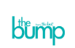
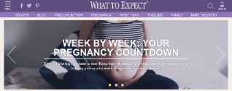
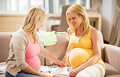


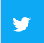
They may look to many sources for pregnancy-related information
Notes:
This audience tends to be high information seeking and may be looking to many, many sources for pregnancy related information.
It is important to note here that while most are seeking information on healthy pregnancy, most are not actively searching for vaccine information.
Because there are numerous existing sources, there is a need for clear, credible and consistent information.

Slide 30
Standards for Adult Immunization Practice
All health care providers, including those who do not provide vaccine services, have role in ensuring adult patients up-to-date on vaccines
Call to action for adult health care providers to
  ASSESS vaccination status of all patients at every clinical encounter
  Strongly RECOMMEND vaccines that patients need
  ADMINISTER needed vaccines or REFER to a vaccine service provider
  DOCUMENT vaccines received by patients in state vaccine registries
Public Health Reports 2014;129:115–123
Notes:
The national vaccine advisory committee, or NVAC, revised the Standards in 2013.
[Read BULLET 1]
Practice standards include…
[BULLETS]

Slide 31
Present Vaccination as a Standard Part of Obstetric Care
Provide your patients with information and resources about maternal vaccines during her first prenatal visit, and be sure to mention the timeframe for each vaccine when discussing her pregnancy
Ensure your staff deliver consistent messaging about the importance of maternal vaccines
Normalize vaccination as part of your patients’ pregnancy care
Notes:
Bullet #2: including nurses, front office staff, managers, etc
Bullet #3: examples include
“ It is October and flu season is coming up. That means it is time for your flu vaccine. Unless you need more information on flu vaccine, Ill have the nurse bring it in.”

Slide 32
Making a strong recommendation

Slide 33
Vaccination Uptake by Provider Recommendation and Offer
97.9% visited health care provider at least once before or during pregnancy¹
When recommended and offered from obstetric provider, vaccine acceptance 5x to 50x higher^{2,3}
1. CDC. Pregnant Women and Flu Vaccination, Internet Panel Survey
2. Ahluwalia IB et al. Obstet Gynecol 2010;116:949–55
3. Shavell VI et al. J Am Board Fam Med 2006;19:345–9
Notes:
Apologies for this slide being a little distorted. This chart shows results from the Internet Panel Survey of flu vaccination coverage before and during pregnancy from patients who visited a health care provider at least once.
Just to provide clarification in definition:
No recommendation: No recommendation of flu vaccine given
Recommended but not offered: Recommendation of flu vaccination given but vaccine not offered to be administered on-site or at all
Offered: Vaccination is available on-site; ready to be administered to patient
All vaccination results are based on self-report.

Slide 34

A Strong Recommendation Makes a Difference
Providers should talk to pregnant patients about the importance of on-time vaccination
  Pregnant patients need to be vaccinated to protect them and their babies
  Pregnant patients may not be aware of the recommendations
  Healthcare providers are patients most trusted sources of health information during their pregnancies.
Notes:
Though there are numerous sources, pregnant women turn to their most trusted source: their ob-gyn or midwife. In our research, most providers say they recommend vaccines to pregnant patients, yet we see that coverage rates continue to be stagnant. Where is the disconnect??
A strong, effective vaccine recommendation makes a difference. It is important for providers to talk to their pregnant patients about the importance of on-time vaccination.

Slide 35
Strong Vaccine Recommendation
CDC’s research indicates that some pregnant women do not feel their healthcare providers strongly recommend vaccines
Providers should state clearly that they would like her to get vaccinated
“Today, I strongly recommend two vaccines to help protect you and your baby against the flu and whooping cough.”
Notes:
Lets talk a little more about a strong vaccine recommendation. Our research indicates that some pregnant women do not feel their providers are strongly recommending vaccines.
Providers should state clearly that they would like her to get vaccinated.
An example of this recommendation could be:
[READ EXAMPLE]

Slide 36
SHARE information with pregnant patients
SHARE tailored reasons why the recommended vaccine is right for the patient.
HIGHLIGHT positive experiences with vaccines to reinforce the benefits and strengthen confidence in vaccination.
ADDRESS patient questions and any concerns about the vaccines.
REMIND patients about the protection vaccines can help provide from serious diseases.
EXPLAIN the potential costs of getting the disease.
Notes:
Healthcare providers can SHARE information with pregnant patients.
These tips are great for general vaccine recommendations with adults but also in the case of pregnant women.
SHARE:
Share tailored reasons why the recommended vaccine is right for the patient.
Highlight positive experiences. These experiences can be personal or in practice.
Address patient questions and concerns. An example, “The most common side effects are mild, like redness, swelling, or pain in your arm where the shot was given. This should go away within a few days.”
Remind patients about the protection vaccines can provide.
Explain the potential costs of getting the disease. These “costs” include serious health effects with each disease for mom and baby, time lost (missing work or family obligations), and of course the financial costs associated.

Slide 37
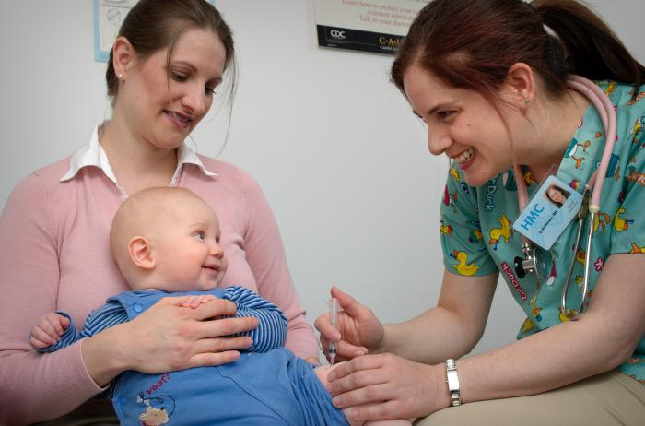
Vaccination Recommendation for Parents
Use the presumptive approach
  Some studies suggests that this results in higher vaccine acceptance rates
Instead of saying “What do you want to do about shots?,” say “Your child needs three shots today.”
Instead of saying “Have you thought about the shots your child needs today?,” say “Your child needs Dtap, Hib, and Hepatitis B shots today.”
NOTE: This does not mean pushing or pressing parents to vaccinate
Notes:
First, use a presumptive approach, by simply stating the vaccines that the child will receive (as opposed to asking parents what they want to do about vaccines). This assumes that the parents will accept vaccines, because national data shows that most parents do.
For example, instead of saying “What do you want to do about shots?,” say “Your child needs three shots today.”
and….
instead of saying “Have you thought about the shots your child needs today?,” say “Your child needs DTaP, Hib, and Hepatits B shots today.”
IMPORTANT: The presumptive approach does not mean pushing or pressuring parents to vaccinate, both of which can erode the trust that a parent places in you.
Many parents won’t have questions about vaccines when you give your strong recommendation and use language that assumes parents will accept vaccines for their child. However, a small percentage of parents may be more hesitant, requiring you to spend more time addressing their questions and concerns.

Slide 38
Immunization coverage and challenges
Notes:
So how are we doing with immunization coverage for maternal and childhood vaccines? Let’s look at the data.

Slide 39
Maternal vaccination coverage
During the 2017–18 influenza season:
  49.1% of pregnant women received influenza vaccination before or during pregnancy,
  54.4% of women with a live birth received Tdap during pregnancy, and
  32.8% received both recommended vaccines.
Vaccination coverage, regardless of vaccine type, was highest among pregnant women with a provider offer of vaccination.
Reasons for non-vaccination:
  Concerns about effectiveness of flu vaccine
  Lack of knowledge about need for Tdap during every pregnancy
  Concerns about safety risks to baby
Rates have remained stagnant in recent years.
Source: Influenza and Tdap Vaccination Coverage Among Pregnant Women — United States, April 2018. https://www.cdc.gov/mmwr/volumes/67/wr/mm6738a3.htm?s_cid=mm6738a3_e
Notes:
Many pregnant women in this country are not getting the vaccines they need.
READ SLIDE
We have heard for years that women don’t know about the need for Tdap during pregnancy, indicating a need for stronger recommendations by healthcare professionals.

Slide 40
Influenza vaccination coverage among pregnant women,
2010–2011 through 2016–2017 influenza seasons
Notes:
As we can see from this graph, maternal flu vaccination rates have remained stagnant over the past 6 years, hovering at around 50%.

Slide 41
Tdap vaccine coverage among pregnant women
Source: Pregnant Women and Tdap Vaccination, Internet Panel Survey, United States, April 2017. https://www.cdc.gov/vaccines/imz-managers/coverage/adultvaxview/pubs-resources/tdap-report-2017.html
Notes:
From 2014 to 2017, CDC conducted internet panel surveys with pregnant women to determine how many had received maternal vaccines.
The red bars show the percentage of women who received Tdap during pregnancy, the blue bars before pregnancy, and the gray bars after pregnancy. The green bars reflect women who never received Tdap.
The percentage of women who have received Tdap vaccine during pregnancy has steadily increased since 2014, but it still remain at about 50%.
As we saw in the previous slide, only about half of pregnant women receive a flu vaccine. This means that half of pregnant women, and their newborns, are unprotected from both pertussis and influenza.

Slide 42
Childhood immunization coverage
Coverage with most recommended vaccines among children aged 19–35 months remains stable and high.
Vaccination rates are lower in more rural areas and among uninsured or Medicaid-insured children.
  These disparities are larger for vaccines that require a booster dose in the second year of life (e.g., DTaP, Hib, and PCV).
  CDC is working to identify reasons for disparities and evidence-based interventions.
A small but increasing proportion of children receive no vaccines (1.3% in 2017 compared to .8% in 2016).
  Unvaccinated children in the 2017 NIS-Child were disproportionately uninsured.
Notes:
CDC tracks childhood immunization coverage annually through the annual National Immunization Survey. Childhood immunization rates remain high and stable.
In 2017, coverage was >90% for vaccination with ≥3 doses of poliovirus vaccine (92.7%), ≥1 dose of MMR (91.5%), ≥3 doses of HepB (91.4%), and ≥1 dose of varicella vaccine (91.0%). 70.4% of children were up-to-date for the combined 7-dose series.
We still face some challenges, however.
READ LAST 2 BULLETS.

Slide 43
3+ HepB
3+ Polio
1+ MMR
1+ Var
4+ DTaP
4+ PCV
Hib-FS*
Rotavirus§
HepB birth dose†
4:3:1:3*:3:1:4¶
2+ HepA
* ≥ 3 or ≥ 4 doses of Haemophilus influenzae type B vaccine, depending on vaccine type.
† Hepatitis B dose administered from birth through age 3 days.
§ ≥ 2 or ≥ 3 doses of Rotavirus vaccine, depending on product type (≥ 2 doses for Rotarix or ≥ 3 doses for RotaTeq).
¶ The combination includes ≥ 4 DTaP, ≥ 3 polio, ≥ 1 MMR, ≥ 3 or ≥ 4 doses Hib, depending on vaccine type, ≥ 3 HepB, ≥ 1 varicella, and ≥ 4 PCV.
Notes:
This graph shows how childhood immunization rates have remained stable since 2011, although we do see some variation in coverage by vaccine, with MMR coverage being the highest and 2+ doses of hepatitis A vaccine being the lowest.

Slide 44
CDC Resources and Tools
Notes:
Patient Education
Posters and videos for waiting room
Low-literacy materials
Materials for diverse audiences and language needs
Answers to commonly asked patient questions
Tips on providing a strong recommendation
Especially when making referrals

Slide 45

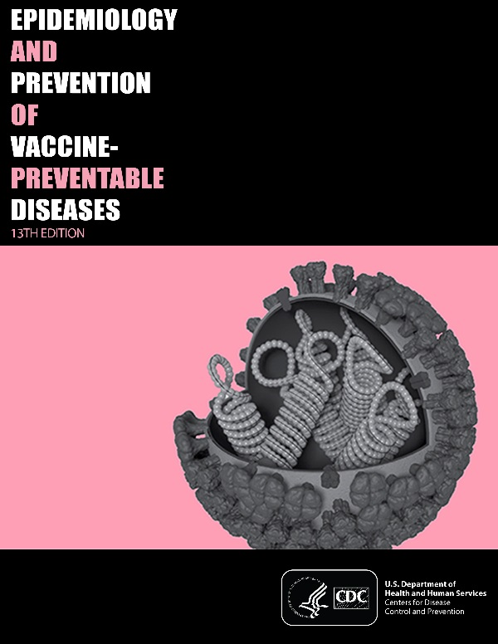
Immunization training for clinicians
You Call the Shots: Web-based modules that discuss vaccine-preventable diseases (VPDs) and explain the latest recommendations for vaccine use. CE/CME credit offered.
Current Issues in Immunization Net Conference (CIINC): Live 1-hour audio and visual presentations with on-demand replays. Offered 4-5 times per year. CE/CME credit offered.
Pink Book Webinar Series: Online series of 15 1-hour webinars. Provides an overview of the principles of vaccination, general recommendations, immunization strategies for providers, and specific information about VPDs and vaccines. CE/CME credit offered.
Webcasts: Topics include HPV, pertussis, flu, vaccine storage and handling, and more. CE credits offered.
www.cdc.gov/vaccines/ed/index.html
44
Notes:
CDC offers a wide range of FREE trainings for clinicians, most of which offer CE/CME credit. These include:
The You Call the Shots online modules about vaccine-preventable diseases and vaccine recommendations
Live net conferences about current issues in immunization
A series of online webinars about the content of the Pink Book, which discusses the epidemiology and prevention of vaccine-preventable diseases; and
Webcasts on a host of other topics.
Visit the website in the blue box at the bottom of this slide for more details.

Slide 46
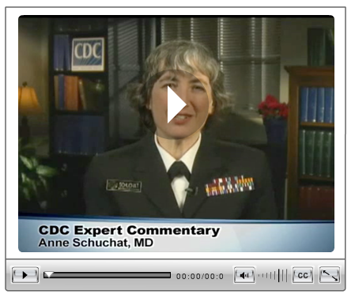
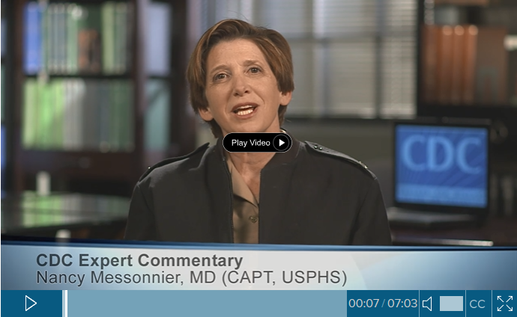
CDC Medscape expert commentaries
Vaccine Communication with Parents: Best Practices–Nancy Messonnier, MD
  http://www.medscape.com/viewarticle/882865?src=par_cdc_stm_mscpedt&faf=1
Overcoming Vaccine Concerns and Refusals –Anne Schuchat, MD
http://www.medscape.com/viewarticle/742313
Notes:
CDC has worked with Medscape to provide expert commentaries from subject matter experts on vaccination.

Slide 47
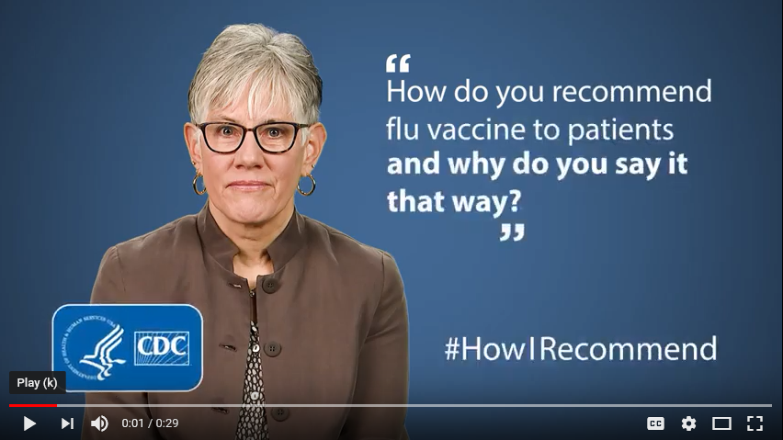
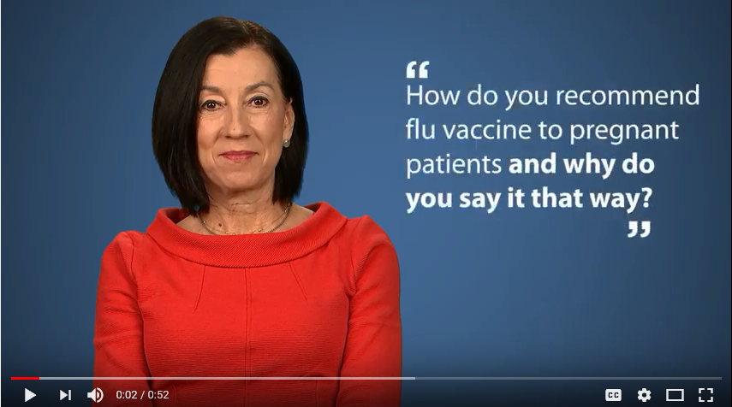
#HowIRecommend videos: Maternal immunization
Carol Hayes, CNM
https://youtu.be/CNRlwiMRYy8
Pamela Rockwell, DO
https://youtu.be/Z5BkbMBZe5o
Notes:
CDC has a series of short videos called How I Recommend, which feature various clinicians demonstrating how they recommend vaccines. These two videos on this slide focus on recommending flu vaccine to pregnant women. One features a certified-nurse midwife, Carol Hayes, and the other features a family physician, Dr. Pamela Rockwell.
In the near future we will be launching a similar video featuring a pediatrician talking about how she recommends childhood vaccines.

Slide 48
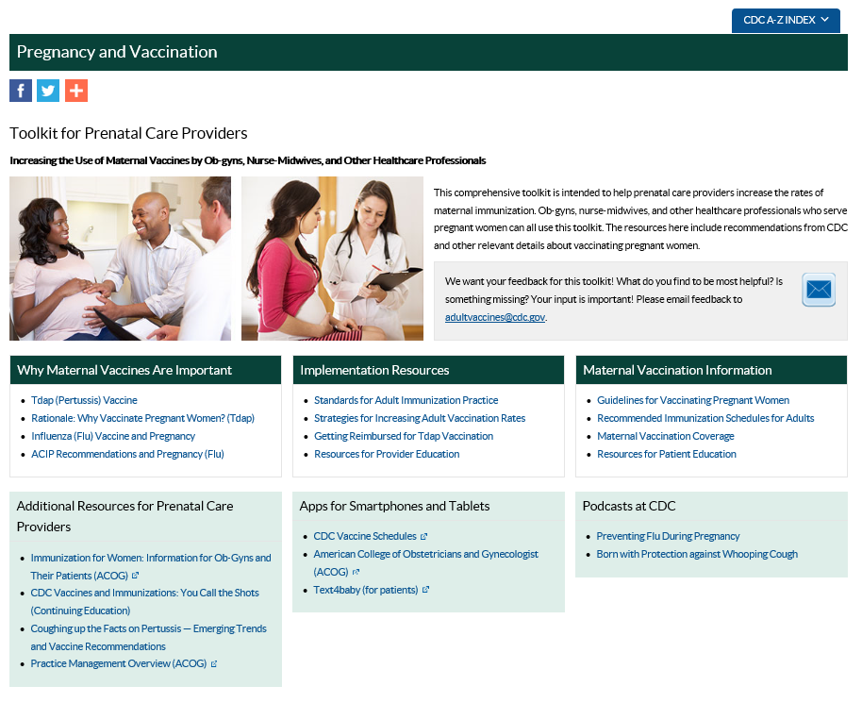
Maternal immunization: Toolkit for prenatal care providers
www.cdc.gov/vaccines/pregnancy/hcp-toolkit
Notes:
We also have an online toolkit for prenatal care providers. This is a one-stop shop for all of our vaccine recommendations, schedules, and educational materials for providers and for patients. I encourage you to take some time to look through the various resources on this website.
You can find it at the URL in the blue box.

Slide 49
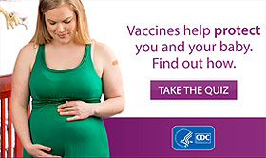
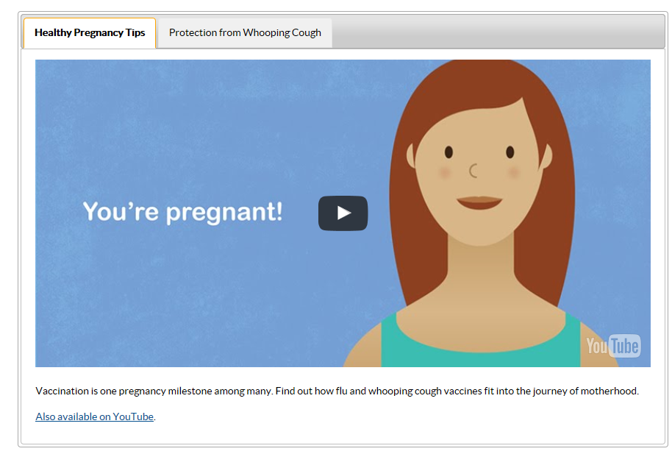
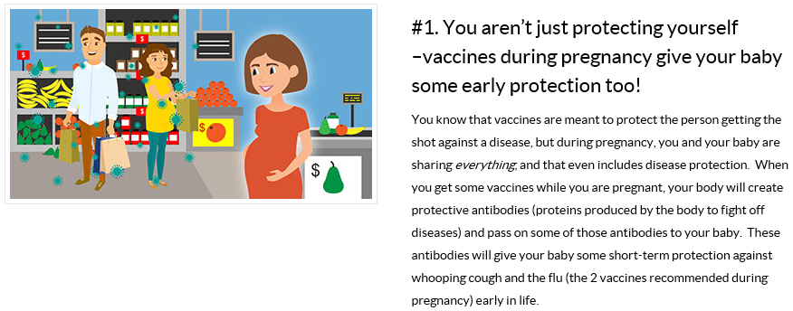
Maternal immunization: Digital resources
Website
Quiz
Animated video
Top 7 list
www.cdc.gov/vaccines/pregnancy
Notes:
We have several digital resources available targeting pregnant women.
Our website frames maternal vaccines as part of a healthy pregnancy. These pages cover vaccines that pregnant women need before, during, and after pregnancy. We also have webpages geared towards provider audiences about making recommendations to pregnant women. Our webpages also are home to several resources including
A maternal vaccine quiz that tests knowledge about vaccines during pregnancy
An animated video that highlights how to have a healthy pregnancy. Along with taking care of herself, working with her doctor, getting her home ready—pregnant women should get vaccinated against flu and whooping cough.
A “Top 7” list CDC developed, titled “Vaccines & Pregnancy: The top 7 things you need to know” explains information pregnant women should know about vaccines and how they contribute to protecting mom and baby.
All of these resources can be found at cdc.gov/vaccines/pregnancy.

Slide 50
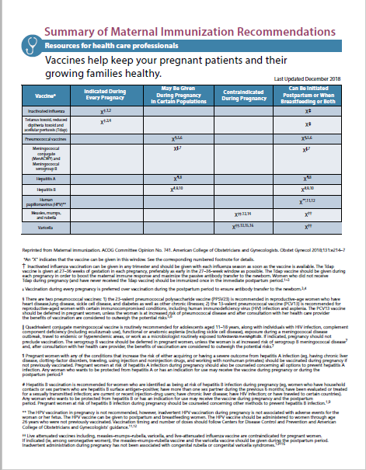
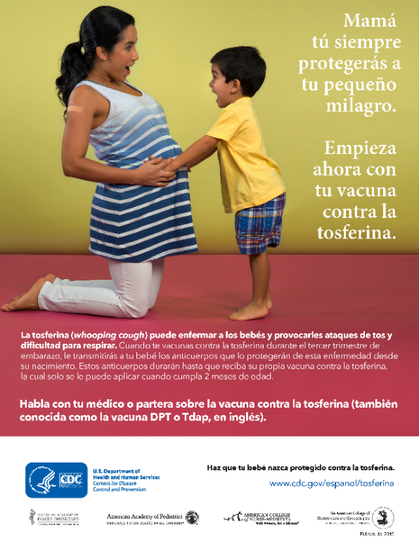
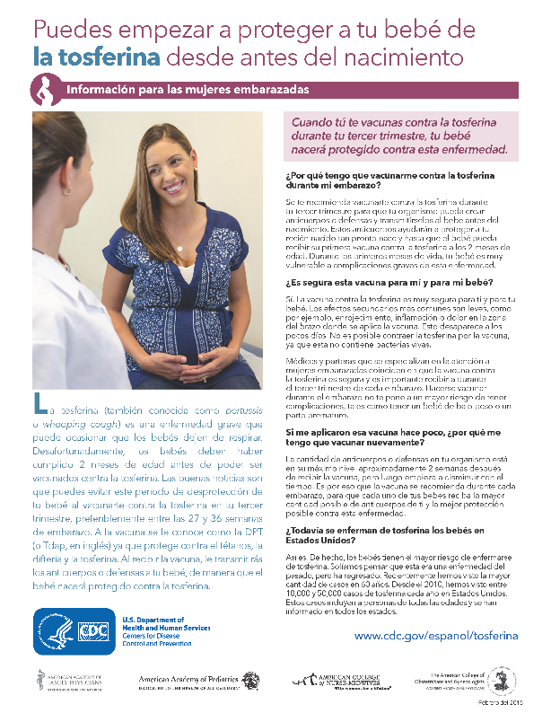
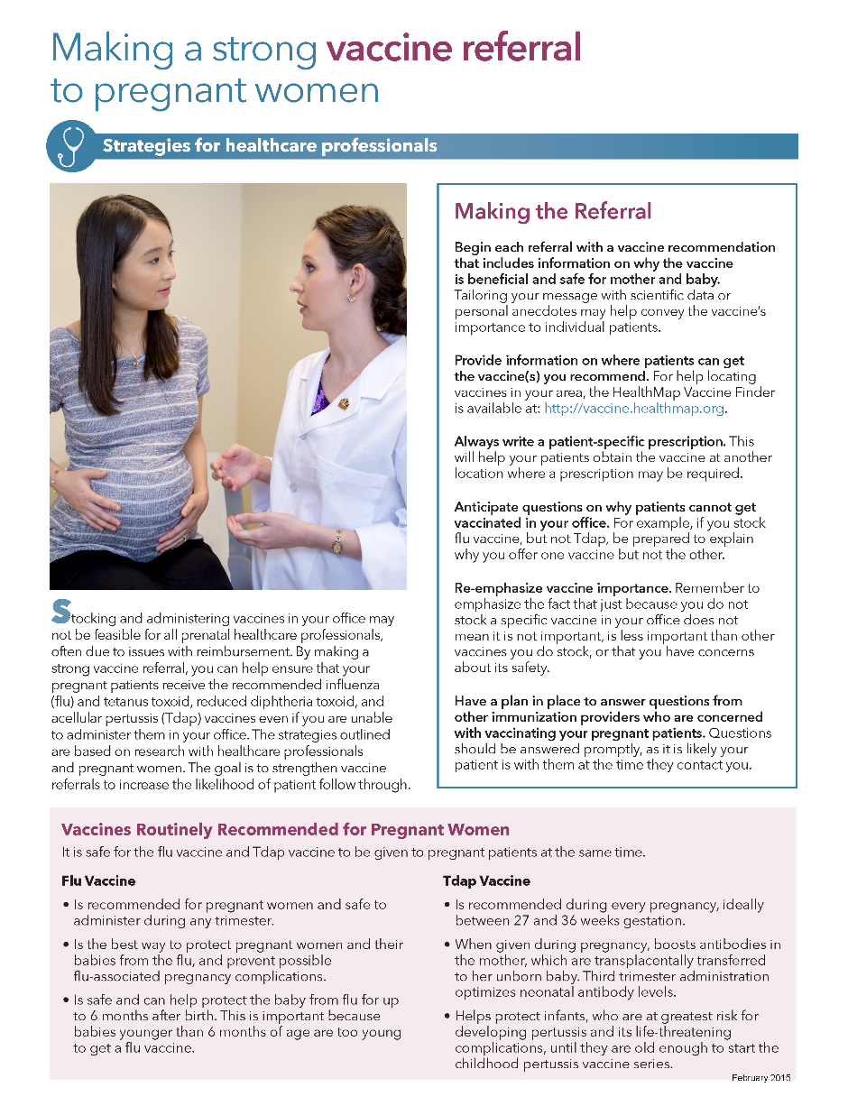
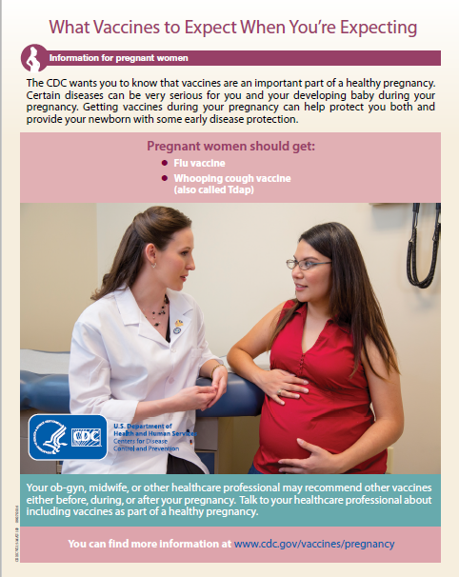
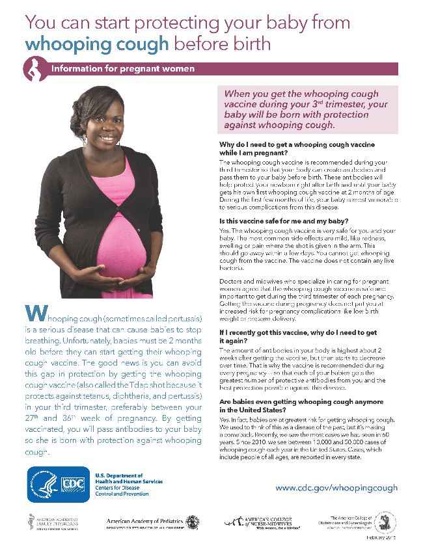
Maternal immunization: Print resources
www.cdc.gov/vaccines/pregnancy/hcp-toolkit
54
Notes:
We offer several print resources including fact sheets and posters. The posters are for pregnant women. We have different fact sheets for providers and pregnant women. The fact sheets for pregnant women are also available in Spanish.
Patient Education materials are
Posters and videos for waiting room
Low-literacy
for diverse audiences and language needs
Provide answers to commonly asked patient questions and
Include tips on providing a strong recommendation especially when making vaccine referrals
We found that moms are responsive to messaging about the importance of vaccines for protecting baby.

Slide 51
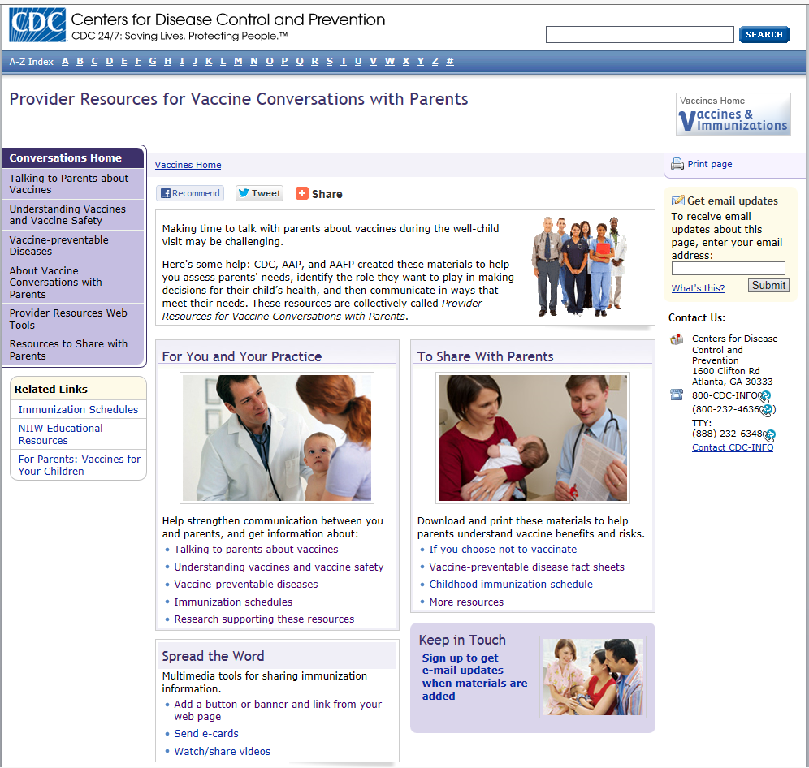
Provider resources for vaccine conversations with parents
Talking to Parents about Vaccines
Preparing for Vaccine Questions Parents May Ask
Understanding Vaccines and Vaccine Safety
  How Vaccines Work
  The Recommended Childhood Immunization Schedule
  Ensuring the Safety of U.S. Vaccines
  Understanding MMR Vaccine Safety
  Understanding Thimerosal, Mercury, and Vaccine Safety
  The Advisory Committee on Immunization Practices
Diseases and the Vaccines that Prevent Them
If You Choose Not to Vaccinate, Understand the Risk and Your Responsibilities
www.cdc.gov/vaccines/conversations
46
Notes:
Now I would like to switch gears and tell you about a few resources related to childhood vaccines.
Many healthcare professionals talk with parents on a daily basis about protecting their children from vaccine-preventable diseases. CDC, AAP, and AAFP created a suite of online materials to help you assess parents' needs, identify the role they want to play in making decisions for their child’s health, and then communicate in ways that meet their needs. These resources are collectively called Provider Resources for Vaccine Conversations with Parents.
They include:
Guidance for how to talk with parents about vaccines, including how to answer some common questions
Plain language fact sheets about vaccine-preventable diseases – in English and Spanish
Fact sheets about vaccine safety
Information for parents who choose not to vaccinate
And more!
These resources may help you start or continue a vaccine conversation with parents; the materials also are effective educational tools for parents to supplement the conversations you have with them.

Slide 52
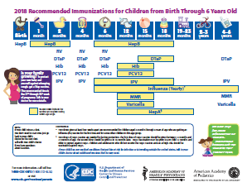
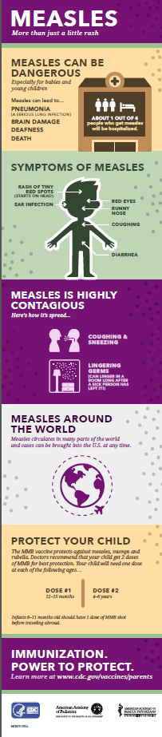
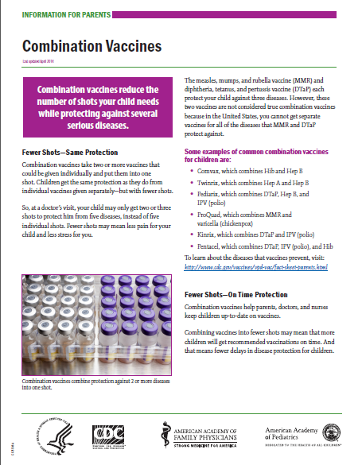
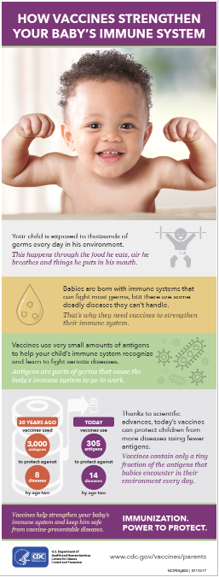
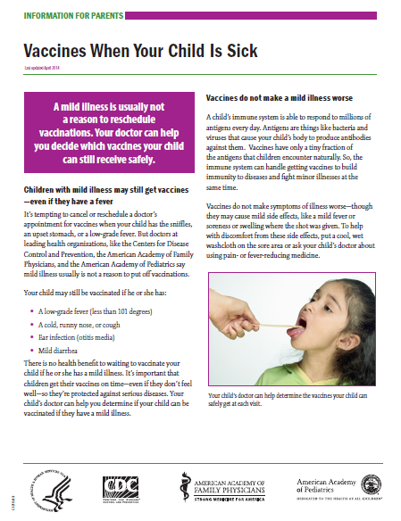
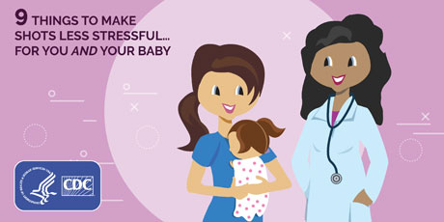
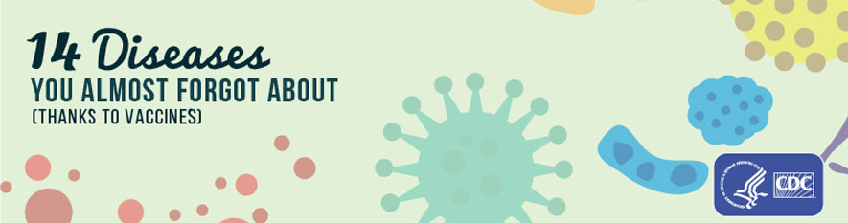
Childhood immunization materials to share with parents
www.cdc.gov/vaccines/parents/resources
49
Notes:
This slide shows CDC childhood immunization resources that you can share with parents. They include:
Fact sheets
Easy-to-read immunization schedules in English and Spanish
and Infographics and listicles
Go to the URL listed on this slide to see these items and more, like posters and videos.

Slide 53
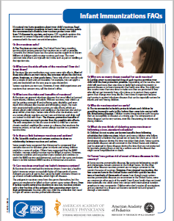
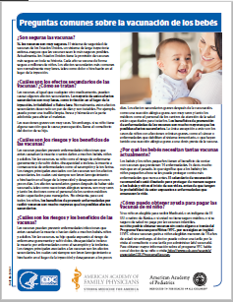
Infant immunization FAQs
Written for parents of children ages 0-2
English and Spanish
HTML and PDF
Co-branded with AAP and AAFP
www.cdc.gov/vaccines/parents/parent-questions.html
50
Notes:
This is another great resource – our Frequently Asked Questions about Infant Vaccines. A few examples include:
Are vaccines safe?
Can vaccines overload my baby’s immune system?
What’s wrong with delaying my baby’s vaccines if I’m planning to get them all eventually?
These fact sheets are written for parents of children 0-2 and CDC developed in collaboration with AAP and AAFP
They are available in English and Spanish, can be viewed online or downloaded as a PDF to print and copy for parents.

Slide 54

The bottom line on maternal immunization
Maternal immunization protects both pregnant women and their newborns.
Pregnant women should get influenza vaccine and Tdap (for every pregnancy).
But vaccination coverage rates remain low.
We know that healthcare professional recommendations have big impact.
It’s important to focus on effective messaging and communication strategies.
Notes:
As we wrap-up this presentation, let’s review a few key takeaways related to maternal immunization:
Maternal immunization protects both pregnant women and their babies.
Pregnant women should get a flu shot and Tdap during every pregnancy
Vaccination coverage rates remain stagnant
Healthcare professional recommendation have big impact
And it is important to focus on effective messaging and communication strategies

Slide 55
The bottom line on childhood immunization
The recommended immunization schedule protects children from 14 serious diseases.
We still see outbreaks of childhood diseases like measles and pertussis.
Women make decisions about their babies’ vaccines early, often while pregnant.
Many parents have questions, even if they ultimately choose to vaccinate.
Prenatal care providers can point parents to credible information sources and encourage them to meet with a pediatrician during pregnancy.
CDC offers tips to help healthcare professionals have better vaccine conversations.
Notes:
And here are a few more things that we hope you will take away related to childhood immunization:
The recommended immunization schedule protects children from 14 serious, preventable diseases, however
We still see outbreaks of childhood diseases like measles and pertussis.
Women make decisions about their babies’ vaccines early, often while pregnant.
Many parents have questions even if they choose to vaccinate
Prenatal care providers can point parents to credible information and also encourage them to meet with a pediatrician while pregnant
CDC offers tips to health care professional have better vaccine conversations.

Slide 56
Who Are Immunization Champions?
Those who go above and beyond to ensure that people in their community are protected from vaccine-preventable diseases.
Researchers, doctors, nurses, medical assistants, parents who have been affected by vaccine preventable diseases.
Champions are a key to our success in addressing current health challenges
Notes:
Some of these health challenges include:
-increasing maternal Tdap and flu vaccination rates
Maintaining childhood immunization rates and addressing vaccine hesitancy
Reducing immunization disparities for rural populations and those living in poverty
Developing new vaccines– e.g. zika, ebola, rsv
Global eradication of polio

Slide 57

CDC Childhood Immunization Champions
Recognizes individuals who make a significant contribution toward improving public health through their work in childhood immunization.
Since 2012, CDC has honored up to one champion in each state, DC, U.S. territories and Freely Associated States.
Awardees have included physicians, nurses, medical assistants, parent advocates, state legislators, coalition members, and more.
Have demonstrated leadership, collaboration, innovation and/or advocacy.
Announced each year during National Infant Immunization Week (NIIW)
https://www.cdc.gov/vaccines/events/niiw
Notes:
Several other organizations across the lifespan, large and small, medical associations have adopted a champions and/or recognition program.

Slide 58
What Can YOU Do?
GET VACCINATED
TALK to pregnant patients about maternal vaccines
  Tell them way it’s important for them and their babies
  Make the conversation and recommendation memorable and compelling
ADMINISTER indicated vaccines in your office if possible and FOLLOW UP to ensure receipt when there is a referral
USE and PROMOTE resources available and encourage others to do the same
  Include maternal vaccine resources in prenatal information packets
  Promote resources and products through social media channels and on your practice website
EDUCATE your staff about maternal vaccines
ENCOURAGE pregnant women to ask questions
IDENTIFY or SERVE as a Vaccine Champion
TELL US what else you need to help you communicate about vaccines
www.cdc.gov/vaccines/pregnancy
Notes:
What can YOU do?
The most important step is to Get Vaccinated. What great example you set as an individual or organization by getting staying up to date on your own vaccines.
Next,
Talk: We want maternal vaccines to be part of a healthy pregnancy
ADMINISTER and FOLLOW-up
Use and Promote our resources:
Educate your staff about maternal vaccines.
Encourage:
Identify or serve as a vaccine champion.
And last but not least—Tell Us what you need to help communicate about vaccines. You play a role in raising awareness about the importance of vaccine and CDC would like to continue to support you in that effort.

Slide 59

Questions?
Ashley Brooks: ylo5@cdc.gov
Notes:
Thank you for your time. I believe we will now take questions.

