Slide 1

Vaccines to Mitigate Risk
During Travel
Wilbur H. Chen, MD, MS, FACP, FIDSA
30 May 2019

Slide 2
Disclosures
Wilbur Chen received research grants from PaxVax, Inc. as the Principal Investigator for the pivotal licensure studies of Vaxchora
PaxVax, Inc. is the manufacturer of Vivotif and Vaxchora

Slide 3
Webinar Objectives
Highlight 6 common travel vaccines
Understand the geographic locations or epidemiology of the 6 vaccine preventable diseases
Become familiar with the current vaccine recommendations for these travel vaccines
Unable to review all possible travel vaccines
Unable to review issues in preventing travel-related illnesses (i.e., traveler’s diarrhea, malaria, mosquito prevention, altitude sickness, etc.)
Unable to discuss medical evacuation, travel insurance, or other possible travel medicine matters

Slide 4
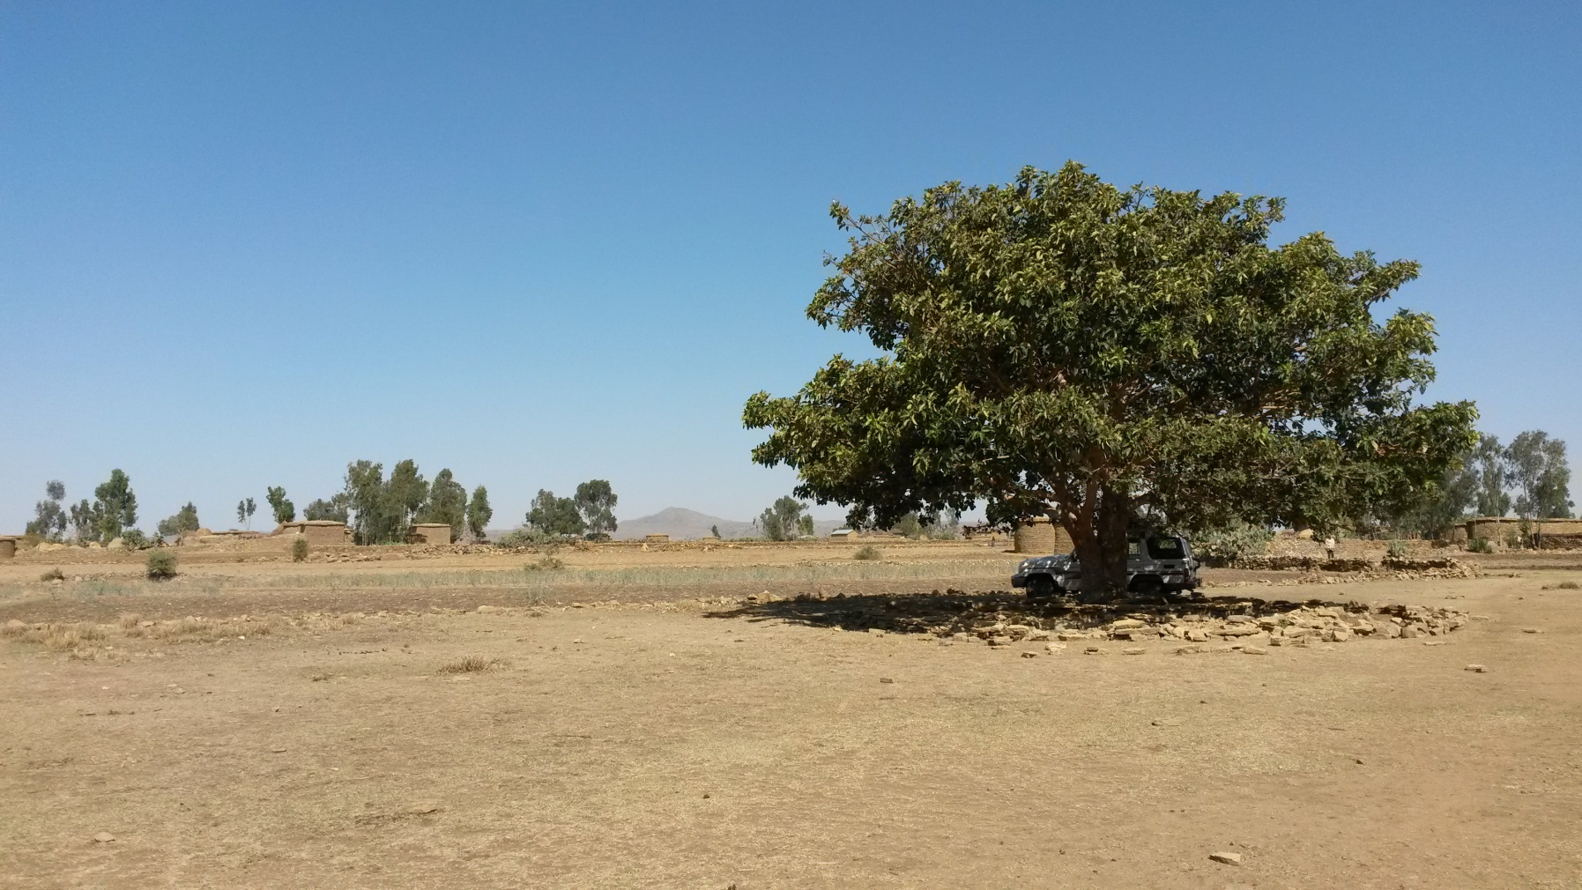
Protection During Travel

Slide 5
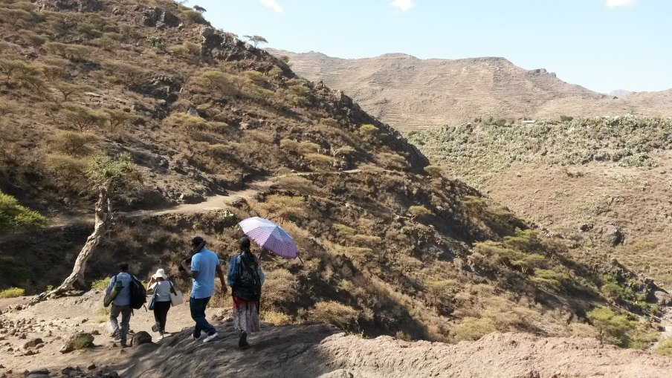
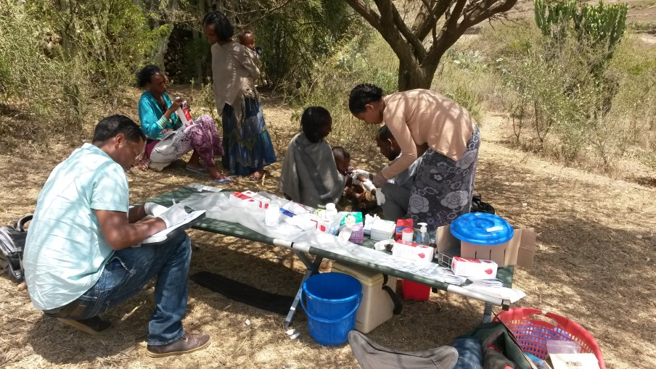
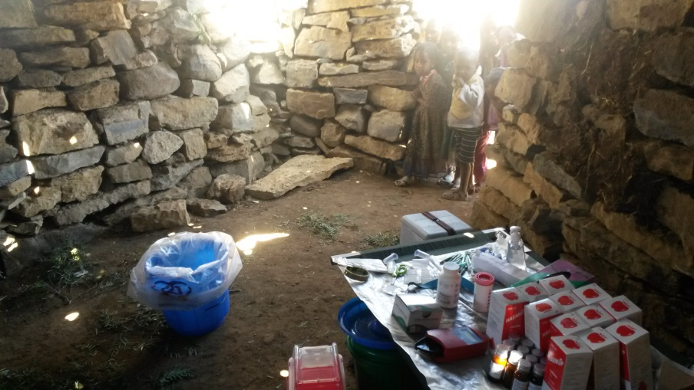
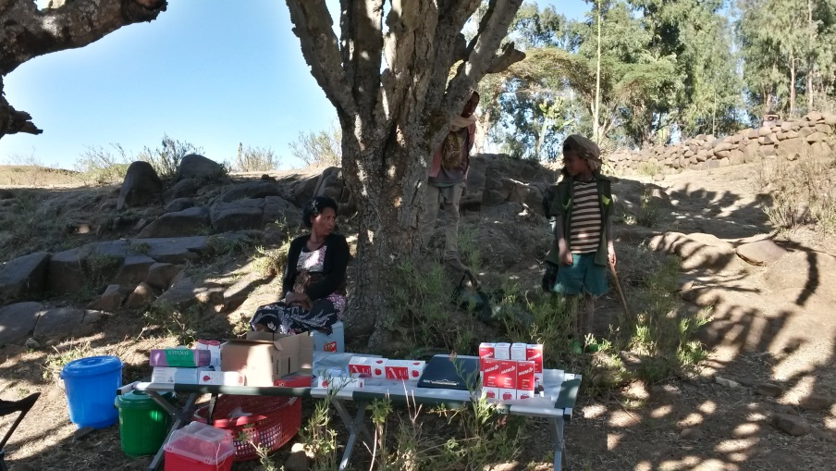
High-Risk Activity…
High-Risk for Infection!

Slide 6
Licensed Travel Vaccines in U.S.
Yellow Fever
Typhoid
Hepatitis A
Japanese Encephalitis
Cholera
Meningococcal
Rabies
Poliovirus
Influenza
Tetanus
Measles, Mumps, Rubella
Hepatitis B
Pneumococcal
Varicella
Tick-borne encephalitis
Anthrax
Smallpox
Tularemia

Slide 7
Organization of Lecture
Pathogen
Epidemiology/Geography
Clinical Presentation
Risk Assessment & Preventive Measures
Vaccine(s) Available
  Contraindications/Precautions
  Adverse Effects
  Efficacy

Slide 8
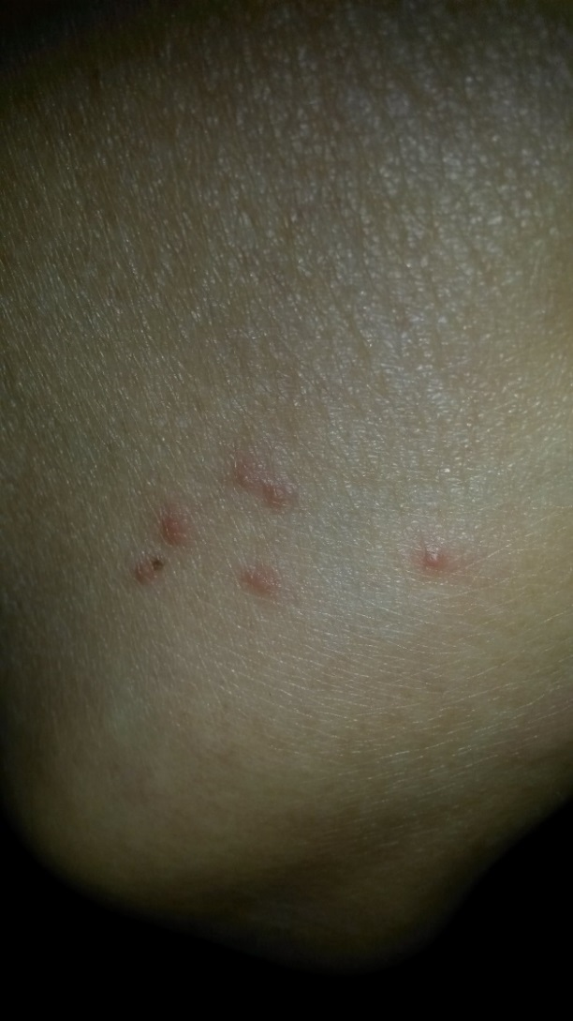
Beware of mosquito bites…

Slide 9
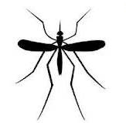
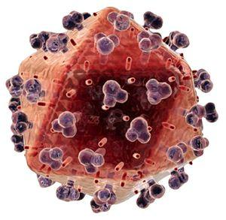
Yellow Fever virus
Caused by a Flavivirus
Transmitted by mosquito bite (Ae. aegypti)
YF causes 200,000 cases of clinical disease and 30,000 deaths each year¹
Substantial underreporting², due to rural nature
1. WHO. Yellow Fever fact sheet, no. 100
2. Weekly Epi Rec 1990; 65: 213

Slide 10
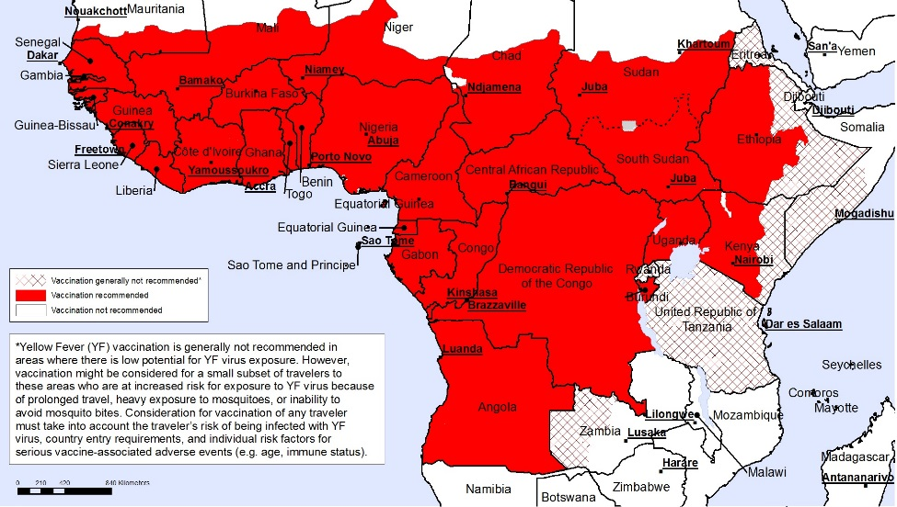
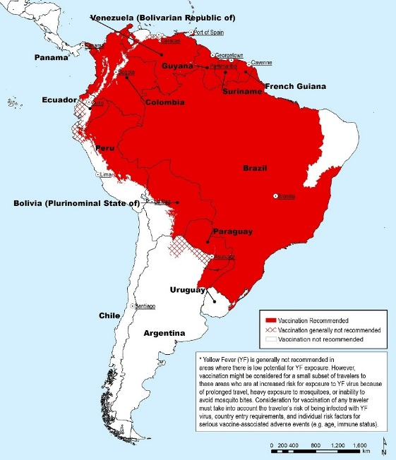
YF: Epidemiology
Geography
Sub-Saharan Africa
  87% cases and 50% case-fatality ratio
Tropical South America
  13% cases and 20% case-fatality ratio
Seasonality
All-year but peaks with mosquito breeding
South America: peak rainfall, humidity, temp = Jan-May
West Africa: late rainy season to early dry season = July-Oct
WHO YF Risk Maps, 2018

Slide 11
YF: Clinical Presentation
Majority of human infections are asymptomatic
But, spectrum can be mild to severe
Incubation 3-6 days
Initial stage: Abrupt Fever and severe Headache; non-specific flu symptoms
Recovery period or brief remission (viremia present): 1 day
Toxic phase (15%): F, N/V, myalgia, arthralgia, jaundice epigastric pain, renal insufficiency, and cardiovascular instability (viremia often not present)
  Multi-organ failure with bleeding diathesis.
  Case-fatality ratio 20-50%; especially with severe yellow fever with hepatorenal dysfunction

Slide 12
YF: Risk to Traveler
2-week stay for unvaccinated traveler:
West Africa 50 illnesses per 100,000
South America 5 illnesses per 100,000
YF: Prevention
Clothing barrier
Insect repellent (DEET)
Vaccination
There is no specific treatment, limited to supportive care

Slide 13
Globally Available YF Vaccines
Manufacturer: WHO pre-qualify:
Sanofi Pasteur, France 1987
Institut Pasteur de Dakar, Senegal 1999
Bio-Manguinhos, Brazil 2001
FSUE Chumakov, Russia 2009

Slide 14
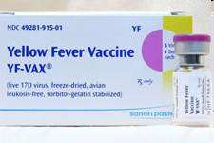
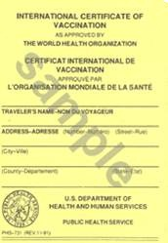
YF Vaccine in U.S.
YF-Vax® (sanofi pasteur)
Live, attenuated 17D-204 strain
Single parenteral dose, 0.5 mL
Approved: age ≥9 months
International Certificate of Vaccination
  valid beginning 10 days after the date of vaccination
International Health Regulations (IHR), since June 2016
WHO World Health Assembly in May 2014: lifetime (i.e., no booster doses necessary).
ACIP recommendations (Feb 26, 2015)
10 year boosters not required

Slide 15
Current Availability
“Sanofi Pasteur’s new state-of-the-art YF-VAX® (Yellow Fever Vaccine) production facility has been licensed by the U.S. FDA and the transition of production continues. We are currently reassessing the YF-VAX return to supply timing and will provide an update by the end of 2019.”
Sanofi Pasteur website, accessed 09 May 2019
https://www.sanofi.us/en/products-and-resources/vaccines/yellow-fever-vaccine-information

Slide 16
YF Vaccine: Contraindications
Hypersensitivity to vaccine components: egg/chicken proteins, gelatin, latex (vial stopper)
Prior anaphylaxis with vaccination
Immunedeficiencies
    symptomatic HIV, CD4 <200, malignant neoplasms, transplantation, etc.
Infants age <6 months
YF Vaccine: Precautions
Age 6-8 months or Age ≥60 years
Pregnancy and breastfeeding
Asymptomatic HIV and CD4 200-499

Slide 17
YF Vaccine: Safety and Adverse Effects
10-30% mild systemic reactions
    low-grade fever, headache, myalgia
Hypersensitivity
    1.8 cases/100,000 doses
Vaccine-associated Neurologic Disease (YEL-AND)
    3-28 d post-vax: Meningoencephalitis, GBS, bulbar/Bell palsy
    Overall: 0.8 cases/100,000 doses
    Age 60-69: 1.6 cases/100,000 doses
    Age ≥70: 2.3 cases/100,000 doses
Vaccine-associated Viscerotropic Disease (YEL-AVD)
    Viremia w/multi-organ involvement (63% case fatality)
    Overall: 0.4 cases/100,000 doses
    Age 60-69: 1.0 cases/100,000 doses
    Age≥70: 2.3 cases/100,000 doses

Slide 18
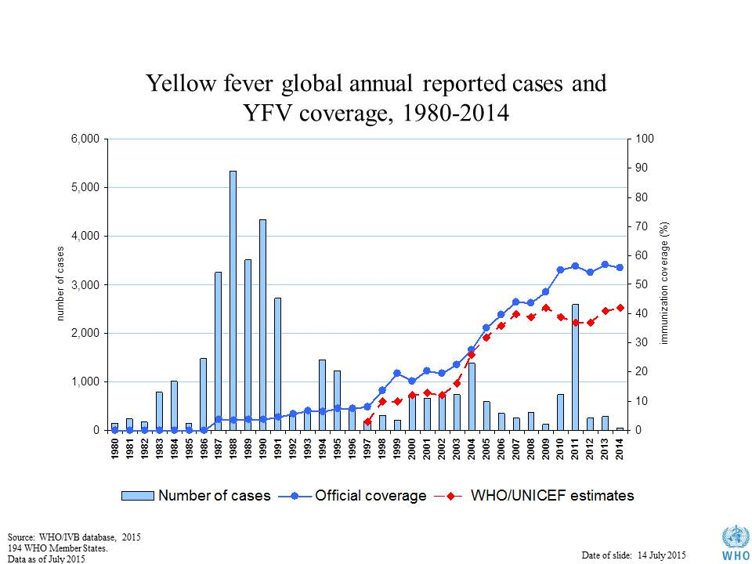
YF Vaccine: Protection
In endemic populations (assuming vaccine coverage of 60-80% of population):
  Within 10 d 80-100% immunity
  After 30 d ≥99% immunity¹
Among vaccinated travelers from industrialized countries: One case, non-fatal (Spain to West Africa, 1988)²
Vaccine Coverage
Case Count
1. MMWR 2010; 59: 1-27 & Vaccines, 5th ed: 2008: 959
2. Lancet 1989: 334:1275
Fig. WHO 2015

Slide 19
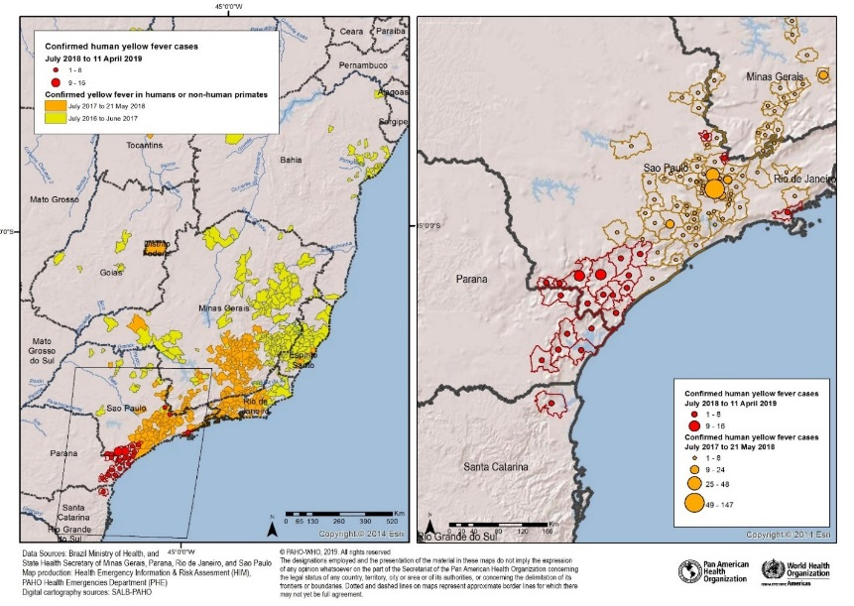
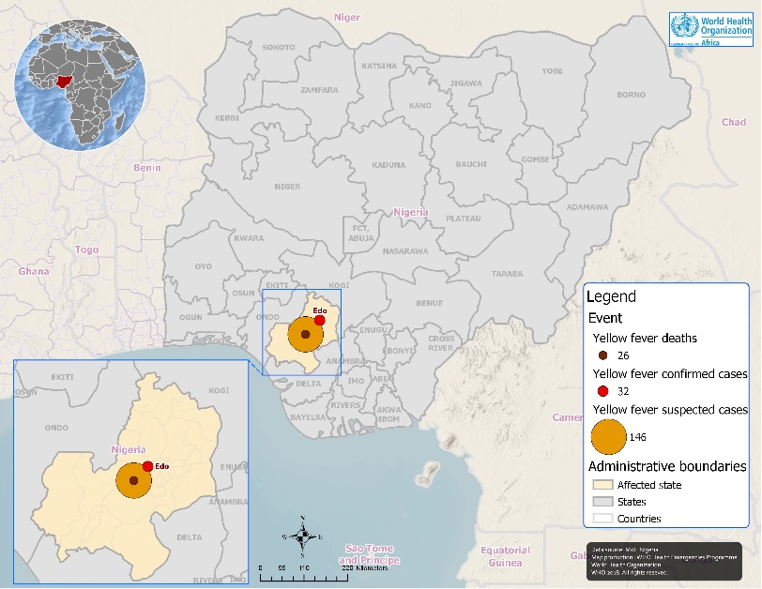
YF Outbreaks
Brazil
  Sao Paulo
Nigeria
  Edo state
WHOYF Risk areas, accessed 09 May 2019:
https://www.who.int/csr/don/18-april-2019-yellow-fever-brazil/en/
https://www.who.int/csr/don/09-january-2019-yellow-fever-nigeria/en/

Slide 20
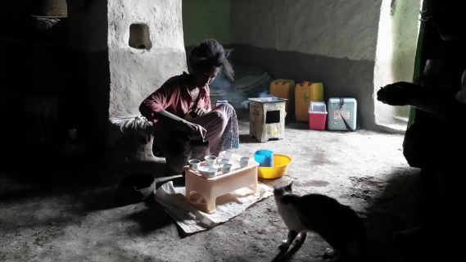
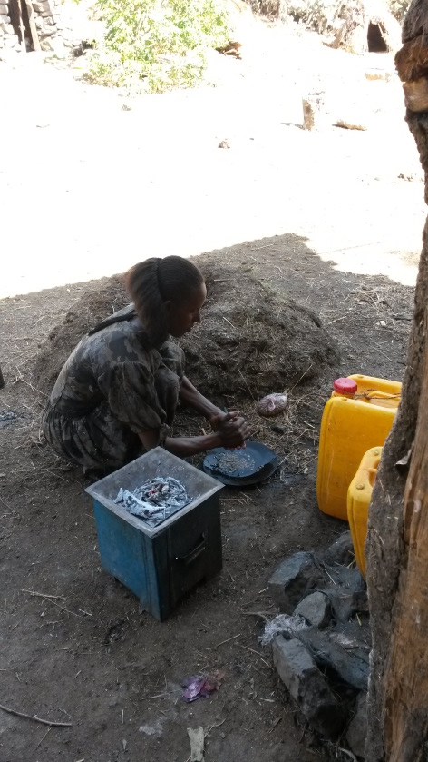
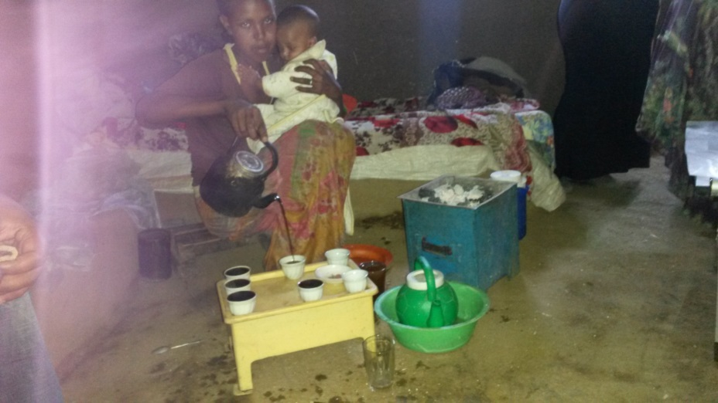
Beware of foodborne risk…

Slide 21


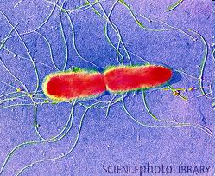
Enteric Fevers (Typhoid)
Human host-restricted bacterial pathogen
Salmonella enterica subspecies enterica serovar Typhi (S. Typhi)
  S. Typhi: 22M illnesses and 200,000 deaths per year
serovars Paratyphi A, B, or C (S. Paratyphi).
  S. Paratyphi: 6M illnesses
Nontyphoidal Salmonella (NTS) include: S. Enteriditis and S. Typhimurium
Transmission: fecal-oral
Bull WHO 2004; 82:346-353

Slide 22
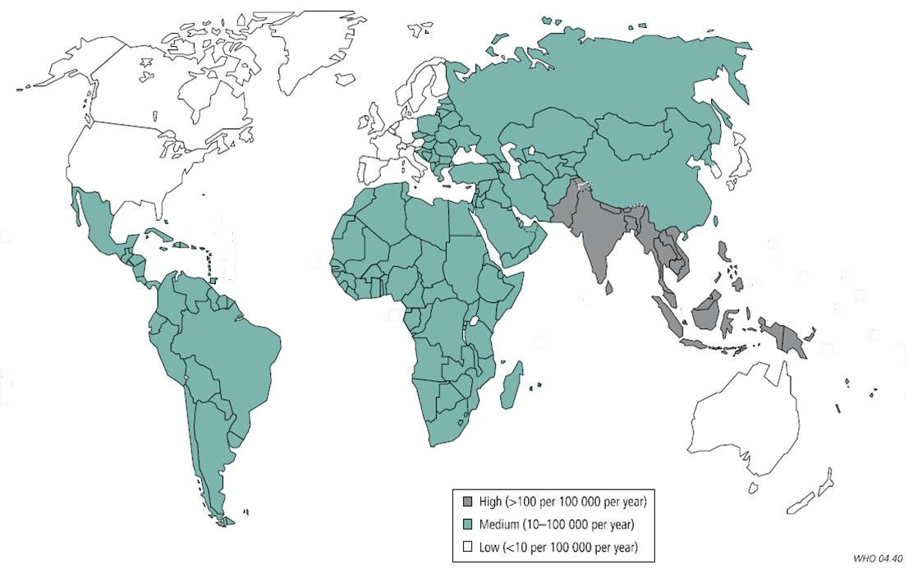
Typhoid: Epidemiology
Associated with poor sanitation and lack of access to clean water
World-wide distribution
    High Incidence >100 cases / 100,000 person years
    Medium 10-100 cases / 100,000 person years
Highest risk: Southern Asia (6-30x higher than other regions
No seasonality
Bull WHO 2004; 82:346-353

Slide 23
Typhoid: Clinical Presentation
Incubation 6-30 days
Insidious Onset: gradual fatigue and fevers (102-104°F); abdominal pain, headache, malaise, anorexia, chills
Without therapy: illness duration 3-4 weeks
Classic Presentation:
    1st week - stepwise fever w/ bradycardia (pulse-temp dissociation)
    2nd week - abdominal pain and “rose spots”
    3rd week – hepatosplenomegaly, intestinal bleeding, perforation
15% serious complications: Intestinal hemorrhage, perforation, peritonitis, septic shock
Chronic Carrier State: 1-6% infections; excrete organisms >1 year
    More common in women and those with cholelithiasis or abnormal biliary tract

Slide 24
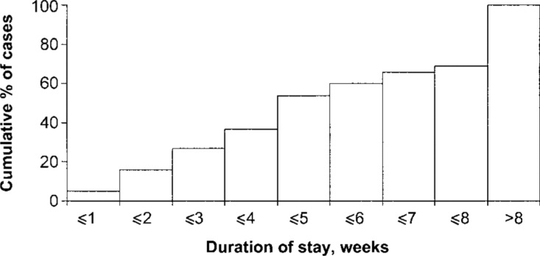
Typhoid: Risk to Traveler
CDC data, all travelers during 1994-1999:¹
  1027 typhoid cases, 3 deaths
  Risk associated with length of stay
  Risk associated with location
  53% Indian subcontinent
  17% Mexico/Central America
  7% Caribbean
  3% Africa
  4% other
CDC data, travelers to SE Asia during 2008-2011:²
  602 typhoid and 142 paratyphoid A cases
  5% typhoid cases and 20% paratyphoid cases were vaccinated
CID 2004; 39: 186-91
Vaccine 2014; 32: 3577-9

Slide 25
Typhoid: Prevention & Treatment
Prevention:
Safe food and water
Vaccination
Treatment:
Rehydration
Prompt Antibiotics
  First Line: Fluoroquinolones, 3rd Gen Cephalosporin, azithromycin
  Beware: FQ resistance in SE Asia!
  Beware: Growing global multi-drug resistance.
Surgery - ileal perforation
corticosteroids

Slide 26
Globally Available Typhoid Vaccines
Parenteral vaccine:
Typhoid Vi capsular polysaccharide
  TypBar & TypBar-TCV (Bharat), Typherix (GSK), Typhim Vi (SP), Shantyph (Shanta), Typho-Vi (BioMed), Zerotyph (Boryung, S. Korea), Typhevac (Shanghai)
Typhoid Vi conjugate (TT)
  Peda-typh (BioMed, India), Typbar-TCV (Bharat)
Combination: ViCPS+Hepatitis A
  Hepatyrix (GSK), Vivaxim (SP)
Oral vaccine:
Live Attenuated
  Vivotif (PaxVax)
*WHO Prequalified: December 2017

Slide 27
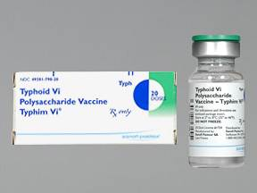
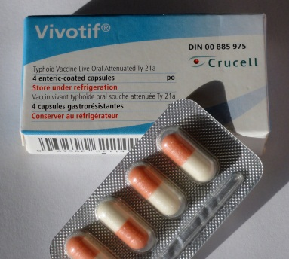
Typhoid Vaccines in U.S.
Typhim Vi® (Sanofi Pasteur)
Purified Vi capsular polysaccharide (Vi PS)
Single parenteral dose, 0.5 mL
Approved: age ≥2 years
Booster every 2-3 years
Vivotif® (Crucell-PaxVax-EBSI)
Live, attenuated bacterial strain (Ty21a)
4 oral doses, spaced alternating days
Approved: age ≥6 years
Booster every 5-6 years

Slide 28
Typhoid Vaccine: Contraindication/Precautions
Typhim Vi®
Hypersensitivity to vaccine components: typhoid polysaccharide, phenol, PBS
Prior anaphylaxis with vaccination
Delay for concurrent acute febrile illness
Vivotif®
Hypersensitivity to vaccine components:
Prior anaphylaxis with vaccination
Immunedeficiencies
Delay for concurrent acute febrile illness
Efficacy reduced with concurrent antibiotics

Slide 29
Typhoid Vaccine:
Safety & Adverse Effects
Typhim Vi®
  70-77% injection site pain, mild
  42% headache
  35% fatigue
  1% fever
Vivotif®
  6% abdominal pain
  6% nausea
  5% headache
  3% fever
  3% diarrhea
  <2% vomiting
  1% skin rash
  No transmission recorded
  No vaccinemia or reversion events reported

Slide 30
Typhoid Vaccine: Protection
Typhim Vi®
Nepal field trial (1986-88):¹
  75% protection against typhoid fever
South Africa field trial (1985-88):²
  55% protection against typhoid fever
India field trial (2004-6): ³
  61% protection
Meta-Analysis (2007): ⁴
  55% cumulative efficacy at 3 years
Vivotif®
  Egypt field trial (1978-81):⁵
  96% protection
Chile field trials (1982-87):
  59% protection, two-doses⁶
  67% protection, three-doses⁷
Indonesia field trial (1986-89):
  79% protection, three-doses⁸
Meta-Analysis (2007): ⁴
  51% cumulative efficacy at 3 years
  Protection in U.S. travelers using either vaccine (2008-11):⁹
80% vaccine efficacy
NEJM 1987; 317: 1101-4
Lancet 1987; 2:1165-9
NEJM 2009; 361: 335-44
Vaccine 2007; 25: 7848-57
JID 1982; 145: 292-5
Vaccine 1990; 8: 81-4
Lancet 1987; 1: 1049-52
Lancet 1991; 338: 1055–9
Vaccine 2014; 32: 3577-9

Slide 31
Typhoid Vaccine covers these serovars of “Enteric Fever”
Typhoid
Paratyphoid (S. Paratyphi A, B, and C)
Non-typhoidal Salmonella
  S. Enteritidis
  S. Typhimurium
  S. Dublin
  S. Choleraesuis
  S. Heidelberg
  S. Newport
  Others…

Slide 32
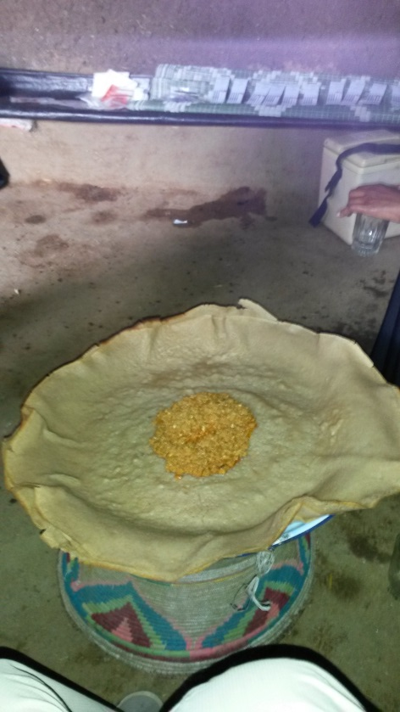
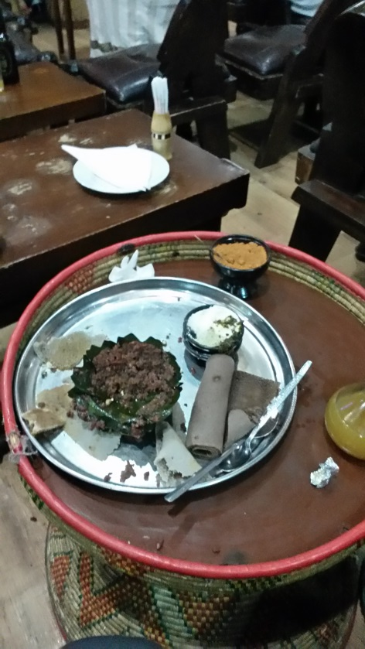
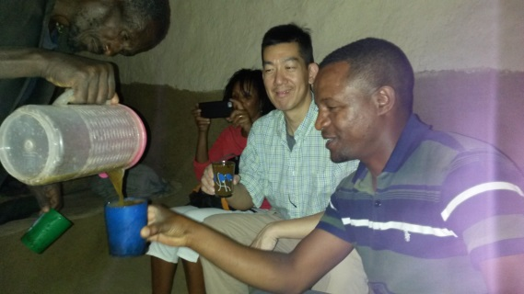
Beware of additional risks with ingestion…

Slide 33

Hepatitis A Virus
Positive-stranded RNA virus
  Picornaviridae family, Heparnavirus genus
Primarily human host-restricted pathogen
  Some non-human primate sp. hosts
Single serotype
  4 genotypes, but not important for biology
Transmission: fecal-oral

Slide 34
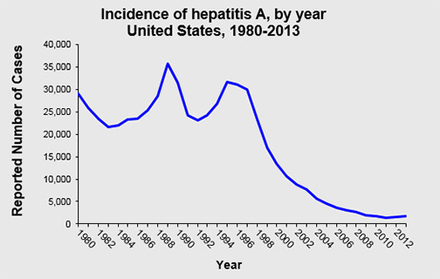
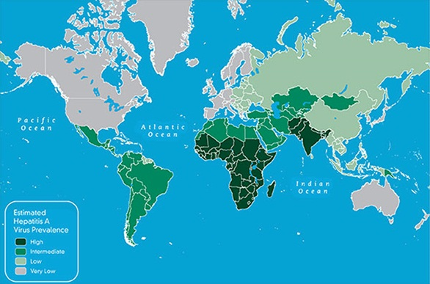
HAV: Epidemiology
Associated with poor sanitation and hygiene
Decline in U.S. with vaccination
World-wide distribution
Highest risk:
    Sub-Saharan Africa, South Asia
Intermediate risk:
    Central & South America
No seasonality
CDC Statistics & Surveillance
CDC 2005 data

Slide 35
HAV: Clinical Presentation
Incubation period: average 28 days (range 15-50 days)
Age <6 years: majority asymptomatic, 10% jaundice
Older than 6 yrs: >70% jaundice
Abrupt Clinical Illness:
  Fever, fatigue, loss of appetite, nausea, vomiting, joint pain, abdominal pain, dark urine, clay-color stools, jaundice
Duration: usually 2 months, 10-15% prolonged/relapsing up to 6 months
Case-Fatality: Overall 0.3% (1.8% for age >50 yrs)

Slide 36
HAV: Risk to Traveler
CDC, estimated HAV cases (endemic and travelers):¹
    2011 - 2700 cases
    2012 - 3000 cases
    2013 - 3500 cases
Swedish travelers (1997-2005),²
    636 travel-related cases
    East Africa, 14.1 cases /100,000 person months
    Middle East, 5.8 cases /100,000 person months
    Indian subcontinent, 5.6 cases/ 100,000 person months
    Risk highest among those Visiting Friends & Relatives (VFR)
Dutch travelers (2003-2011),³
    2094 total cases, 931 (44%) from travel
    Attack rate during 2003-2005, 7.5 per 100,000 travelers
    Attack rate during 2009-2011, 3.5 per 100,000 travelers
1. CDC Statistics & Surveillance 2. J Travel Med 2009; 16:233-8 3. J Travel Med 2015; 22: 208-11

Slide 37
Globally Available HAV Vaccines
Inactivated vaccines:
Monovalent
  Avaxim (SP), Havrix (GSK), Vaqta (CSL/Merck)
Combination: HAV+ViCPS
  Hepatyrix (GSK), Vivaxim (SP)
Combination: HAV+HBV
  Twinrix (GSK)
Live Attenuated vaccine:
  H2 & L-A-1 strains (China)

Slide 38
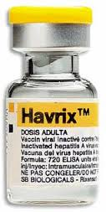

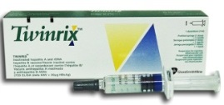
HAV Vaccines in U.S.
Havrix® (GSK) | Vaqta® (Merck) | Combined A/B Twinrix® (GSK)
inactivated | inactivated | inactivated
Approved since 1995 | Approved since 1996 | Approved since 2001
Adults: 1 mL IM at 0 & 6-12 m | Adults: 1 mL IM at 0 & 6-18 m | Adults: 1 mL IM Children: not “approved”
Children (1-18 y): 0.5 mL IM at 0 & 6-12 m | Children (1-18 y): 0.5 mL IM at 0 & 6-18 m | Standard Dosing: 0, 1, 6 m Accelerated: Dosing: 0, 7, 21-30d; 12 m
Since 2006, routine vaccination of children age ≥1 year*
* MMWR 2006; 55: RR-7

Slide 39
HAV Vaccines:
Contraindications/Precautions
Prior anaphylaxis with vaccination
Hypersensitivity to a vaccine component: viral antigen, aluminum hydroxide adjuvant, neomycin
Latex, vial stopper and syringe plunger
No special precautions for the immunocompromised

Slide 40
HAV Vaccines:
Safety & Adverse Effects
Adults:
Injection site soreness (56%)
Headache (14%)
Malaise (7%)
Children:
Injection site soreness (15%)
Feeding problems (8%)
Headache (4%)
Injection site induration (4%)

Slide 41
HAV Vaccines: Protection
Protective antibodies:¹
  First dose, ≥94% adults and ≥97% children
  Second dose, 100% adults and children
Havrix® Thailand field trial:²
  Efficacy 94% (CI 79-99%) after 2 doses, 1 m apart
Vaqta® New York trial:³
  Efficacy 100% (CI 87-100%) after 1 dose
MMWR 2006; 55: RR-7
JAMA 1994; 271: 1328-34
NEJM 1992; 327: 453-7

Slide 42
HAV Vaccines: “off schedule”
Delayed second dose:
Adults, Two-dose, 18 months apart: 100% protective antibody after second dose¹
Children, Two-dose, 4-8 years apart: 100% protective antibody after second dose²
Vaccine 2003; 21: 3208-11
J Travel Med 2004; 11:120-1

Slide 43
Which is not a Flavivirus?
Chikungunya
Dengue
Tick-borne Encephalitis
West Nile
Yellow Fever
Zika

Slide 44
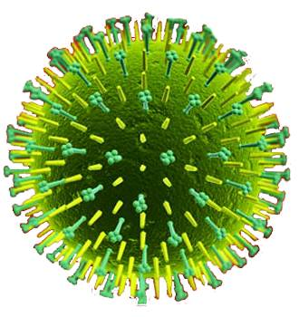
Japanese Encephalitis Virus
Caused by a Flavivirus
Transmitted by mosquito bite (Culex sp.)
JE is estimated to cause ~68,000 clinical cases each year¹
Most important cause of viral encephalitis in Asia and Western Pacific
Substantial underreporting², due to rural nature
1. Bull WHO 2011; 89:766-74
2. Vaccine 2000; 18: 1-25

Slide 45
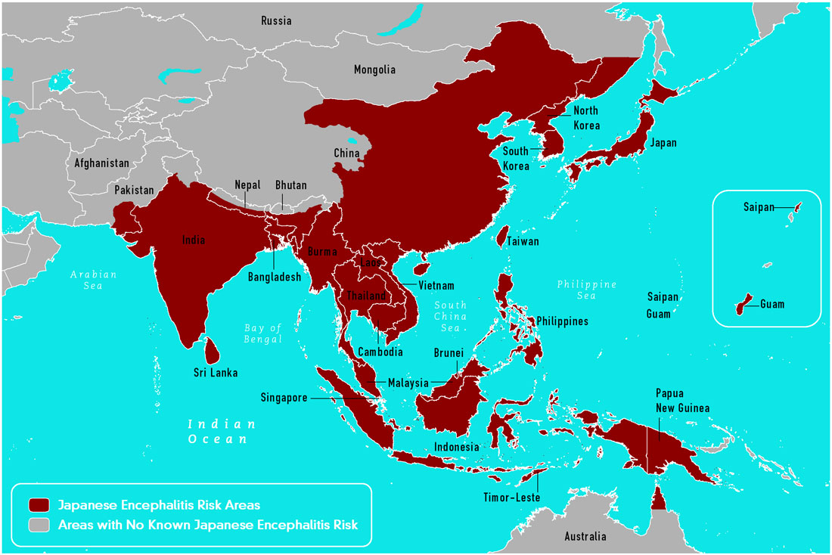
JE: Epidemiology
Geography
Asia & Western Pacific
  Rural agricultural areas (e.g., rice farming)
  20-30% case-fatality ratio
Seasonality
  Temperate: peaks summer and fall
  Tropics: all year with peaks during rainy (monsoon) season

Slide 46
JE: Clinical Presentation
<1% of JE infection develop clinical illness
~1 in 200 infections result in severe disease
Incubation 5-15 days
Initial stage: Fever, Headache, Vomiting
Progression to Severe disease (days): encephalitis, mental status changes, neurological symptoms, movement disorders, seizures (children especially), or death
Among those with encephalitis, 20-30% fatality
Among those recovering from acute illness, 30-50% survivors have residual neurologic, cognitive, or psychiatric symptoms

Slide 47
JE: Risk and Prevention
Risk
Endemic incidence, 1.8 cases per 100,000 residents
Estimated incidence among unvaccinated travelers to Asia <1 case per 1 million travelers
7 documented US traveler cases (1973-2011)
Prevention
Clothing barrier
Insect repellent (DEET)
Vaccination
There is no specific treatment, limited to supportive care
Bull WHO 2011; 89:766-74
CDC Yellow Book 2014

Slide 48
Globally Available JE Vaccines
Inactivated vaccine:
Vero cell, alum-adjuvanted (Intercell) – N. America, Australia, Europe
Vero cell (Beijing-1 strain) - Japan
Live Attenuated vaccine (Chengdu Inst. Biol Products):
SA₁₄-14-2 strain - China, India, Nepal, Korea, Sri Lanka, Thailand
Live Chimeric vaccine (SP):
YF 17D backbone - Australia & Thailand

Slide 49
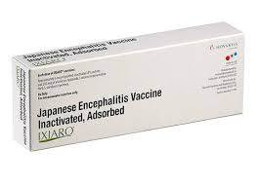
JE Vaccine in U.S.
Ixiaro® (Intercell-Valneva)
Inactivated, whole-virus
Vero cell culture-derived
SA₁₄-14-2 attenuated strain
Approved (2009):
  Age ≥3 years
  Two parenteral doses, 0.5 mL, spaced 28 days
  Age 2 months to <3 years
  Two parenteral doses, 0.25 mL, spaced 28 days
  Booster dose after 1 year
*JE-Vax (inactivated mouse brain-derived vaccine) is no longer produced, expired May 2011

Slide 50
JE Vaccine
Contraindications
Severe Allergic Reactions to vaccine components: protamine sulfate
Prior anaphylaxis with vaccination
Precautions
Hypersensitivity to vaccine components
Immunocompromised may have diminished protection

Slide 51
JE Vaccine: Adverse Effects
Adults:
Injection site pain (25%)
Headache (20%)
Myalgia (10%)
Better tolerated than JE-Vax
Children (1-3 years):
Fever (20%)
Infants (1-11 months):
Injection site redness (15%)
Fever (20%)
Irritability (15%)
Diarrhea (10%)

Slide 52
JE Vaccine: Protection
Thailand field trial of JE-MB¹
  Efficacy 91%
Taiwan, trial of JE-MB, 30-years experience
  Efficacy 97%²
  Incidence 1967 (pre-vaccination), 2.05 cases per 100,000³
  Incidence 2003, 0.11 cases per 100,000⁴
Neutralizing antibody (PRNT₅₀) of ≥1:10 is a reasonable surrogate of protection⁵
NEJM 1988; 319: 608-14 2. Vaccine 2006; 24: 2669-73
3. AJTMH 1999; 61: 78-84 4. Epi Rev 1999; 21: 73-86
5. FDA, 16 May 2013 and Vaccine 2005; 23: 5205-11

Slide 53
JE Vaccine: Accelerated Schedule & Booster Doses
October 2018: FDA approval of Accelerated Schedule
adult travelers (18-65 years old) may get 2 doses of Ixiaro 7 days apart.
Booster Doses
Current recommendation: single booster at 12-24 months
76 months (6.3 years) after booster dose, 96% (64 of 67) maintained PRNT Ab
Vaccine 2015; 33: 3600-04

Slide 54
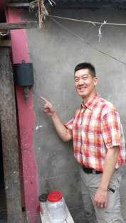
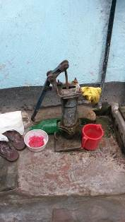
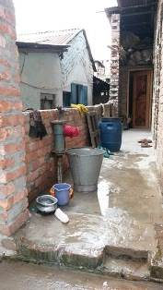
Beware of sewage contamination of your water…

Slide 55
Cholera
Vibrio cholerae
Serogroups O1 (and O139)
  Serotype Inaba or Ogawa
  Biotype El Tor or Classical
Rapidly dehydrating diarrhea
1.4-4.3 million cases and 28,000-142,000 deaths annually¹
Transmission: fecal-oral
WHO, July 2015

Slide 56
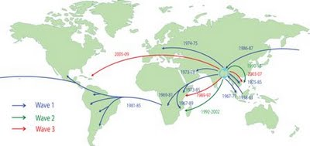
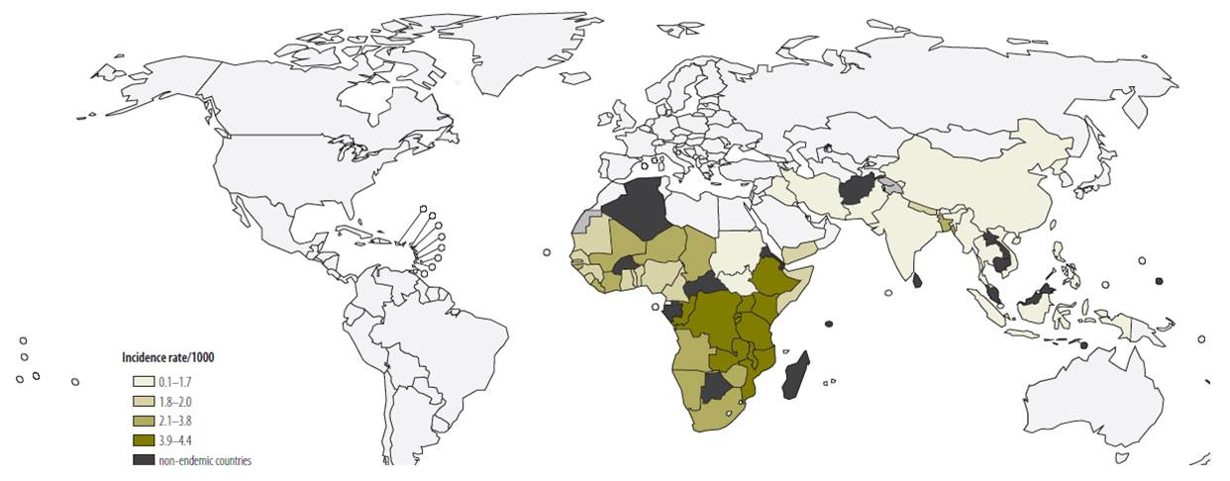
Cholera: Epidemiology
Pandemics
  Currently 7th (since 1961)
Epidemics
  Example: post-earthquake Haiti in 2010
Endemic
  Examples: India, Nigeria, DRC, Tanzania, Kenya, Ethiopia, Bangladesh
Ali, Bull WHO 2012; 90:209

Slide 57
Globally Available Cholera Vaccines
Oral inactivated monovalent
  Dukoral (Crucell)
Oral inactivated bivalent
  Shanchol (Shantha)
  Euvichol (EuBiologics)
Oral, live monovalent
  Vaxchora (PaxVax)

Slide 58
Cholera Vaccine in U.S.
Vaxchora (PaxVax)
Live, attenuated O1 classical Inaba strain (CVD 103-HgR
Single-dose
Approved age 18-64 years
Licensed June 10, 2016
ACIP Recommendation (June 22, 2016)¹
  “Cholera vaccine (CVD 103-HgR, Vaxchora™) is recommended for adult (18-64 years old) travelers to an area of active cholera transmission”
MMWR , Vol 66, No 18, 12 May 2017

Slide 59
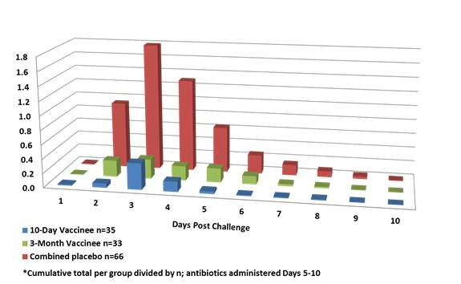
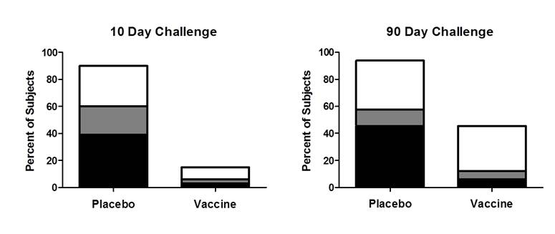
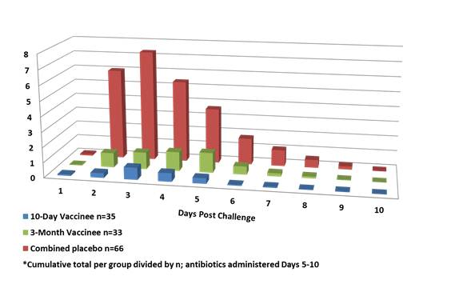
Cholera Protection
Primary Efficacy (Mod-Severe Diarrhea)
 | Vaccine 10-Day | Vaccine 3-Month
Vaccine Efficacy | 90.3% | 79.5%
95% CI | 62.7-100 | 49.9-100
Average Volume of Diarrhea
10 Day Challenge
3 Month Challenge
Average No. of Diarrheal Stools
Mild Diarrhea
Moderate Diarrhea
Severe Diarrhea
10-Day Vaccinee n=35
3-Month Vaccinee n=33
Chen, CID 2016
Combined placebos n=66

Slide 60
Cholera High-Risk Populations
Risk of Infection:
Travelers visiting friends and relatives
Long-term travelers (e.g., expatriates)
Travelers who do no follow safe food and water precautions and personal hygiene (e.g., adventure backpacking)
Healthcare, aid, relief, and response workers with direct contact with cholera patients
Risk of Poor Outcome with cholera:
Travelers without ready access to rehydration therapy and medical care
Blood type O
Pregnant
Immunocompromised
Chronic cardiovascular or renal disease

Slide 61
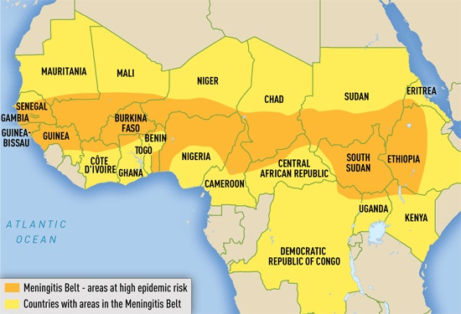
Meningococcal Meningitis
Neisseria meningitidis
6 major serogroups: A, B, C, W-135, X, and Y
Incidence: (cases/100,000 population)
  Americas, Europe, Australia 0.3-3/100K
  Sub-Saharan Africa 100-1000/100K
    “Meningitis Belt”
    Dry season (Dec – June)
    5-10% of population are carriers
    Serogroup A,C,X,W
CDC Yellow Book 2016

Slide 62
Meningococcal Vaccines in U.S.
Quadrivalent Conjugate (Menactra, Menveo)
Monovalent, group B (Bexsero, Trumenba)
Combination
  C, Y, Hib-TT (MenHibrix) does not contain serogroup A

Slide 63
Meningococcal Vaccines for Travel
To Saudi Arabia (within 3 yrs of travel)
Age >2 yr 1 dose, Quadrivalent vaccine
Age 3 m – 2 yr 2 doses, Men A containing vaccine
To endemic & hyperendemic area, during dry season
2 m – 55 yr Quadrivalent (MCV)
>55 yr Quadrivalent (MCV)
MMWR 2013; 62:1-22
CDC Yellow Book 2016

Slide 64
What about Measles?
For Travel:
Young Children 12 months and older should have 2 doses of measles vaccine, separated by at least 28 days
Infants 6-11 months should have a single dose of measles vaccine, then upon 1st birthday should receive 2 doses, at least 28 days apart
For adults, if cannot find documentation of 2 doses or of a positive measles titer, then it is okay to administer measles vaccine

Slide 65
ACIP References
Yellow Fever - MMWR 2015; 64: 647-650
Typhoid - MMWR 2015; 64: 305-308
Hepatitis A - MMWR 2007; 56: 1080-1084
Japanese Encephalitis - MMWR 2013; 62: 898-900
Cholera – MMWR 2017; 66: 482-485
Meningococcal - MMWR 2013; 62: 1-27

Slide 66
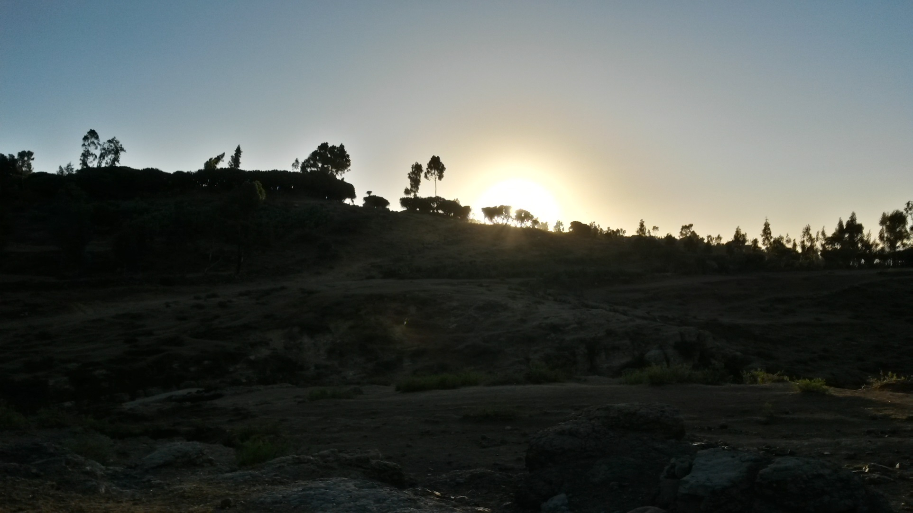
Safe Travel!

