Slide 1
Immunizations,
preventative health,
And
Your voice
Nathan Boonstra, md, faap
Twitter: @pedsgeekmd Facebook: fb.com/pedsgeekmd Blog: pedsgeekmd.com

Slide 2
objectives
Evaluate parental use of the internet and social media for medical information
Discuss the information gap that exists between public health and parents in the age of social media
Explore uses of social media to promote immunization and preventative health interventions
Review guidelines for advocacy using social media
I have no relevant disclosures to report.

Slide 3
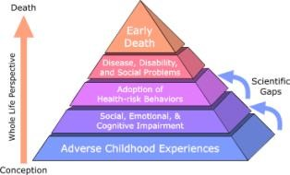
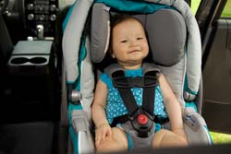
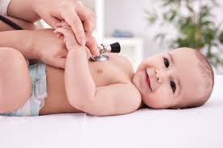
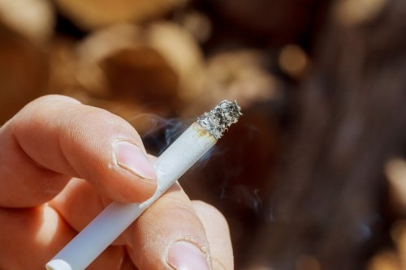
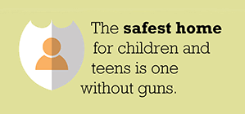
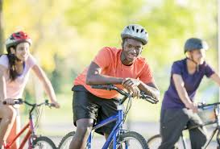
objectives
Evaluate parental use of the internet and social media for medical information
Discuss the information gap that exists between public health and parents in the age of social media
Explore uses of social media to promote immunization and preventative health interventions
Review guidelines advocacy using social media
I have no relevant disclosures to report.

Slide 4
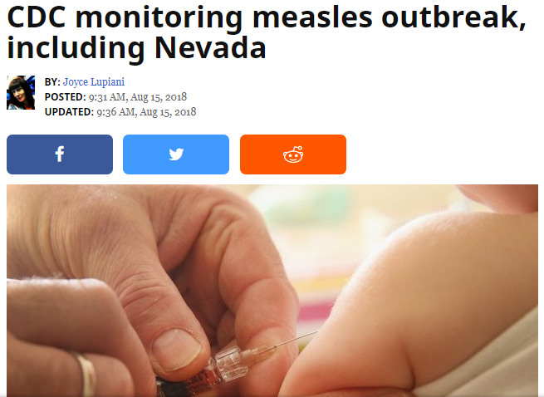

Slide 5
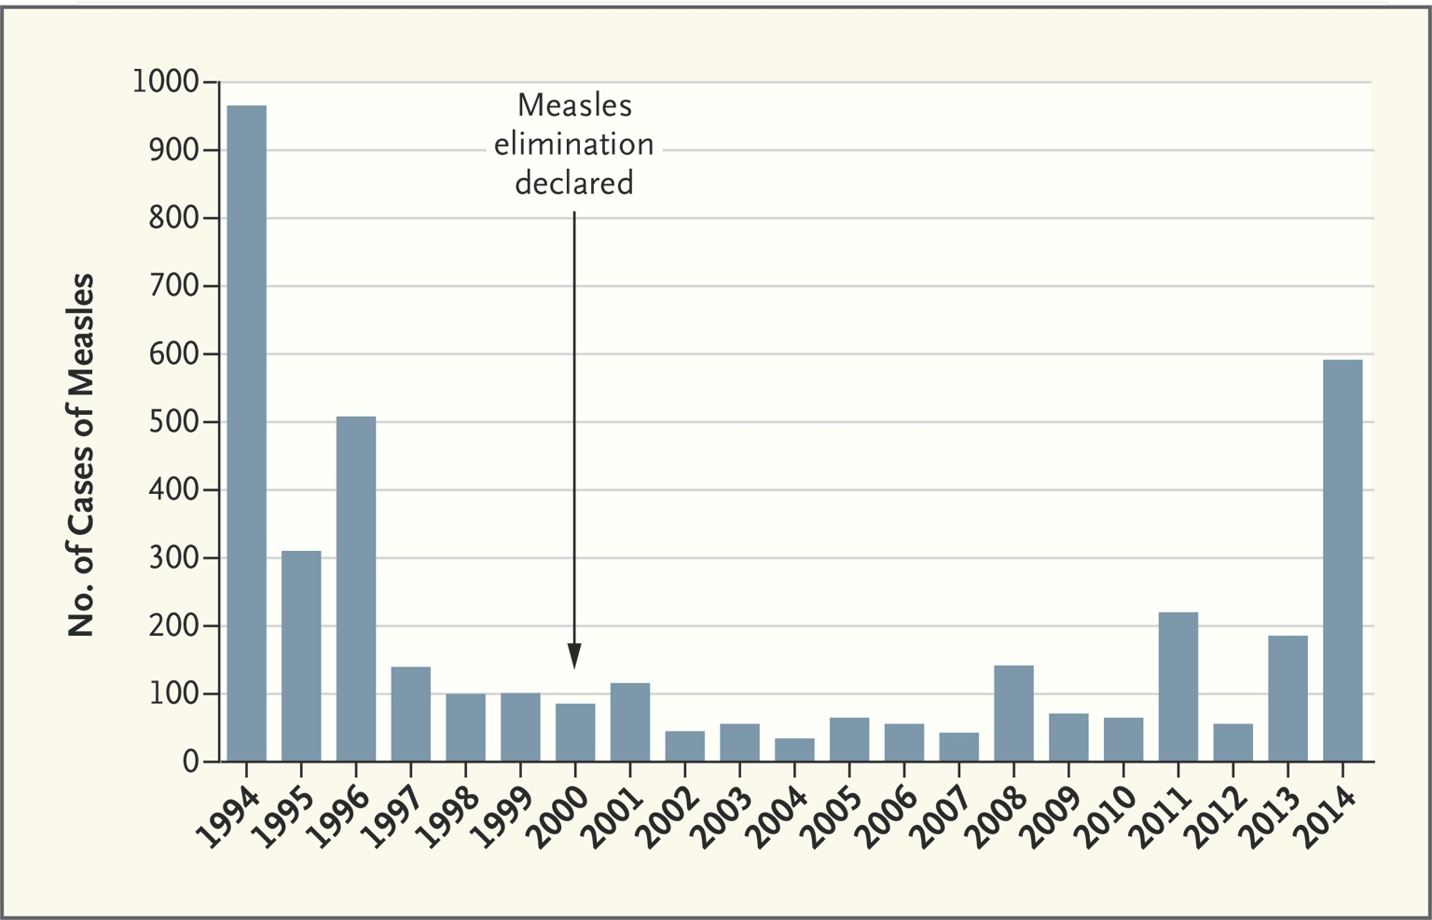
@edsgeekmd

Slide 6
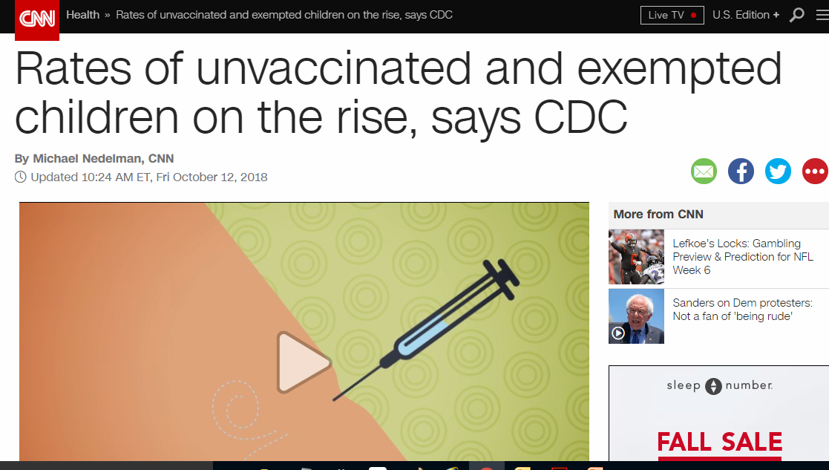

Slide 7
parents using online sources for medical information regarding their child
2001
Pew Internet Research
2013
Pehora, et al

Slide 8
public
search engines
university
or hospital sites

Slide 9
what are parents looking for?
food
drugs
shots

Slide 10
what are parents looking for?
shots

Slide 11
what are parents looking for?
28%
antivaccine

Slide 12
11%
of parents searched the internet
prior to ER visit
Wikipedia
WebMD
CDC
AAP (healthychildren.org)
Shroff et al, 2011
AAP poster presentation

Slide 13
“Online diagnosers”
Pew Internet Research, 2013

Slide 14
Safe
sleep
Searches
Chung et al, 2012

Slide 16
social media use
U.S. adults
66%
Parents
75%
Pew Internet Research, 2015

Slide 17
79%
useful
information
Pew Internet Research, 2015

Slide 18
42%
social-emotional
support
Pew Internet Research, 2015

Slide 19
31%
parenting
questions
Pew Internet Research, 2015

Slide 20
59%
useful, specific
parenting info
Pew Internet Research, 2015

Slide 22
75% use social media daily
51% more than once
Pew Internet Research, 2015

Slide 23
Internet Research
perceived
vaccine efficacy
perceived vaccine safety
perceived disease susceptibility
Jones et al 2012

Slide 24
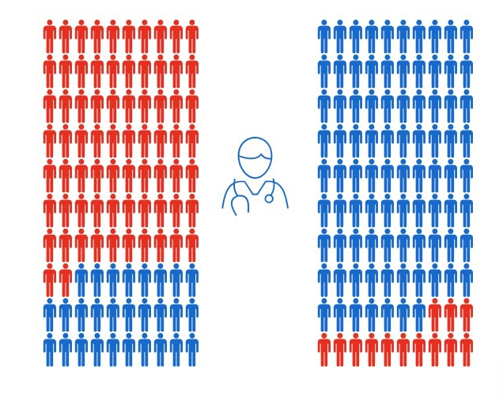
social networks
Brunson et al
2013
not vaccinating
vaccinating

Slide 25
social networks
Brunson et al
2013
not vaccinating
vaccinating

Slide 28
SiMPLE STEPS
Advocate for what you enjoy and are passionate about

Slide 30
SiMPLE STEPS
Advocate for what you enjoy and are passionate about
Find role models.

Slide 31
Get a Twitter account.
Go ahead…
I’ll wait.

Slide 32
SiMPLE STEPS
Advocate for what you enjoy and are passionate about.
Find role models
Advocate personally and publicly.

Slide 33
social networks
Brunson et al
2013
not vaccinating
vaccinating

Slide 34
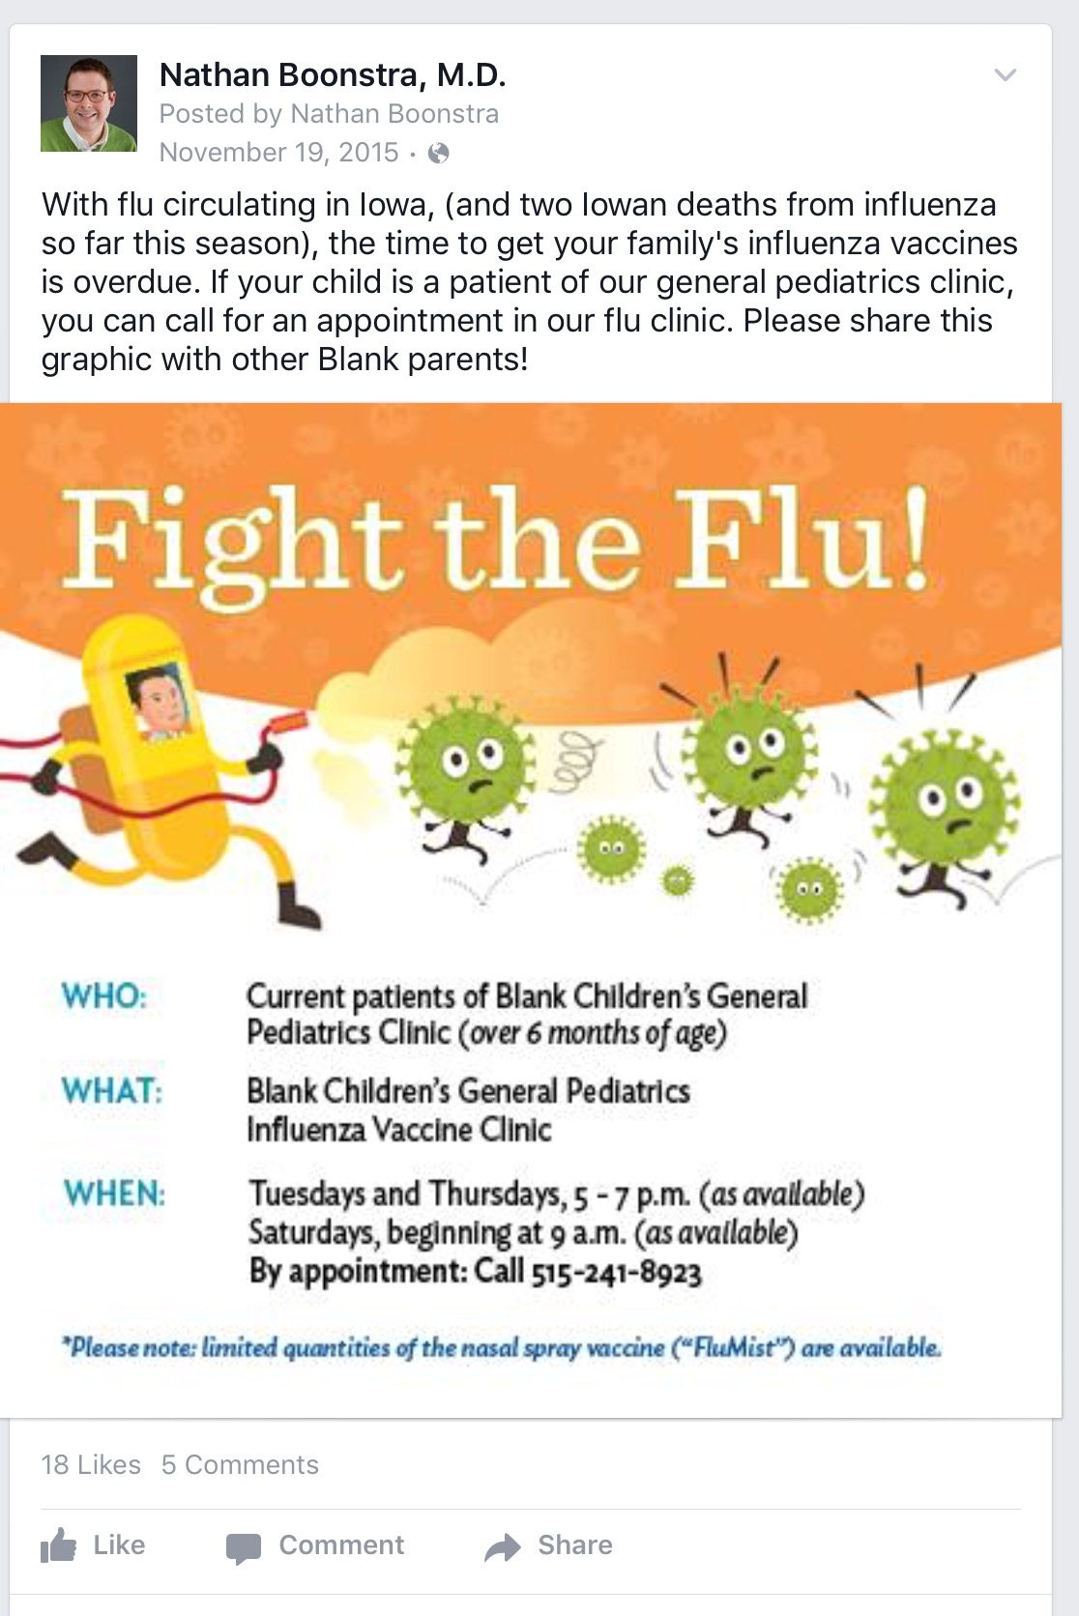

Slide 35
SiMPLE STEPS
Find role models
Advocate for what you enjoy and are passionate about.
Advocate personally and publicly.
You don’t have to be an prolific, eloquent author.

Slide 37
Twitter
Facebook
blogging

Slide 38
SiMPLE STEPS
Find role models
Advocate for what you enjoy and are passionate about.
Advocate personally and publicly.
You don’t have to be an prolific, eloquent author.
You don’t have to know every answer.

Slide 39
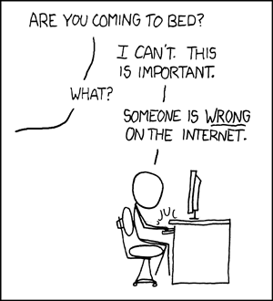

Slide 40
SiMPLE STEPS
Find role models
Advocate for what you enjoy and are passionate about.
Advocate personally and publicly.
You don’t have to be an prolific, eloquent author.
You don’t have to know every answer.
Use resources.

Slide 41
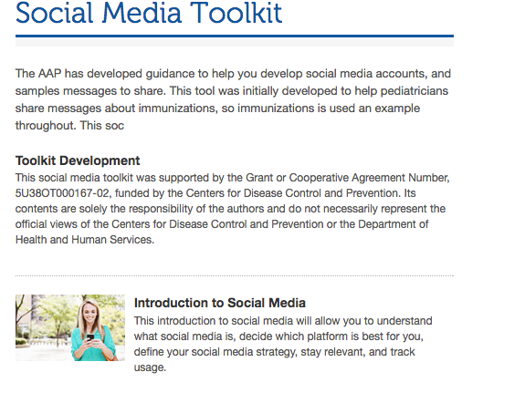
tinyurl.com/aapsmtoolkit

Slide 42
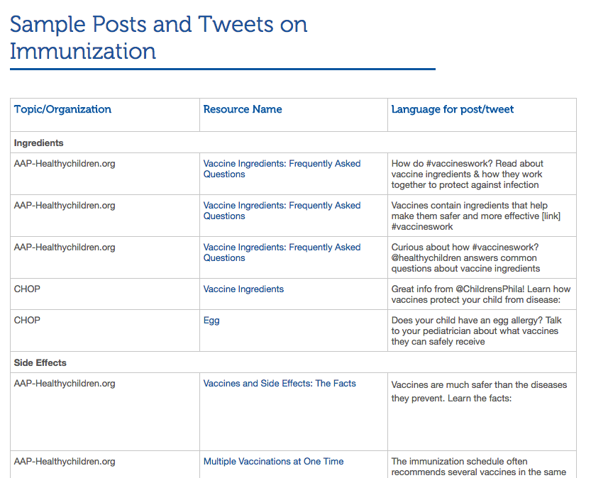

Slide 43
A few good GUIDELINES
Bring your expertise.
Adhere to the guidelines of your organization.
Be respectful.
Use a disclaimer.
Don’t diagnose or give specific patient instructions.
Always consider HIPAA.

Slide 44
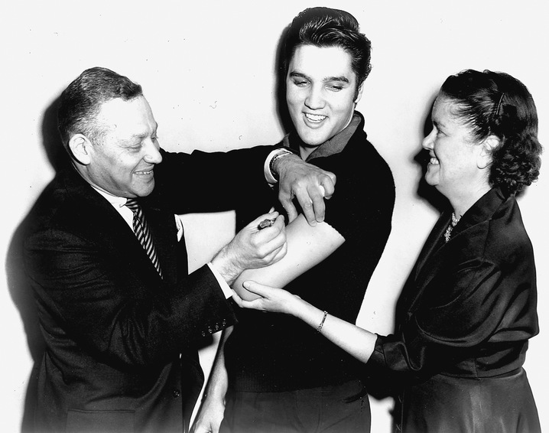
Thank you. Thankyouverymuch.
Twitter: @pedsgeekmd Facebook: fb.com/pedsgeekmd Blog: pedsgeekmd.com

