Slide 1
Healthcare Professionals and the Flu Vaccine: Best Practices for Reaching Healthy People 2020 Goals
Trudy Larson, MD
Professor and Dean, School of Community Health Sciences

Slide 2


Slide 3
What is the Problem?
Influenza is responsible for hospitalizations and deaths every year
Most healthy adults may be able to infect others beginning 1 day before symptoms develop and up to 5 to 7 days after becoming sick
  Some persons can be infected with the flu virus but have no symptoms. During this time, those persons may still spread the virus to others.
Certain people are at high risk of serious complications from the flu.
  Include chronic lung diseases, such as asthma and chronic obstructive pulmonary disease (COPD), diabetes, heart disease, neurologic conditions and pregnancy
Since health care workers may care for or live with people at high risk for influenza-related complications, it is especially important for them to get vaccinated annually

Slide 4
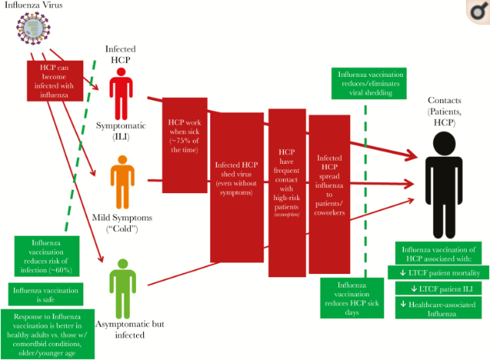

Slide 5
HCP Influenza Vaccination Outcomes
Prevent HCP from illness (and absenteeism)
Prevent transmission of influenza from HCP to patients and other HCP
Reduce hospital acquired influenza cases
Reduce morbidity and mortality of patients
  ILI (influenza like illness)
  Mortality
Adding other infection control measures improves effectiveness
  Reduce presenteeism (being present at work when ill)

Slide 6
How does HCP influenza vaccination work?
Studies have shown that HCP produce better immunity (better vaccine efficacy) than patients
  HCP generally healthy adults
  Patients often have conditions that make the effectiveness of influenza vaccine less robust (the elderly, those with chronic conditions, the young)
  Particularly important in long term nursing facilities with frail elderly
HCP vaccination reduces ILI and all cause mortality in patients
  ILI (influenza like illness) may be caused by many pathogens however influenza infection impacts respiratory tract integrity and may precede other infections
  Vaccination protects against influenza infection and disease (although not always with variable rates of effectiveness) but may be sufficient to provide a reduced risk to others

Slide 7
National Recommendations: ACIP
All persons older then 6 months should get an annual influenza vaccination
The Advisory Committee on Immunization Practices (ACIP) recommends that all HCP receive an annual flu vaccination
Biggest problem is figuring out the best way to make this happen

Slide 9
Immunization in Health Care Providers
Early-season flu vaccination coverage was higher among HCP whose employers required (88.4%) or recommended (65.1%) that they be vaccinated compared with HCP whose employer did not have a requirement or a recommendation regarding flu vaccination (29.8%). (data from 2017)

Slide 10
Immunization rates in Health Care Providers
Early-season 2017–18 influenza (flu) vaccination coverage among health care personnel (HCP) was 67.6%, similar to early-season coverage during the 2016–17 season (68.5%).
By occupation, early-season flu vaccination coverage was highest among pharmacists (86.4%), physicians (82.7%), nurses (80.9%), nurse practitioners/physician assistants (79.7%), and other clinical personnel (75.1%) and lowest among administrative and nonclinical support staff (61.0%) and assistants and aides (56.2%).

Slide 11
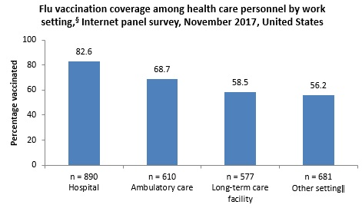

Slide 12
Immunization Rates in Health Care Providers
The most common reason reported for not getting vaccinated was fear of experiencing side effects or getting sick from the vaccine (22.1%).

Slide 13
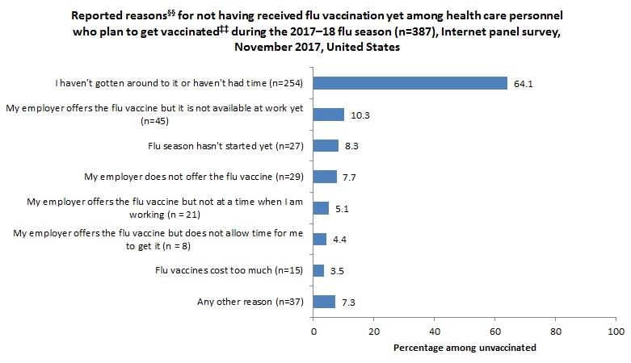

Slide 14
Table 1. Percentage of HCP with an employer requirement for vaccination and percentage of HCP vaccinated with and without an employer requirement for vaccination, by work setting,§ Internet panel survey, November 2017, United States
 |  |  | Percentage vaccinated among HCP with and without an employer requirement for vaccination
 | Percentage of HCP with an employer requirement for vaccination |  | Required | Not required
 | Unweighted n | Weighted % | Weighted % | Weighted %
Hospital | 653 | 66.9 | 89.0 | 69.7
Ambulatory care / Physician office | 282 | 41.7 | 91.2 | 52.5
Long-term care facility | 166 | 28.4 | 86.5 | 47.5
Other setting^{ǁ} | 170 | 22.4 | 85.2 | 47.8
Total | 1011 | 41.4 | 88.4 | 52.8

Slide 15
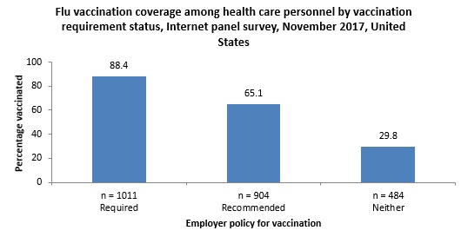

Slide 16
Success of Influenza Vaccine
One study in a children’s hospital: randomized, double blind, placebo control study
  Flu vaccination associated with 28% reduction in absenteeism from respiratory infections
3 year randomized, double blind , placebo control study:
  Vaccinated personnel had 29% fewer cumulative days of febrile respiratory illness and 53% fewer cumulative days of work absence
Studies in long term care facilities:
  Staff vaccination reduced all-cause mortality, influenza like illness and hospitalizations among patients
Acute care hospitals show inverse relationship between influenza vaccination and nosocomial infections (patients)

Slide 17
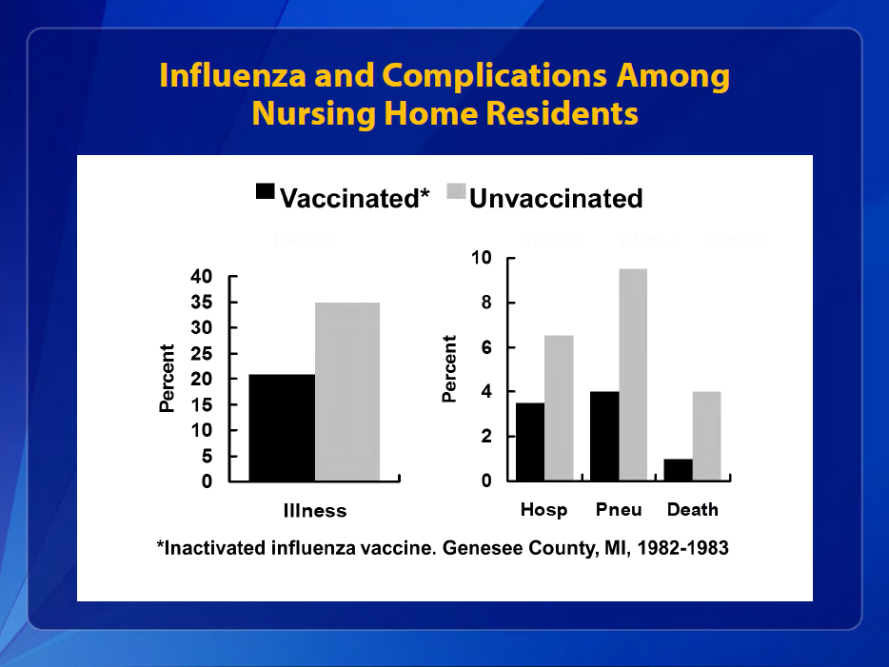

Slide 18
Interventions to promote flu vaccination among HCP each season
Employers should offer flu vaccination to HCP:
  At the worksite over multiple days and shifts,
  Free of charge, and with
  Active promotion.
Educational materials should be provided to address questions and misperceptions about flu vaccination benefits and risks.
Consider implementing mandatory influenza vaccine policies
  Access must be guaranteed
  Option for those who medically can’t get vaccine
  Long term planning needed: communication!!!!!

Slide 19
Instituting Mandatory Influenza Policies
Careful planning in advance is needed
  What does mandatory mean? What are the consequences?
  Educate all those who will be effected including direct and indirect health care employees
  Must reduce barriers to getting vaccine and plan for early season immunization
  Set up data measures
    Measurement and feedback of vaccination coverage are recommended by the Community Preventive Services Task Force
A big reason: Required by the U.S. Centers for Medicare and Medicaid Services (CMS) for acute care hospitals, ambulatory surgery centers, and outpatient dialysis facilities to report HCP influenza vaccination coverage rates for their facilities
AND it’s legal!

