Slide 1

Communications to Build Vaccine Confidence in Communities
Devon Greyson, PhD MLIS
Assistant Professor
University of Massachusetts
dgreyson@umass.edu
@DevonGreyson

Slide 2
Disclosures
I do not have an affiliation (financial or otherwise) with any pharmaceutical, medical device or communications organizations.
I do not intend to make therapeutic recommendations for medications that have not received regulatory approval (i.e. “off-label” use of medication).
The research presented here today has been funded by public (government) sources.

Slide 3



Vaccine Hesitancy
A Multidimensional Issue
Understanding Hesitancy in Context
The British Columbia Studies
Crafting Messages That Resonate
Techniques To Build Confidence

Slide 4

Vaccine Hesitancy
A Multidimensional Issue

Slide 5
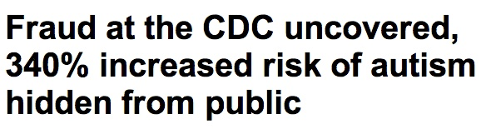
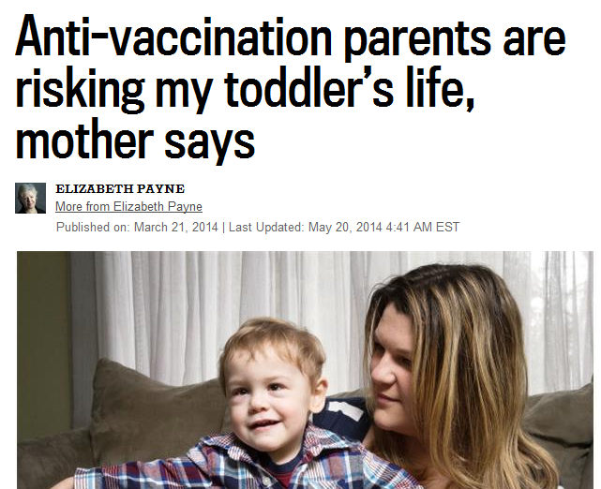

Role of Media in Promoting Hesitancy
“Our Girls Aren’t Guinea Pigs”
– Maclean’s, August 2007
“Parents ‘horrified’ after botched vaccination exposes six-year-old B.C. girl to HIV”
– National Post, October 2014
“Saying No to Vaccines: A Resource Guide for All Ages”
– Booklet by Dr. Sherri Tenpenny
“Non-vaccinating mother prefers immunity through disease exposure”
– Ottawa Citizen, May 2014
“Jenny McCarthy’s Shocking Vaccine Comments: Defying Doctors’ Advice?”
– Hollywood Life, April 2014

Slide 6
A Definition of Vaccine Hesitancy
Vaccine Hesitancy…
Refers to delay in acceptance or refusal of vaccines despite availability of vaccine services
Complex and context specific, varying across time, place and vaccine
Influenced by such factors as:
  Complacency
  Convenience
  Confidence
SAGE Working Group on Vaccine Hesitancy Final Report
www.who.int/immunization/sage/meetings/2014/october/SAGE_working_group_revised_report_vaccine_hesitancy.pdf?ua=1
MacDonald NE and SAGE Working Group on Vaccine Safety. Vaccine 2015; 33(34):4161-4

Slide 7
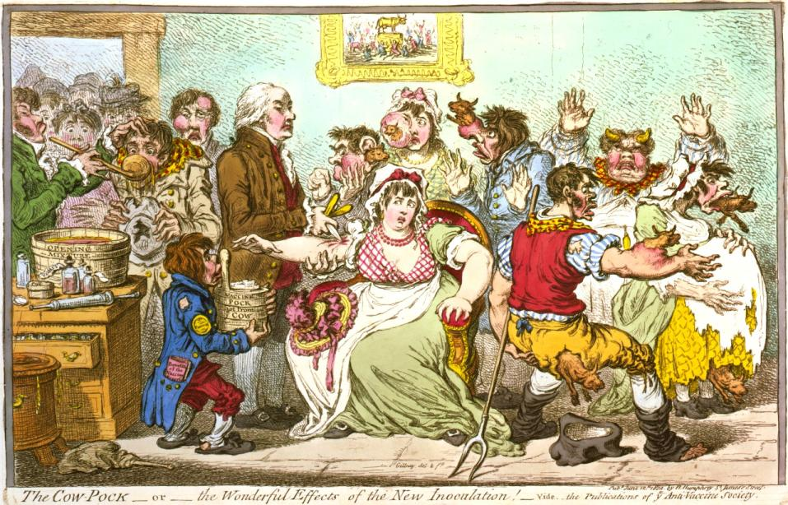
Vaccine Hesitancy
It’s as old as vaccination—since Jenner first scraped cow-pox blisters and inoculated people
James Gillray, Publications of the Anti-Vaccine Society, 1802
Library of Congress, Prints & Photographs Division, LC-USZC4-3147 (color film copy transparency), archival TIFF version (4 MB), converted to JPEG with the GIMP 2.4.5, image quality 88.

Slide 8
Hesitancy – Acceptance Continuum
Refusers
Partial Refusers
Serious Concerns
Minor Concerns
Acceptors

Slide 9

Hesitancy: The Stereotype

Slide 10



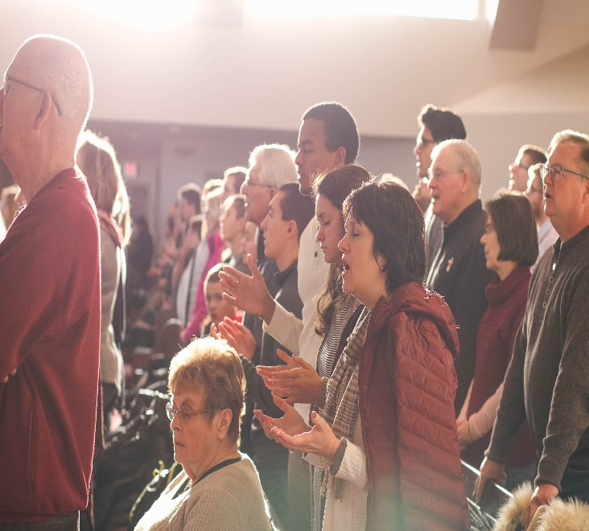

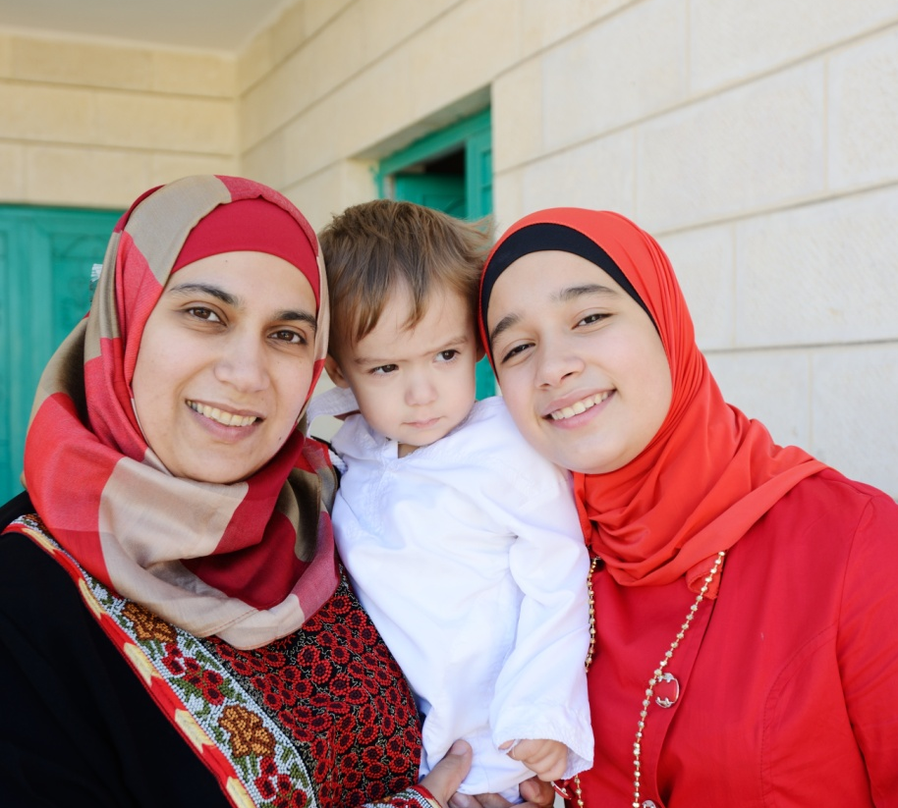
The Reality: Not All Hesitancy Is The Same

Slide 11
Context Matters
Context matters: measuring implementation climate among individuals and groups
– Jacobs et al., Implementation Science, 2014
Context matters: A community-based study of urban minority parents’ views on child health
– Bolar et al., Journal of the Georgia Public Health Association, 2016
Context matters in programme implementation
– Clarke et al., Health Education, 2010
Exploring which context matters in the study of health inequities and their mitigation
– Edwards & Di Ruggiero, Scandinavian Journal of Public Health, 2011

Slide 12

Understanding Hesitancy
In Context
The British Columbia Studies

Slide 13
Example: British Columbia
AK
Yukon Territory
Northwest Territories
British Columbia
Alberta
Saskatchewan
WA
MT
OR
ID
WY

Slide 14

Example: British Columbia

Slide 15
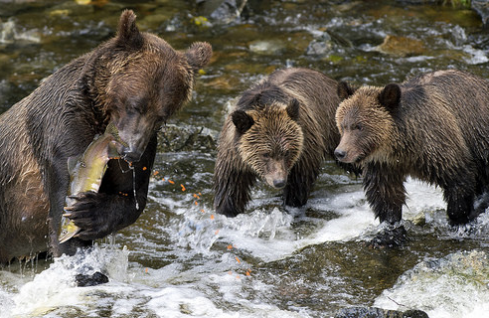
Example: British Columbia

Slide 16

Example: British Columbia

Slide 17
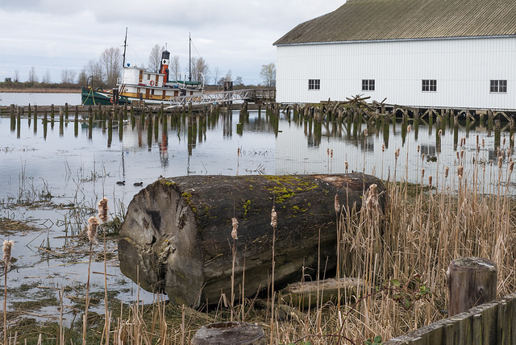
Example: British Columbia

Slide 18
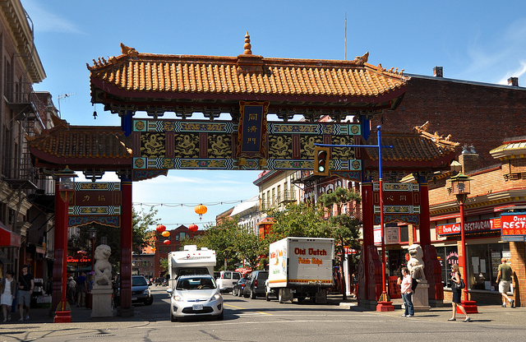
Example: British Columbia

Slide 19
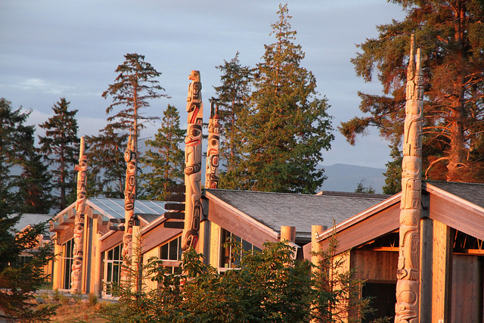
Example: British Columbia

Slide 20
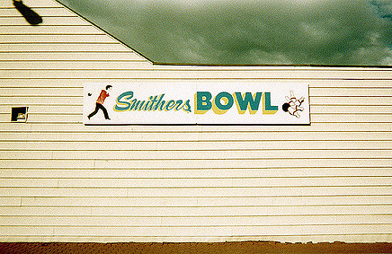
Example: British Columbia

Slide 21
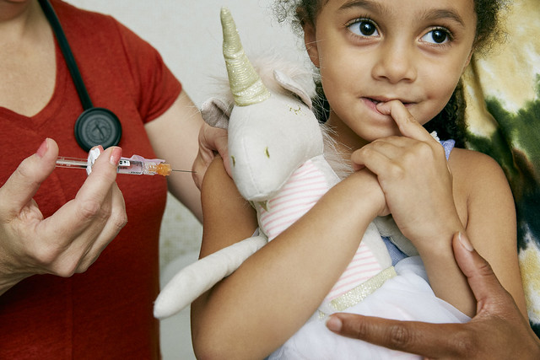
CONSIDER: Who are the un- and under-vaccinated groups in your community?

Slide 22

Hesitancy Studies: Parents
Pregnant women and new mothers about flu shots
Mothers & fathers from pregnancy to toddlerhood in Greater Victoria
Mothers of infants under 6 months in Fraser Health region
Mothers of children up to 6 years in Greater Vancouver across the hesitancy spectrum
Mothers of primary school children (age 6-12) in Greater Vancouver who changed their minds

Slide 23
Hesitancy Studies: Providers
Family Doctors and Nurses who vaccinate
Survey of Registered Midwives
Interviews with a variety of maternity care providers

Slide 24
Hesitancy Studies: Policy
Survey of public and parents’ attitudes about policies to increase childhood vaccination
Examination of policies and how they’ve worked (or not) in various contexts around the world.

Slide 25

What Matters for Vaccine Confidence?
Key Findings

Slide 26

What Matters for Vaccine Confidence?
Healthcare providers (including alternative providers)

Slide 27
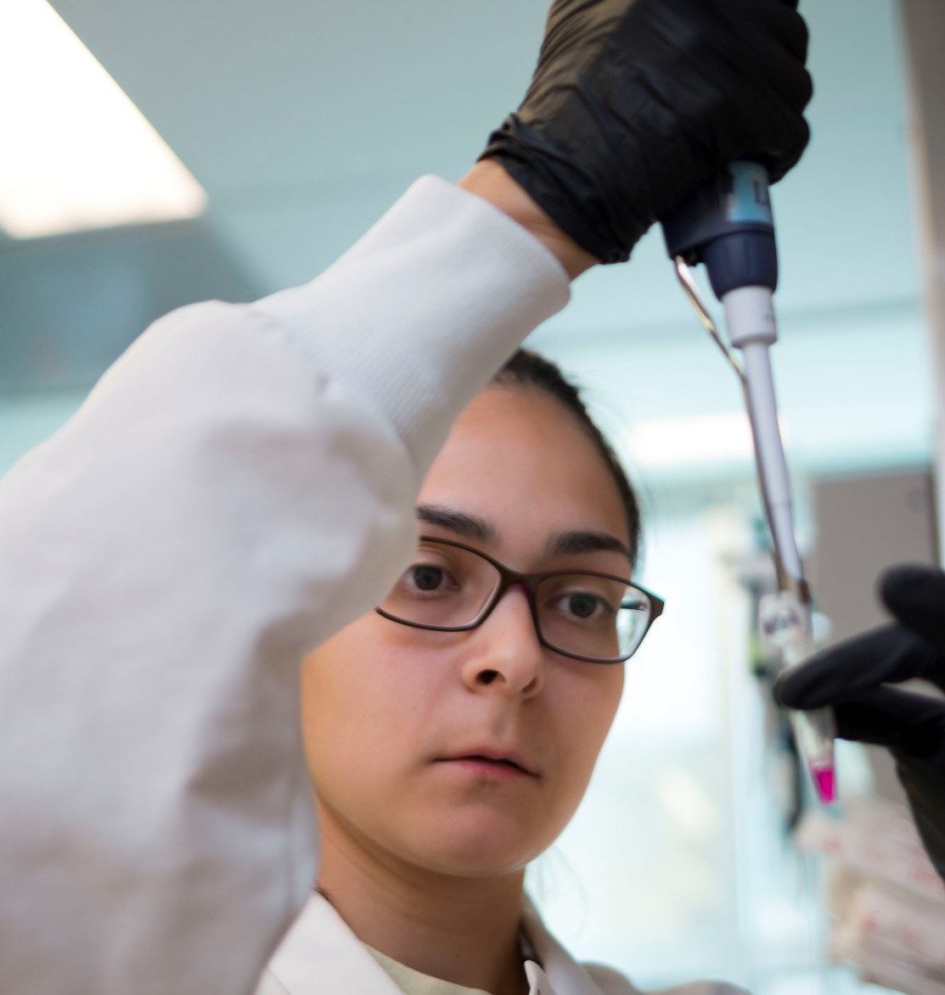
What Matters for Vaccine Confidence?
Scientific evidence

Slide 28

What Matters for Vaccine Confidence?
Consistent and stable health care

Slide 29
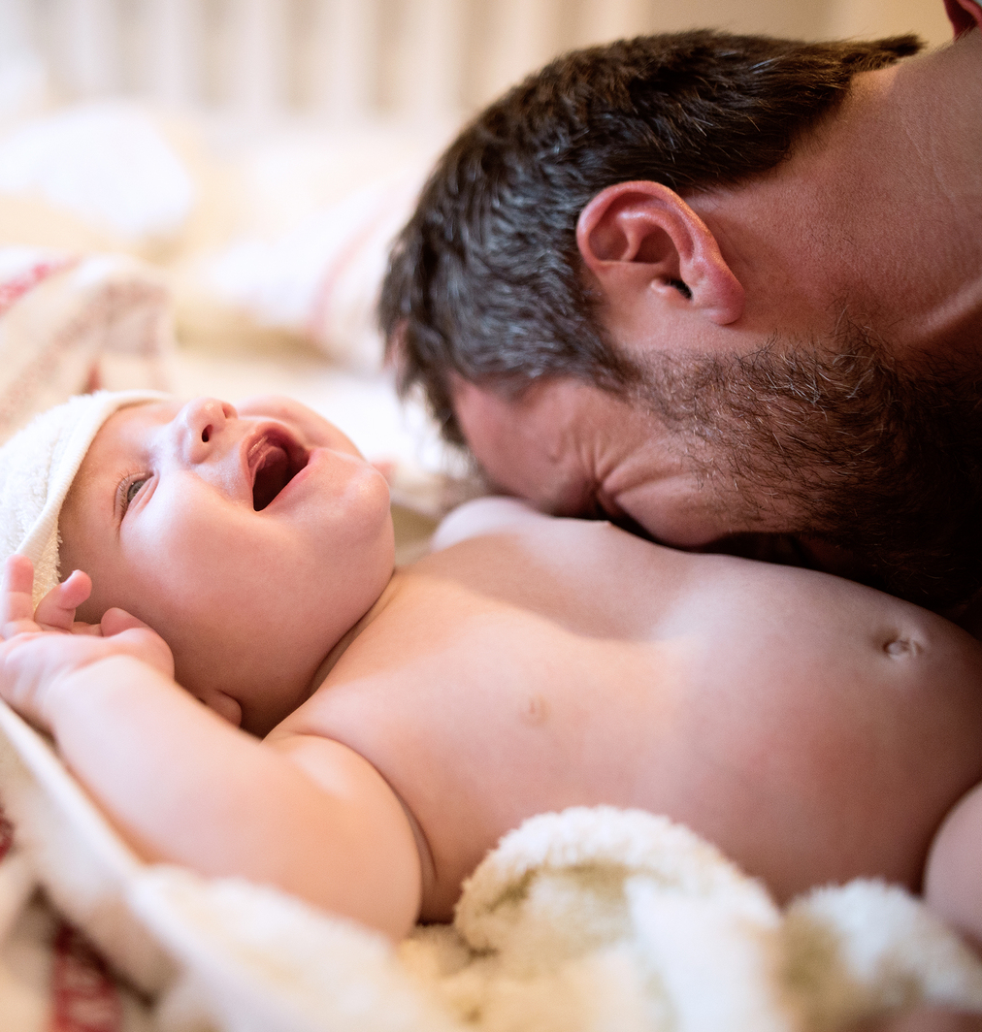
What Matters for Vaccine Confidence?
Fathers and Coparents

Slide 30
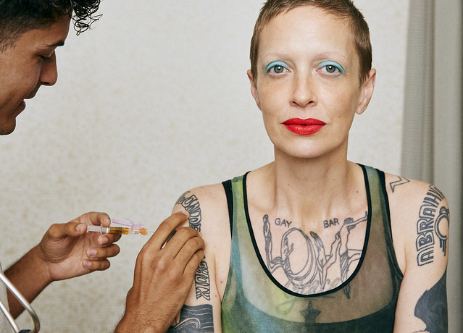
CONSIDER: Who are their trusted information sources for undervaccinated members of your community?

Slide 31

Crafting Messages
That Resonate
Techniques To Build Confidence

Slide 32

1: Emphasize the Pro-Social

Slide 33
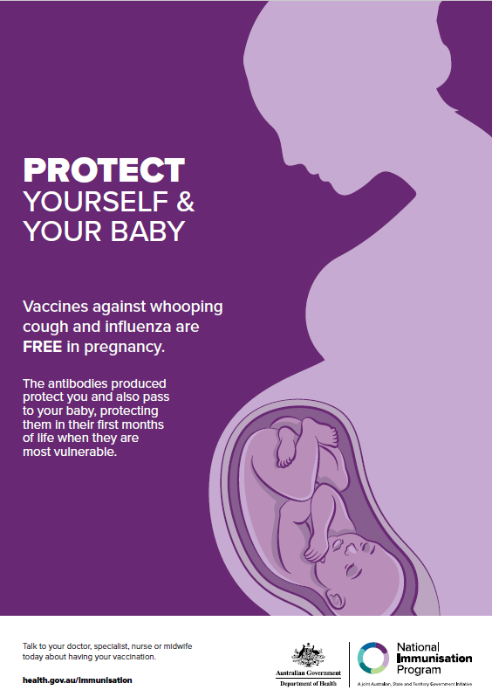
Pro-Social Strategy In Action:
To the Parent of the Unvaccinated Child Who Exposed My Family to Measles
  When your child gets sick, others are endangered—including my daughter with cancer.
— Tim Jacks, for Mother Jones
Magazine, February 2, 2015

Slide 34

2: Be Ready With Good Scientific Answers

Slide 35
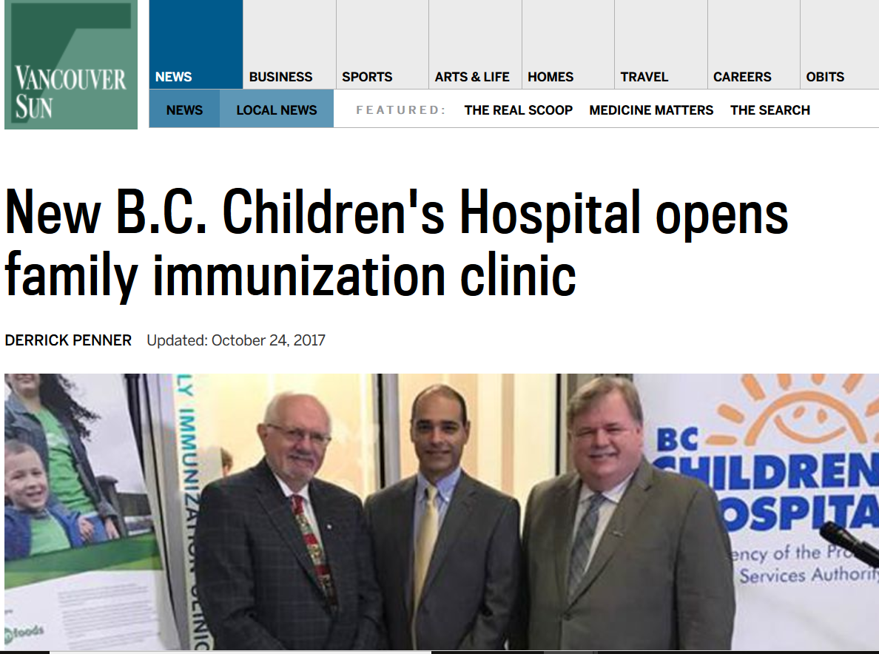
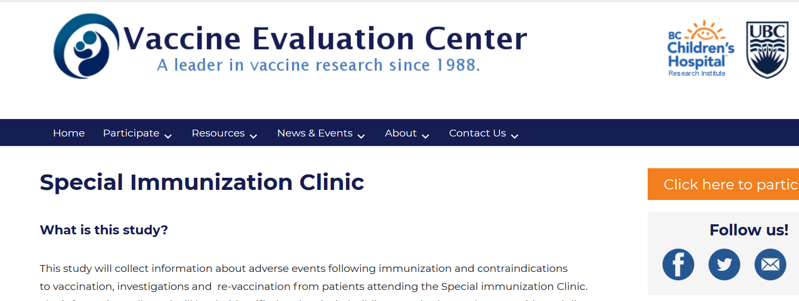
A Source of Answers for B.C.
Established in 2017 at the B.C. Children’s Hospital
Source for information, including answers to unusual questions
Access for concerned parents

Slide 36

3: Build Alliances
CAM – Contemporary and Alternative Medicine
Pro-vaccine practitioners in naturopathic medicine, chiropractic care, registered midwifery providers, etc.

Slide 37
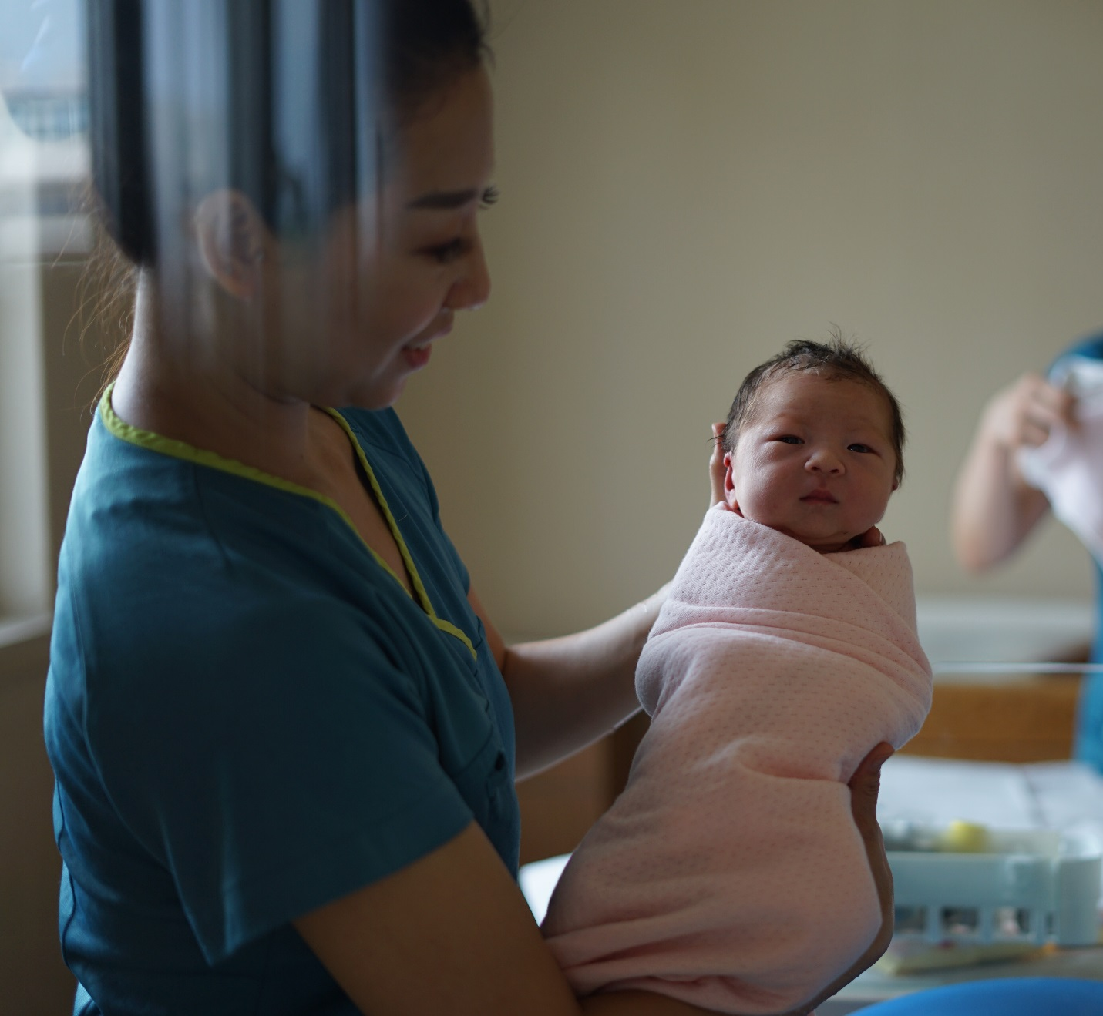
Data Point: 2017 Midwifery-led Births in Canada
Total Midwifery-led births in Canada | 42,248 (10.8%)
Midwifery-led births in British Columbia | 10,027 (22.4%)

Slide 38
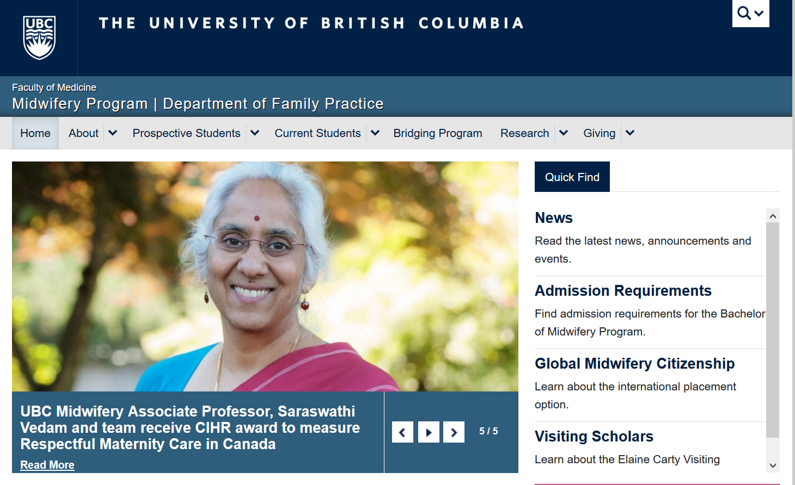
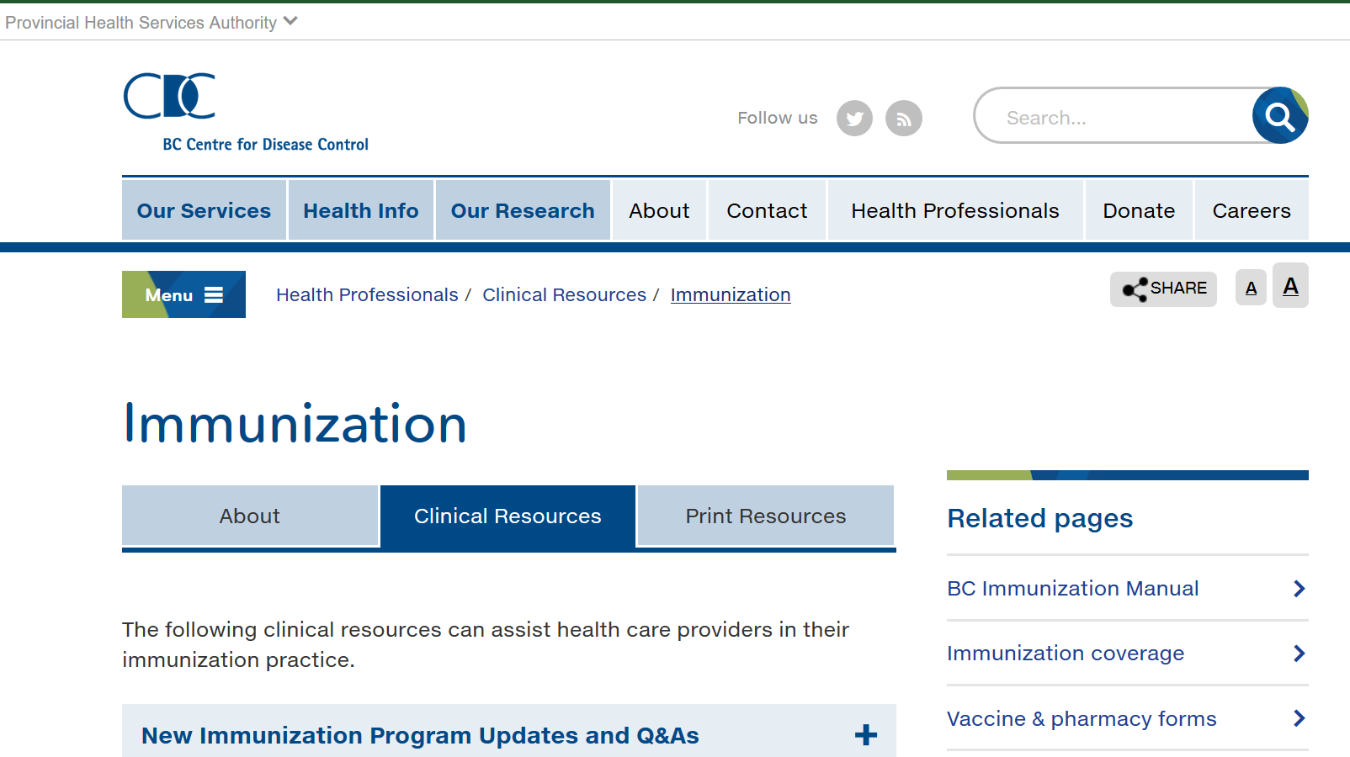
A Success Story:
University of British Columbia & B.C. Centre for Disease Control
Partnering for Midwifery Education

Slide 39

4: School-Based Immunization Programs

Slide 40
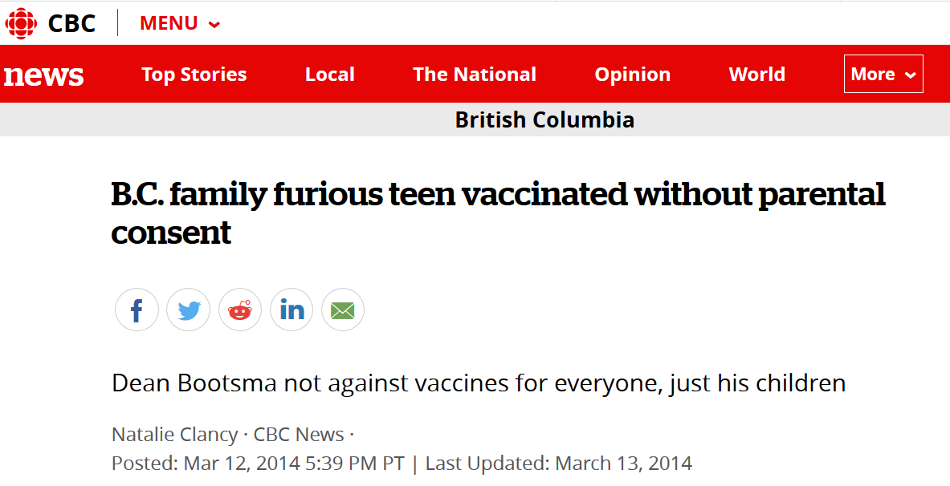
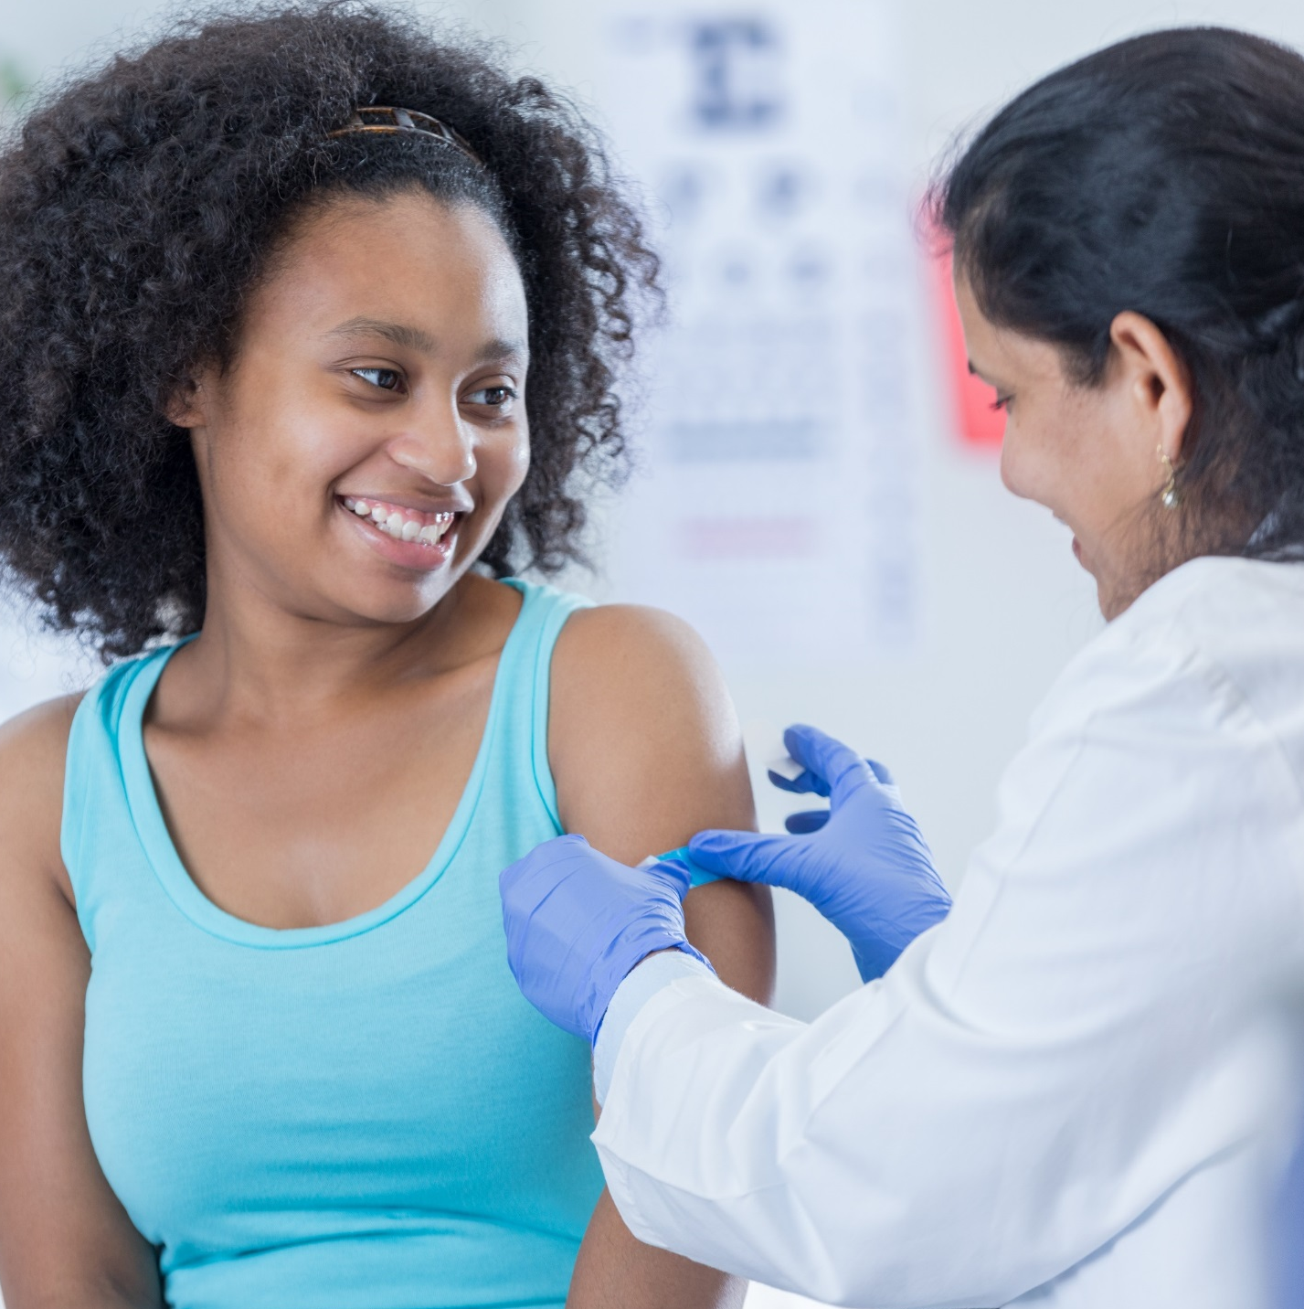

In-School Vaccination Considerations
Timing and consistency
Insurance
Consent laws
Local norms

Slide 41

5: Culturally-Specific Health Promotion Groups
Remember and acknowledge diversity

Slide 42


A Success Story:
Somali Community and Minnesota Public Health Organizations
Partnering for Community Awareness & Vaccination
“How a Muslim Community Overcame Disinformation Linking Vaccines to Autism”
- Andrew Buncombe for The Independent, May 6, 2018

Slide 43

6: Explore and Address Structural Barriers

Slide 44
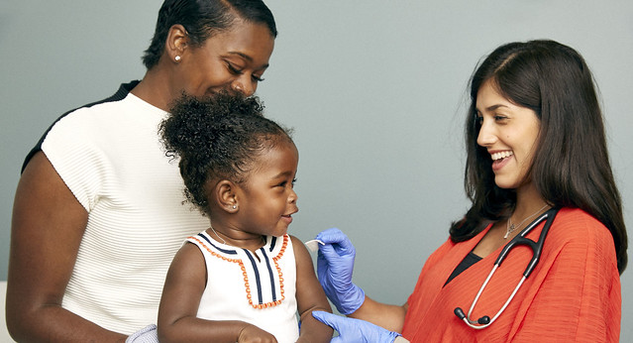
CONSIDER: Who in your community can you partner with to improve vaccination rates?

Slide 46





Special Thanks
Thank you:
Study participants
Dr. Julie Bettinger
Dr. Clara Rubincam
Dr. Eve Dube
British Columbia Immunization Committee
Canadian Immunization Research Network
Michael Smith Foundation for Health Research
Photo credits:
SELF Magazine x American Academy of Pediatrics
Vaccine Photo Project
RayMorris1
Charles (Chuck) Peterson
Bruce Irschick
Bill Hertha
faungg's photos
Green Fire Productions
andrea

