Slide 1
Efforts to Improve Immunization Coverage Rates in Nevada - Adults
Brian Sandoval
Governor
Richard Whitley
Director
Julie Kotchever, Ph.D.
Administrator
Ihsan Azzam, Ph.D., M.D.
Chief Medical Officer
Kristy Zigenis
Adult Immunization Coordinator

Slide 2
Vaccines Aren’t Just For Kids
Adults need vaccines to keep themselves and our communities healthy
Many adults are unaware or misinformed about the need for vaccines beyond childhood
A provider’s recommendation is one of the strongest predictors of whether the patient gets the vaccine.

Slide 3
The Standards for Adult Immunization Practice
All Providers who serve adults, at every clinical encounter
Assess
Which vaccine(s) your patient needs
Recommend
The vaccine(s) to the patient
Administer/Refer
The vaccine(s) or refer to an immunizing provider
Document
The administered vaccine(s) in NV WebIZ

Slide 4
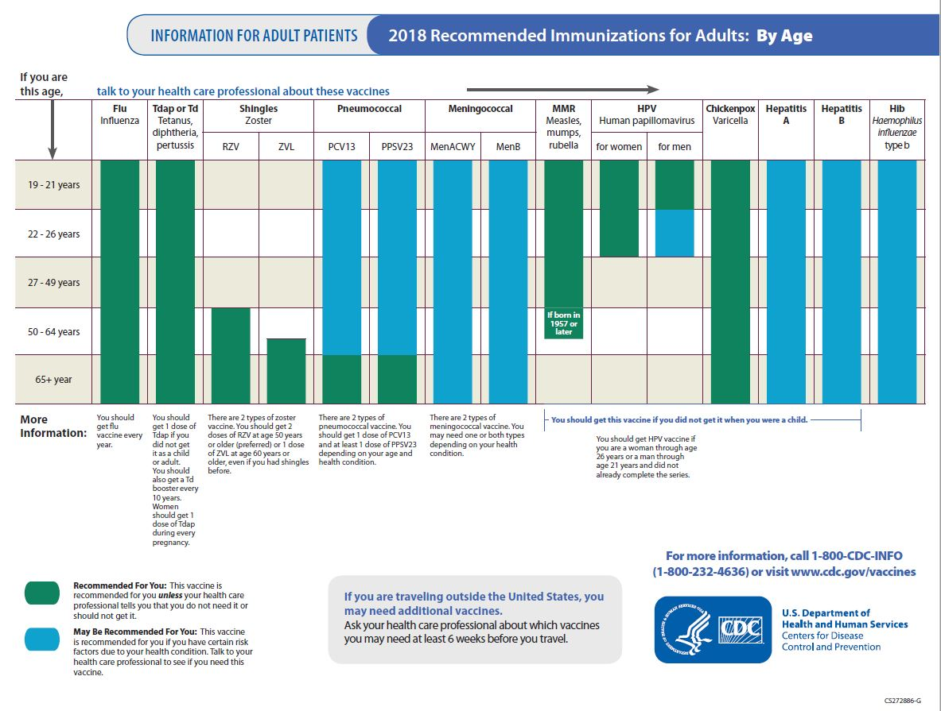

Slide 5
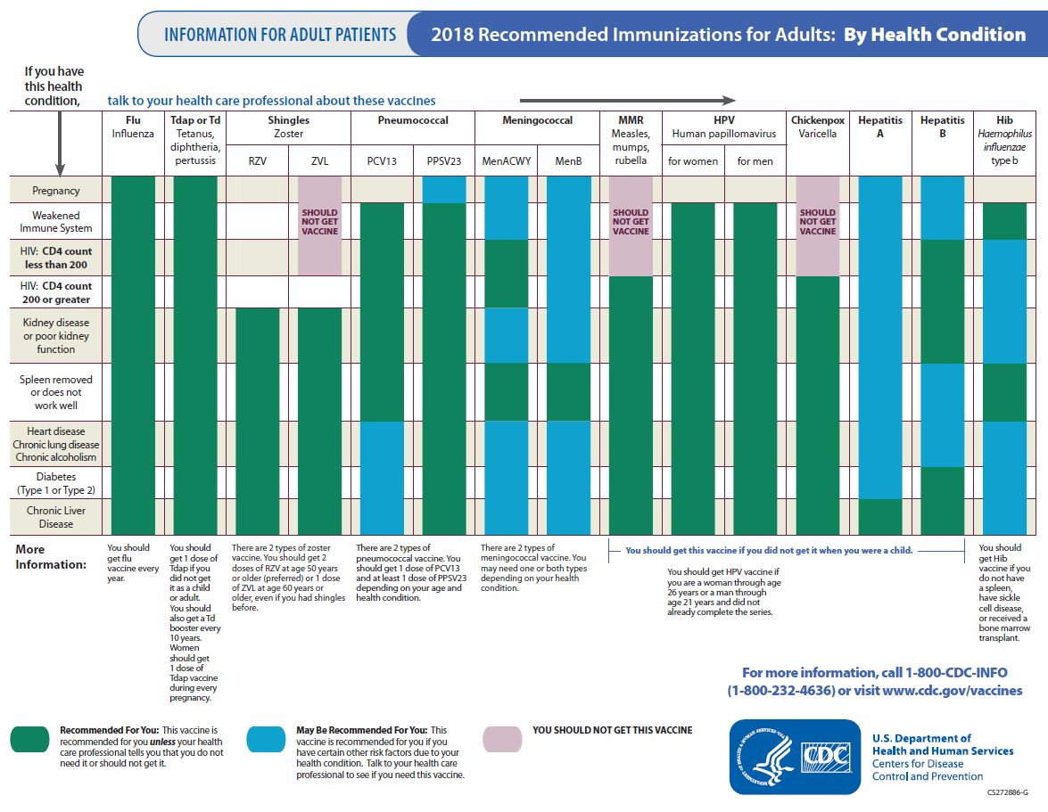

Slide 6

National Adult Immunization Landscape
Flu (2016-17) 43.3% of adults ≥18
Pneumococcal (2016) 72.4% of adults ≥65
Tdap (2016) 36.1% of adults 18-64
Zoster (2015) 30.6% of adult ≥60
(Rates were found on CDC fluvaxview, 2015 National Health Interview Survey and MMWR 2015)

Slide 7

Nevada Adult Immunization Landscape
Although Nevada’s uninsured rate has dropped over the past few years it has not translated into higher vaccination coverage rates.
Flu (2016-17) 33.4% of adults ≥18
Pneumococcal (2016) 65.9% of adults ≥65
Td/Tdap (2016) 50.9% of adults ≥18
Zoster (6/2017) 21.5% of adult ≥64
(Rates were run using Crystal Reports off the NV WebIZ replica database, CDC fluvaxview, 2015 National Health Interview Survey)

Slide 8
Barriers to Improving Vaccination Rates
Limited patient awareness of the need for vaccines as an adult
Financial burden on patient for out of pocket expenses (Co-pay/Deductible)
Limited incorporation of vaccination recommendation into routine patient care by adult providers
Limited/incorrect use of the State Immunization Information System (WebIZ)
Financial burden on the provider due to inadequate reimbursement rates
Confusion over Medicare Vaccine Coverage (Part B vs Part D)

Slide 9

Barriers to Improving Vaccination Rates
Mistaken assumptions about vaccines
Fear of side effects/ fear of needles
Lack of reliable transportation
Mistrust of medical institutions due to prior negative experiences navigating the healthcare system
Many adults see multiple specialty providers to manage chronic conditions and may ‘fall through the cracks’
Not all providers carry all ACIP recommended vaccines creating a potential missed opportunity by sending them elsewhere

Slide 10

Part B vs Part D
Vaccines covered by Part B
  Influenza
  Pneumococcal
  Hepatitis B (High Risk)
  Other vaccines based on risk and exposure (ex. Tetanus after a skin puncture wound)
Vaccines covered by Part D*
      Shingles
      Td/Tdap
      Varicella
      Most other recommended/prescribed vaccines
*Patient cost will vary depending on an individual’s Part D plan and where they go to receive the vaccine

Slide 11
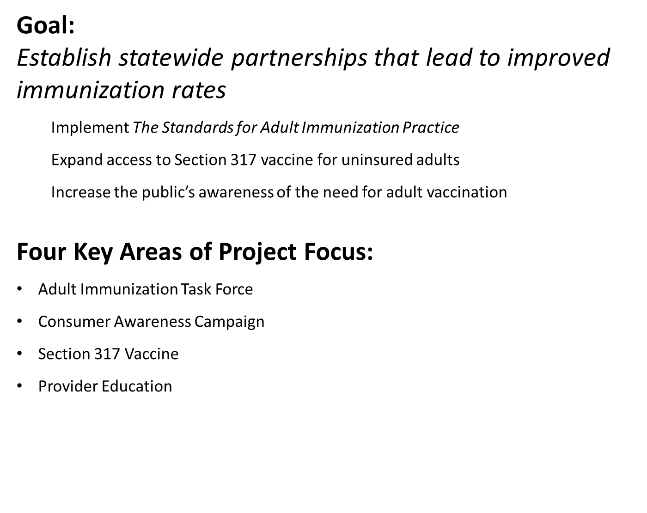

Nevada Adult Immunization Partnership and Improvement Grant

Slide 12
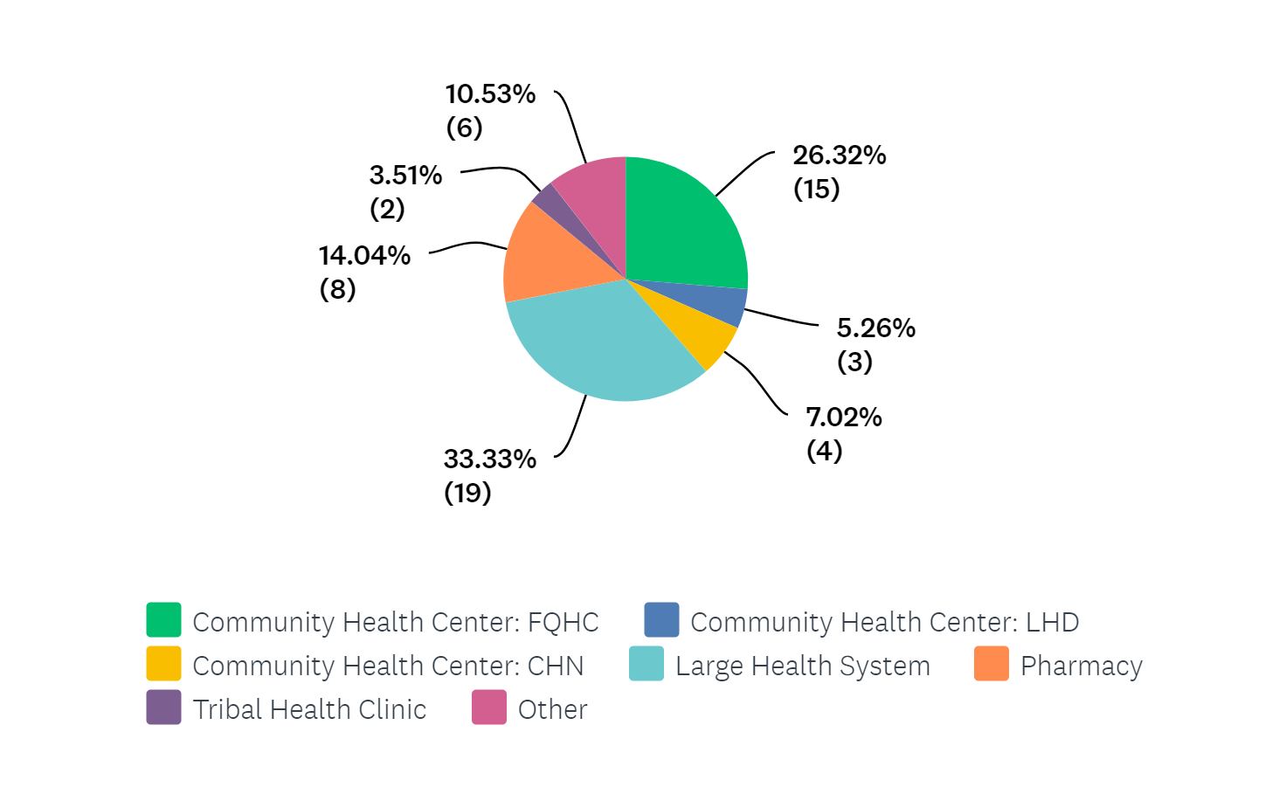
Provider Education
Site Visits
57 Participating Sites

Slide 13
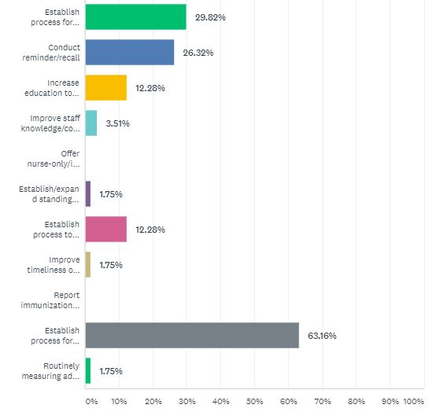
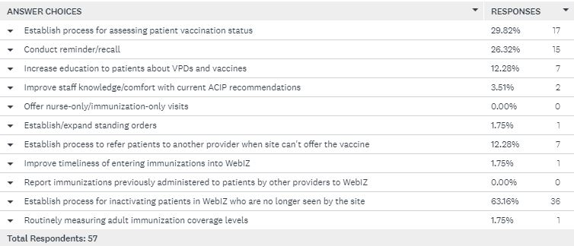
Quality Improvement Strategies

Slide 14

Provider Education
Site Visits
Roughly 60% of participating
sites saw an improvement to
their coverage rates
The average rate of improvement was 14% points

