Slide 1
Immunization for Cancer Survivors
Charmian Lykins, MPH, RN, OCN
Renown Institute for Cancer
Reno, NV

Slide 2
What we will talk about
Introduction to cancer survivorship (demographics, late and long term effects of treatment)
The use and timing of immunizations related to cancer treatment
Absolute and relative contraindications for vaccines in cancer survivors
Identifying patients with immunization gaps after cancer treatment
Where to find more information
Notes:
Full disclosure – the ongoing health of cancer survivors is an ENORMOUS topic!
We will only scratch the surface today.
I do hope you will leave here with a better understanding of their needs and where to find quality information and resources to help you as you care for these often vulnerable people,

Slide 3
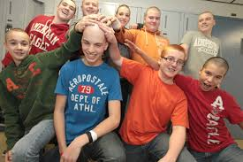
Defining “Cancer Survivor”
National Cancer Institute (1996)
From the time of diagnosis, through the balance of his or her life.
Family members, friends, and caregivers are also impacted by the survivorship experience and are therefore included in this definition.
Image source: The Breton Post
Notes:
Have you ever heard someone say they hate the term, survivor?
The word comes laden with understated meanings, for sure.

Slide 4
Defining “Cancer Survivor”
President’s Cancer Panel (2003) | National Coalition of Cancer Survivorship | Memorial Sloan Kettering | American Society of Clinical Oncologists
Anyone who has ever had a cancer diagnosis. Synonymous with “patient” | Living with, through, and beyond a cancer diagnosis | A particular period in a cancer patient's life, which is post treatment, separate from diagnosis and treatment and from end-of-life care. | Someone who has a history of cancer. “Co-survivor”: a person who has cared for a friend or loved one with cancer.
Bell, K.; Ristovski-Slijepcevic, S. (2013) Cancer survivorship: why labels matter. Journal of Clinical Oncology, 31:4, 409-411
Notes:
There are lots of ways to define survivor. For the purposes of this talk, we are going to limit our discussion to the Memorial Sloan Kettering framework which focuses on a particular period in a cancer patient’s life – after active treatment is complete and not including end of life care.

Slide 5
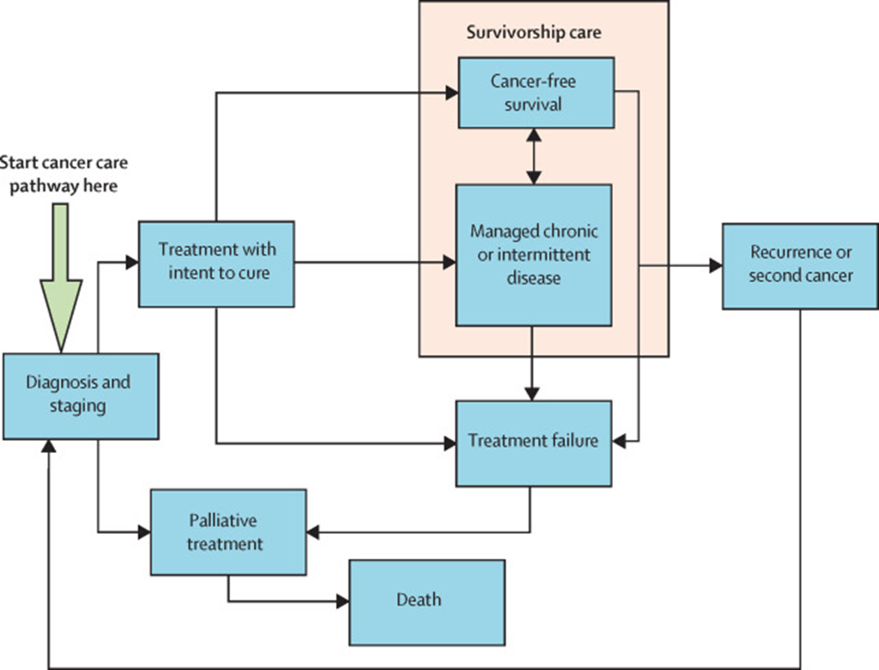
Defining “Cancer Survivor”
Source: Mayer, S.; Nasso, S.; Earp, J. Defining cancer survivors, their needs, and perspectives on survivorship health care in the USA. The Lancet Oncology, Vol 18, No 1 e11..e18, January 2017. DOI: http://dx.doi.org/10.1016/S1470-2045(16)30573-3 |
Notes:
This is a nice infographic of a very generalized cancer treatment trajectory.
Depending on the potential treatment options and the patient’s goals, the treatment might be intended to be curative or palliative.
After treatment, the cancer may be cured or may be managed like a chronic disease.
Let’s focus on patients who are in that pink box.

Slide 6
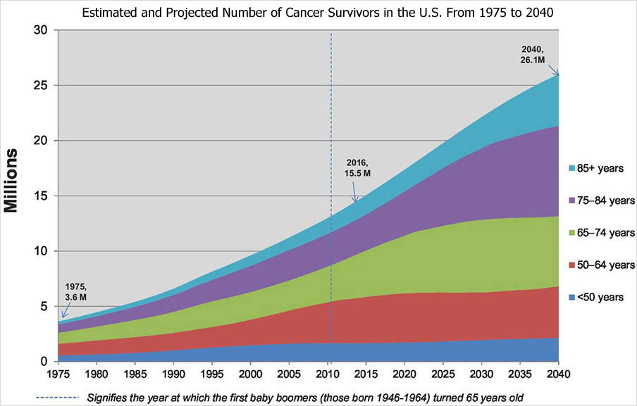
Demographics: A “Silver Tsunami”
WHY?
Aging population
Better screening
Better curative treatment
Better palliative treatment
More women survivors
Bluethmann, S. M., Mariotto, A. B., & Rowland, J. H. (2016). Anticipating the “Silver Tsunami”: Prevalence Trajectories and Co-Morbidity Burden Among Older Cancer Survivors in the United States. Cancer Epidemiology, Biomarkers & Prevention : A Publication of the American Association for Cancer Research, Cosponsored by the American Society of Preventive Oncology, 25(7), 1029–1036. http://doi.org/10.1158/1055-9965.EPI-16-0133 accessed at: https://www.ncbi.nlm.nih.gov/pmc/articles/PMC4933329/
Notes:
The American Association for Cancer Research projects number of cancer survivors will increase by 68% from 2016 - 2040
Demographics (aging population)
Better screening (catching earlier)
Better curative treatment(more success at eliminating disease)
Better palliative treatment (more success at managing late stage disease and treating toxicities)

Slide 7
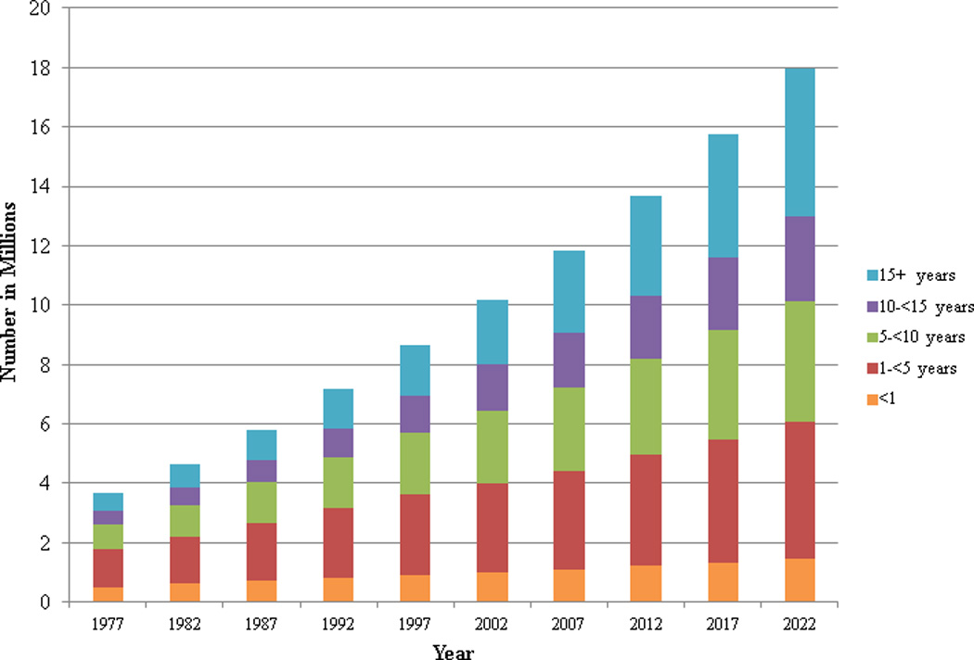
Demographics: “Survivors” are a heterogeneous group
Source: de Moor, J.; Mariotto, A.; Parry, C. et al. Cancer survivors in the United States: prevalence across the survivorship trajectory and implications for care. Cancer Epidemiol Biomarkers Prev. 2013 Apr; 22(4): 561–570.
Published online 2013 Mar 27. doi: 10.1158/1055-9965.EPI-12-1356
Notes:
You can see that there is not a huge projected change for people in their 1st year of survivorship. These people are usually still closely followed by their oncologists anyway.
But look at the growth in the other categories.
Patients who are over 5 years out usually seek most of their care in the community. That would be the green, purple and blue categories.

Slide 8
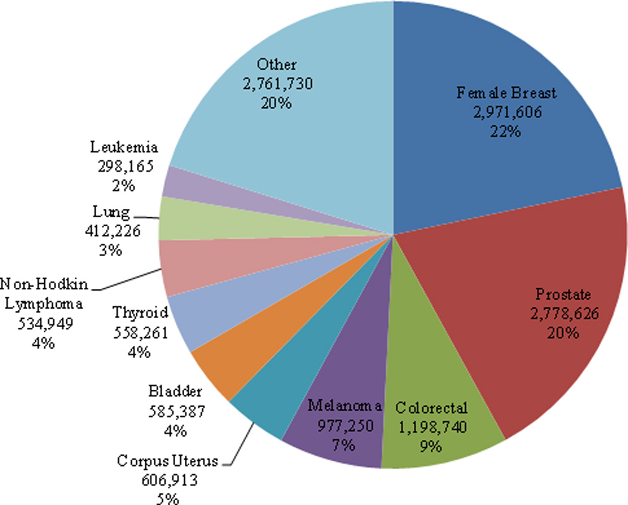
Demographics: “Survivors” are a heterogeneous group
Source: de Moor, J.; Mariotto, A.; Parry, C. et al. Cancer survivors in the United States: prevalence across the survivorship trajectory and implications for care. Cancer Epidemiol Biomarkers Prev. 2013 Apr; 22(4): 561–570.
Published online 2013 Mar 27. doi: 10.1158/1055-9965.EPI-12-1356
Notes:
Female breast, prostate, colorectal, and melanoma make up almost 2/3 of adult survivors.
The point is, when talking about cancer survivors, we are talking about a diverse group. Even within these categories, treatments and prognoses vary. One size does not fit all.

Slide 9
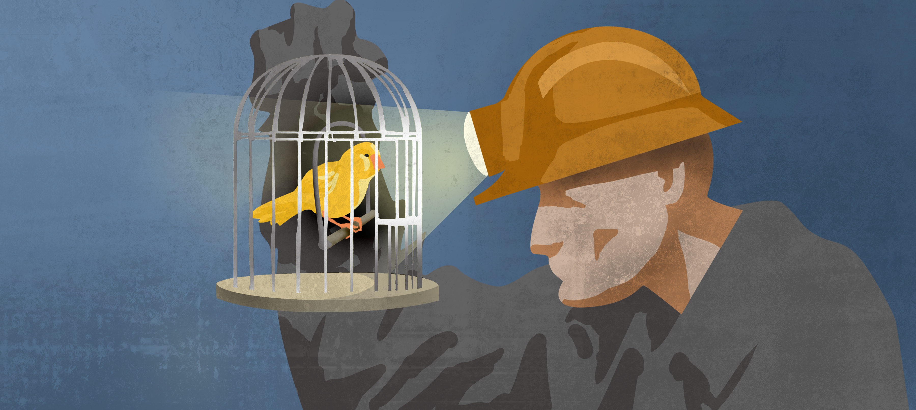
Demographics: Childhood cancer survivors
Cure rates are now approaching 80-90% for many subtypes
Data from earliest cohorts is now 25+ years
Childhood Cancer Survivor Study
Health outcomes compared to siblings
Implication: You will be seeing more patients with a remote history of childhood onset cancer
Survivors of pediatric vs adult onset cancers may have similar - but not identical – risks as they continue to live longer post treatment
Notes:
A unique subset of survivors are those adults who originally experienced cancer during childhood. These have been the canaries in the coal mine that have informed our understanding of the complexities of survivorship.
Common childhood cancers and adult onset cancers often arise from different tissues (epithelial vs mesenchymal) and are treated through different protocols
More comorbidities in adults
Pediatric growth and development issues

Slide 10
Care coordination: Ambiguous follow up recommendations
41 guidelines published between 2010 -2016.
85% of guidelines from professional organizations
Ambiguous recommendations present in 83% of guidelines
44% recommended against at least 1 test
Recommendations specified testing frequency but infrequently provided a definitive stop time.
Imaging recommendations varied among guidelines for each cancer.
Merkow RP, Korenstein D, Yeahia R, Bach PB, Baxi SS. (2017). Quality of cancer surveillance clinical practice guidelines: specificity and consistency of recommendations. JAMA Intern Med;177(5):701–709. doi:10.1001/jamainternmed.2017.0079
Notes:
It is not your imagination. Follow up recommendations are by no means harmonized. In this 2017 JAMA paper, Merkow et al looked at 41 guidelines published between 2010 and 2016.

Slide 11
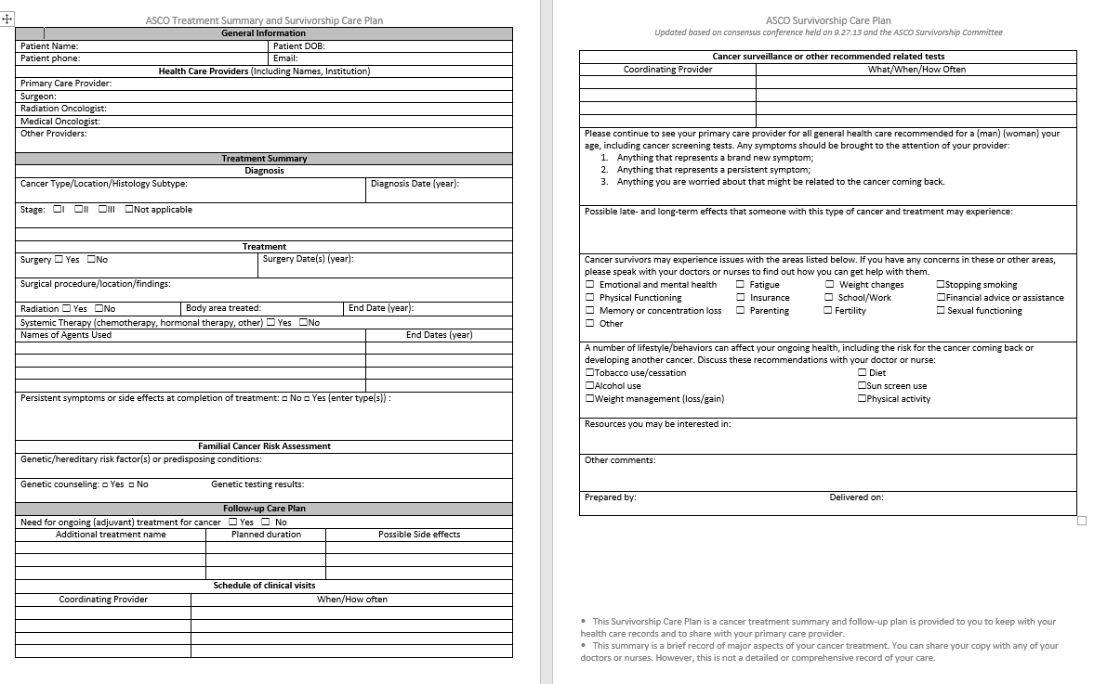
Care coordination: Sample Survivorship Care Plan
Notes:
In 2006, the Institute of Medicine published a landmark report entitled From Cancer Patient to Cancer Survivor, Lost in Transition.
One of the recommnedations was to put in place a standard communication process between specialty oncology and primary care.
This is what they came up with- a Survivorship Care Plan.
Who has seen one?
Ask your patients to share this with you. If they don’t have one, ask them to request one from their cancer care team.

Slide 12
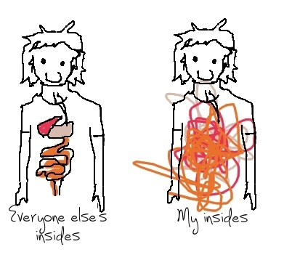
Late and long-term effects: Cancer treatment is finished - the effects may linger
Long term effects: Effects caused by cancer or its treatment that started during treatment and continue after treatment is complete.
Late effects: Effects that show up after cancer treatment is completed, sometimes separated from treatment by many years or decades.
What to expect? It all depends:
Stage upon diagnosis
Treatment modalities
Time since treatment
Underlying comorbidities

Slide 13
Late and long-term effects: Surgery
Functional limitations
Decreased ROM
Phantom pain, neuropathic pain
Vitamin deficiencies (GI)
Body image
Sexual dysfunction
Asplenia
Notes:
You are probably all pretty familiar with late effects of surgery.
For cancer survivors, body image and sexual dysfunction loom large because do you remember which two cancer sites are the most prevalent> Breast and prostate.

Slide 14
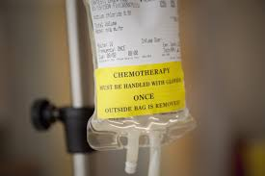
Late and long-term effects: Cancer cells “R” us
Traditional chemotherapy interrupts the process of creating daughter cells
Chemo doesn’t discriminate between healthy dividing tissue and cancerous tissue
Different drugs work at different points in the cell cycle
Image source:
-Hertz, E., et al (2015). Effect of Paullinia cupana on MCF‑7 breast cancer cell response to chemotherapeutic drugs. Molecular and Clinical Oncology, 3, 37-43
Notes:
A quick biology refresher
Cancer is unchecked cell proliferation

Slide 15
Late and long-term effects: Chemotherapy examples
Class | Generic Name(s) | Be aware of the possibility of:
Anthracycline antibiotic | Doxorubicin, epirubicin, idarubicin, mitoxantrone | Cardiomyopathy, secondary cancers
Heavy metals | Carboplatin, cisplatin | Peripheral neuropathy, hearing loss, infertility
Alkylating agents | Bleomycin, cyclophosphamide, ifosfamide | Lung toxicity, pulmonary fibrosis, Infertility, secondary cancers, urinary tract toxicity, neurotoxicity
Vinca alkaloids | vincristine | Peripheral neuropathy, foot drop, Raynaud’s
Antimetabolites | Methotrexate (HD) Cytarabine (HD) | Cognitive problems, hepatotoxicity
Epipodophyllotoxins | Etoposide, tenoposide | Secondary cancers
glucocorticoids | Dexamethasone, prednisone | Metabolic syndrome, cataracts, reduced bone density, osteonecrosis
Nitrogen Mustards | Busulfan | Pulmonary fibrosis, secondary cancers
A great resource: www.chemocare.org
Notes:
Here are some representative examples of late effects from different chemotherapies.
I don’t expect you to rememeber all these. But I would like to beseech you to find out what drugs your patients received and look up the potential late effects. For example, a patient who received a lot of Busulfan or Bleomycin may be a t great risk for respiratory compromise if they go scuba diving, do to the risk of pulmonary fibrosis. Maybe a a PFT should be ordered to assess respiratory function first.

Slide 16
Late and long-term effects: Cancer cells “R” us
Radiation kills dividing cells by causing damage to the DNA
Image source:
-- Baskar et al. (2014). Biological response of cancer cells to radiation treatment..Front Mol Biosci ://www.frontiersin.org/articles/10.3389/fmolb.2014.00024/full

Slide 17
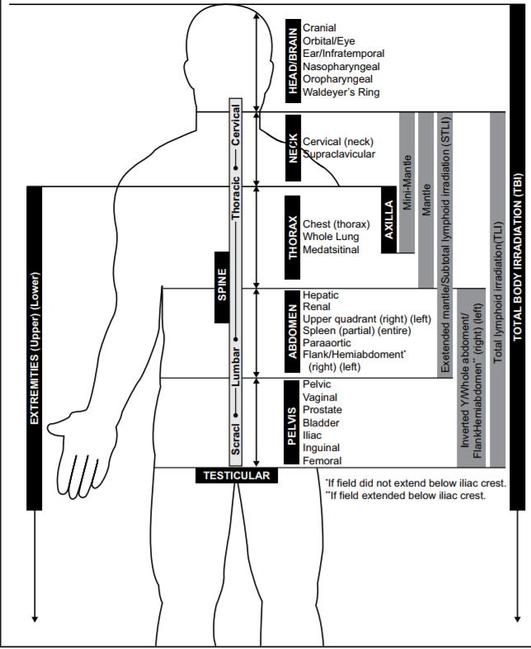
Late and long-term effects: Radiation
Secondary benign or malignant neoplasms
Skin cancer
Breast cancer
Skin fibrosis or altered pigmentation
Neurocognitive deficits
Alterations in pituitary-hypothalamic axis
Dental issues
Pulmonary fibrosis
Cardiac toxicity
Functional asplenia
Esophageal stricture
Diabetes
Hepatic fibrosis
Bowel obstruction, strictures
Renal insufficiency, bladder fibrosis
Infertility, vaginal stenosis
A great resource: www.ASTRO.org
Notes:
Depends on the field and the total and fractionated dose
Think of a patient with radiation to the neck. Risk is to the structures in that area- what is the thyroid function? Is the patient having trouble swallowing? Have they lost weight because of it?
In terms of immune status, think of the main hematopoiesis centers (bone marrow), the spleen, and the thymus in children.

Slide 18
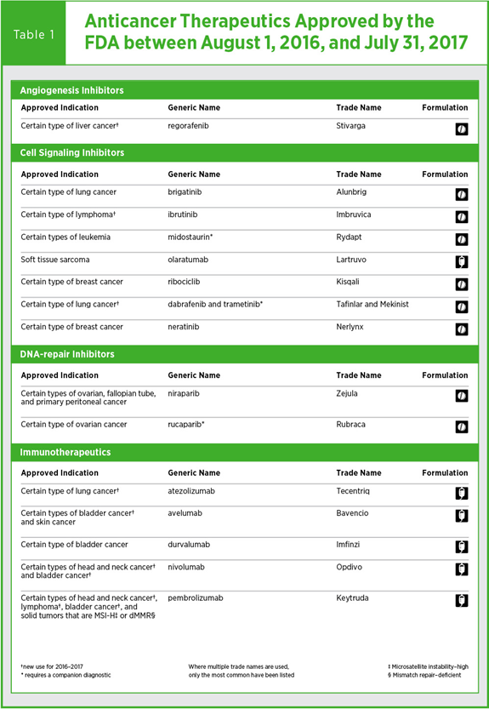
Late and long-term effects: Immunotherapy
History:
Coley’s Toxins- 1891
Provenge – 2007
Checkpoint inhibitors 2010
CAR-T gene therapy 2017
Semantics: “Cancer vaccines”
Preventative: only HPV
Treatment: Harness the immune system’s power to destroy “non-self” cells
Most are still not first-line treatments
http://www.marketwatch.com/story/cancer-vaccines-long-considered-failures-are-hot-again-2017-09-15
https://www.wsj.com/articles/scientists-see-progress-for-cancer-vaccines-1505268060
Notes:
Immunotherapy seems like the new kid on the block, but researchers have been trying to hack the immune system’s power to eliminate cancer cells for over 100 years.
Coley’s Toxins were killed bacteria injected into patients based on observations by Dr. Coley that a patient’s tumor regressed after a serious skin infection. It was dangerous and not a well controlled process and fell into obscurity.
Provenge was a prostate cancer vaccine that hasn’t lived up to its promise.
Checkpoint inhibitors on the other hand are being approved for new indications as we speak.
Car-T cell therapy is true designer medicine, and a very exciting frontier.
Checkpoint inhibitors: T cells on patrol assess proteins on the surfaces of cells to determine if they belong or are an enemy. If they determine it is a danger, they attack. Cancer cells can commit identity theft by wearing these proteins of normal cells, which allows them to evade the attack. Checkpoint inhibitors block these proteins so that T-cells can identify the cancerous cells. They inhibit the inhibitors.
CAR-T therapy- Chimeric antigen receptor T-cell therapy: T cells from the patient are removed and genetically engineered to attack the patient’s cancer cells. FDA approved for some advanced leukemias and now lymphomas.

Slide 19
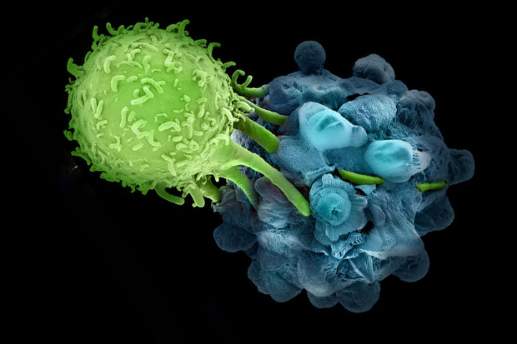
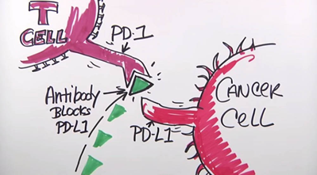
Late and long-term effects: Toxicities of Immunotherapy
Unlike traditional chemo, side effects related to increased immune response
Colitis/diarrhea
Dermatitis
Endocrinopathies
Hepatitis
Pneumonitis
Rarely:
Ocular or orbital inflammation, retinal and choroidal disease
Joint inflammation
Long term and late effects – under study
Gordon, R.; Kasler, M.; Stasi, K. et al. (2017). Checkpoint inhibitors: common immune-related adverse events and their management. CJON; supp Vol 21, No 2. pp45-52. doi 10.1188/17.CJON.S2.45-52
Notes:
These haven’t been in use for long enough to have a good handle on late effects. But as an FYI, if you are caring for a patient currently receiving immunotherapy, remember they ramp up immune response.
So while you would want to rule out infections, you should also consider hyperimmunity.
Communicate with the oncologist about these patients!

Slide 20
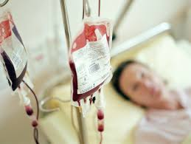
Late and long-term effects: R/t supportive care during cancer treatment
Multiple red blood cell transfusions iron overload
Can be seen after as few as 8 units of PRBC
Marker: serum ferritin
Heart, liver, spleen, pancreas and endocrine systems most affected
Phlebotomy, chelation
Multiple treatments with broad spectrum antibiotics
Change in normal gut and dental flora
Mucositis caused by cytotoxic therapy contributing factor?
Related to subsequent GI dysfunction/obesity?
↑ susceptibility to MDRO
-Mir, M. (2016). Transfusion induced iron overload treatment and management. Accessed at: emedicine.medscape.com
Vozza, I., et al (2015). Changes in microflora in dental plaque from cancer patients undergoing chemotherapy and the relationship of these changes with mucositis: A pilot study. Medicina Oral, Patología Oral Y Cirugía Bucal, 20(3), e259–e266. http://doi.org/10.4317/medoral.19934
-Zwielehner, J. et al (2011). Changes in Human Fecal Microbiota Due to Chemotherapy Analyzed by TaqMan-PCR, 454 Sequencing and PCR-DGGE Fingerprinting. PLoS ONE, 6(12), e28654. http://doi.org/10.1371/journal.pone.0028654
Notes:
Bone marrow function is impaired by cytotoxic therapy. Red cells, white cells and platelets are affected. Some patients are bone marrow suppressed for an extended time, especially patients with hematological cancers and are at risk for the following .
People at risk for MDRO infections are:
Are older
Have weakened immune systems
Have chronic illnesses
Have been treated with antibiotics in the past
Had a recent surgery
Have had repeated or prolonged hospitalizations
Have open wounds or sores
Have tubes or drains in the body

Slide 21
Vaccine considerations: Cancer and immunity- It’s complicated
Cancer
Inflammation: increase cancer risk
Immunity: impaired by treatment
Immunity: harnessed to kill cancer cells
Immunosuppression: increase cancer risk

Slide 22
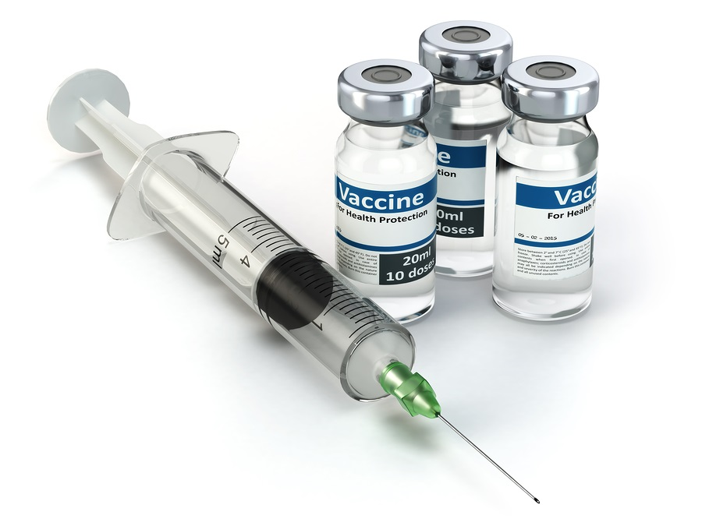
Vaccine considerations: General guidelines for vaccination for cancer survivors
Communicate with Oncologist!
Critical thinking:
What is the immune status of patient?
What kind of treatment? Surgery, chemotherapy, radiation, immunotherapy?
Where in the treatment regimen is the patient?
Complete or ongoing?
Immune response decreases most during induction and consolidation
Immune function may recover within 3 months- this is variable
Recipient of blood products/antivirals?
For hematologic malignancies, re-immunization may not be necessary: check serum antibody titer to Tetanus, diphtheria, measles, mumps, rubella, Hep B, polio
Primary responses are more affected by immune suppression than booster responses
Rubin, L.; Levin, M.; Ljungman, P. et al. (2014). 2013 IDSA clinical practice guideline for vaccination of the immunocompromised host. Clin Infect Dis; 58:309-318.
CDC Pink Book: https://www.cdc.gov/vaccines/pubs/pinkbook/genrec.html
Shah, M.; Kamboj, M. (2018). Immunizing Cancer Patients: Which Patients? Which Vaccines? When to Give? Oncology Journal 32 (5)

Slide 23
NCCN Guidelines 1.2018 General Principles of Immunizations
For all cancer and transplant survivors, consider and encourage:
Inactivated vaccines (influenza)
Vaccines made of purified antigens (pneumococcal)
Vaccines made of bacterial components (diphtheria-tetanus-pertussis)
Genetically engineered recombinant antigens (Hep B)
“In absence of known harm, administration of inactivated vaccines with the hope of achieving some protection may be worthwhile. The usual doses and scheduled are recommended.”

Slide 24
NCCN Guidelines 1.2018 General Principles of Immunizations
Ideal situation:
all indicated vaccines 2 or more weeks prior to starting treatment (live vaccines 4 or more weeks prior)
Real world:
Need recovery of neutrophils and lymphocytes for proper response
Baseline WBC must be adequate
Ongoing infection should not be present
Off immune suppressants (>0.5mg/kg of prednisone or equivalent, or combo of 2 immunosuppressants given concurrently)

Slide 25
NCCN Guidelines 1.2018 General Principles of Immunizations
Inactivated or recombinant vaccines:
2 or more weeks before treatment starts OR
3 or more months after cancer chemotherapy
Inactivated influenza vaccine can be administered during treatment
Live viral vaccines – consult with oncologist or infectious disease specialist recommended
4 or more weeks before treatment starts OR
3 or more months after cancer chemotherapy
24 months or more after SCT if no GVHD and off of immune suppressants
NOTE: Survivors who received anti-B cell antibody therapy (ex: Rituxan) require a delay of at least 6 months after the last dose of such therapy

Slide 26
Shah, M.; Kamboj, M. (2018). Immunizing Cancer Patients: Which Patients? Which Vaccines? When to Give? Oncology Journal 32 (5)

Slide 27
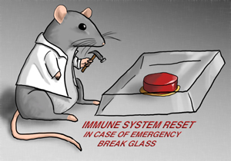
More complicated: Vaccines in Hematopoietic Cell Transplant Survivors
Communicate with transplant team/oncologist FIRST!
Influenza vaccine annually starting 6 months after HCT (4 months if outbreak)
PCV13: 3 doses, 1 month apart, administered 3-6 months after HCT
PPSV23: 1 dose 12 months after HCT if NO cGVHD
Hib: 3 doses 6-12 months after SCT
MCV4: consider in outbreak situations/endemic areas
Td/Tdap: 3 doses 6 months after HCT
HepB: 3 doses 6 months after HCT
IPV: 3 doses 6-12 months after HCT
HPV: survivors through age 26 – 3 doses 6-12 months after HCT
Live viral vaccines are CONTRAINDICATED if active GVHD or ongoing immunosuppression.
MMR and VAR: Check titers
2 dose series at least 24 months after HCT and 8-11 months after last IVIg

Slide 28
What about travel vaccines?
Vaccine | Recommendations for use | Notes for patients status post stem cell transplant
Hepatitis A | Follow recommendations for general population in each country. | Ig should be administered to Hep A susceptible SCT recipients who anticipate Hep A exposure
Varicella | Limited data on safety or efficacy | Avoid < 24 months post SCT, active GVHD or on immunosuppression
Yellow Fever | Limited data on safety or efficacy Examine risk-benefit balance | Avoid < 24 months post SCT, active GVHD or on immunosuppression
Rabies | Appropriate for potential occupational exposure | Pre-exposure should probably be delayed until 12-24 months post SCT Post exposure with human rabies Ig can be delivered after SCT
Tick Borne Encephalitis | According to local policy in endemic areas | No data exist regarding when vaccination can be expected to induce an immune response
Japanese B encephalitis | According to local policy in endemic areas | No data exist regarding when vaccination can be expected to induce an immune response
Typhoid bacterial capsular polysaccaride | Recommended if risk factor is present | No data
OPV | Not recommended- an effective inactivated alternative exists | Contraindicated for SCT recipient
BCG, LAIV | Not recommended | Contraindicated for SCT recipient
Cholera, Rotavirus, Zoster | No data available | No data regarding safety, immunogenicity, or efficacy among SCT recipients
Source: Ljungman, P.; Cordonnier, C.; Einsele, H.; Englund, J.; Machado, C.; Storek, J. Small, T. (2009). Vaccination of hematopoietic cell transplant recipients. Bone Marrow Transplantation: 44, 521-526. doi:10:1038/bmt.2009.263

Slide 29
Vaccine considerations: Testing for immunity after treatment?
Vaccine preventable disease | Absence of protective antibody titer after treatment | Recovery of protective Ab titers after booster in patients who lost humoral immunity
HepB | 46% | 91%
Measles | 25% | 80%
Mumps | 26% | 100%
Rubella | 24% | 100%
Tetanus | 14% | 100%
Polio | 7% | 100%
Immune titer losses linked to
Profound lymphopenia and longer B cell recovery time (esp. treatment for ALL)
Decreases in intramedullary plasma cell counts
Younger patients appear to have more persistent alterations
Zignol M, Peracchi M,Tridello G, et al. (2004). Assessment of humoral immunity to poliomyelitis, tetanus, hepatitis B, measles, rubella, and mumps in children after chemotherapy. Cancer;101:635– 641.
Notes:
Serum antibody levels after chemotherapy were examined in 192 children
70.3% - hematologic malignancies

Slide 30
Late and long-term effects: American Society of Clinical Oncology (ASCO) Guidelines
Chemotherapy-Induced Peripheral Neuropathy
Fatigue
Anxiety and Depressive Symptoms
Fertility Preservation in Patients with Cancer
Colorectal Cancer
Prostate Cancer
Breast Cancer
Survivorship Care Plan templates
A great resource: www.cancer.net
Notes:
Screening, Assessment, and Management of:
Follow-Up Care, Surveillance Protocol, and Secondary Prevention Measures for Survivors of:

Slide 31
Late and long-term effects: National Comprehensive Cancer Network (NCCN) Guidelines
Disease specific / general survivorship guidelines for adult onset cancers
Guidelines for prevention of and surveillance for new or recurrent cancers
Assessment for late and long term effects and intervention guidelines
ALL
AML
Anal Carcinoma
Bladder Cancer
Bone Cancer
Breast Cancer
CNS Cancers
Cervical Cancer
CLL
CML
Colon/Rectal cancer
Esophageal Cancer
Gastric Cancer
Hairy Cell Leukemia
Head and Neck Cancer
Hepatobiliary Cancer
Hodgkin Lymphoma/non-Hodgkin Lymphomas
Kidney Cancer
Malignant Pleural Mesothelioma
Melanoma
Multiple Myeloma/Other Plasma Cell Neoplasms
MDS
Myeloproliferative Neoplasms
Neuroendocrine Tumors
Non-Melanoma Skin Cancers
Non Small Cell/Small Cell Lung Cancer
Occult Primary Cancer
Ovarian Cancer
Pancreatic Adenocarcinoma
Penile Cancer
Prostate Cancer
Soft Tissue Sarcoma
Testicular Cancer
Thymomas and Thymic Cancers
Thyroid Carcinoma
Uterine Neoplasms
Vulvar Cancer
A great resource: www.nccn.org
Notes:
NCCN is a coalition of 27 leading US Cancer Centers. They have put together a set of evidence based guidelines that are available on their website for free- you have to register.

Slide 32
Late and long-term effects: Childhood cancer survivors
Children’s Oncology Group: Long Term Follow up Guidelines for Survivors of Childhood, Adolescent, and Young Adult Cancers
Guidelines with associated literature support
Summary of cancer treatment templates
Health Links (patient education)
A great resource: www.survivorshipguidelines.org

Slide 33
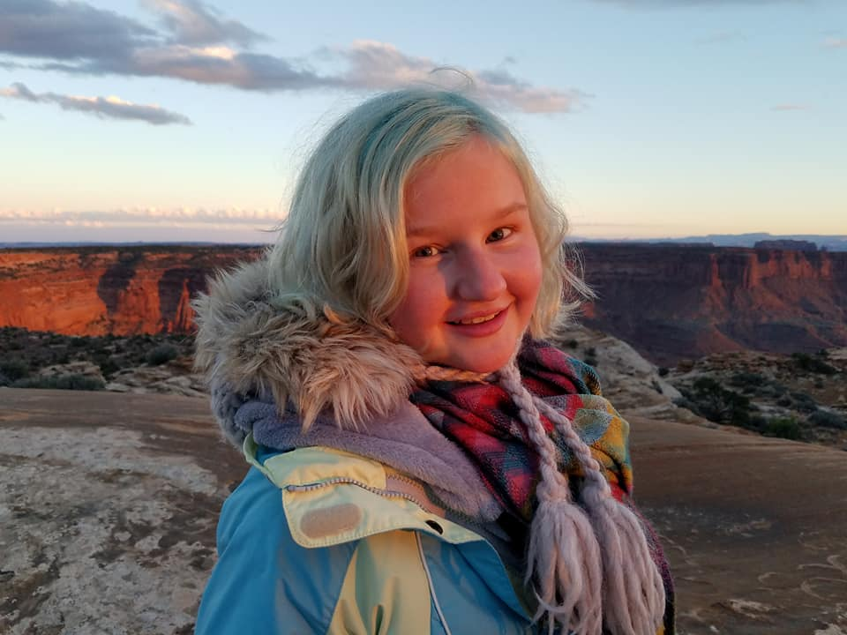
Questions? Charmian Lykins (775)982-2833 clykins@renown.org

